Slide 1
Introduction to HTTP and Web Interactions

Slide 2
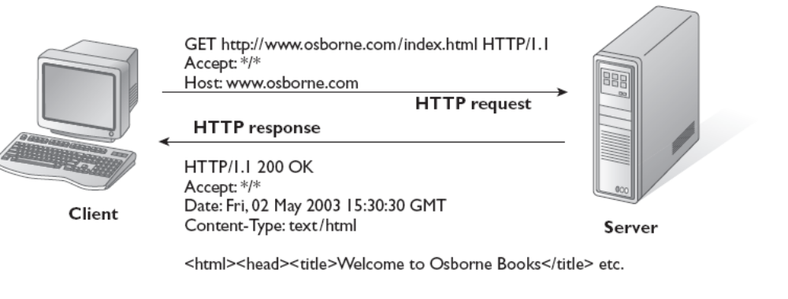
Request-Response Interchange
Java Servlets and JSP |

Slide 3
Java and Web Interactions
Socket API
Client-side code:
Socket socket = new Socket (www.yahoo.com, 80);
InputStream istream = socket.getInputStream ( );
OutputStream ostream = socket.getOutputStream ( );
Once the socket connection is made successfully:
GET /mypath.html HTTP/1.0
Java Servlets and JSP |

Slide 4
HTTP Request-Response Example
Web Browser
Web Server
Request
GET /files/new/image1 HTTP/1.1
Accept: image/gif
Accept: image/jpeg
Response
HTTP /1.1 200 OK
Date: Tue, 19-12-00 15:58:10 GMT
Server: MyServer
Content-length: 3010
… (Actual data for the image)
Java Servlets and JSP |

Slide 5
Important HTTP Request Commands
HTTP command | Description
GET | Request to obtain a Web page
HEAD | Request to obtain just the header of a Web page
POST | Request to accept data that will be written to the client’s output stream
DELETE | Remove a Web page
Java Servlets and JSP |

Slide 6
Introduction to Servlets

Slide 7
Servlets Basics
A servlet is a server-side program
Executes inside a Web server, such as Tomcat
Receives HTTP requests from users and provides HTTP responses
Written in Java, with a few additional APIs specific to this kind of processing
Java Servlets and JSP |

Slide 8
JSP-Servlet Relationship
JSP is an interface on top of Servlets
A JSP program is compiled into a Java servlet before execution
Why JSP?
  Easier to write than servlets
  Designers can write HTML, programmers can write Java portions
Servlets came first, followed by JSP
See next slide
Java Servlets and JSP |

Slide 9
JSP-Servlet Concept
JSP
Servlet
Container
Browser
Web server
Compile
HTTP request (GET)
Servlet
Interpret and Execute
HTML
HTTP response (HTML)
Java Servlets and JSP |

Slide 10
Servlet Overview
Servlets
  Introduced in 1997
  Java classes
  Extend the Web server functionality
  Dynamically generate Web pages
Servlet container (e.g. Tomcat)
  Manages servlet loading/unloading
  Works with the Web server (e.g. Apache) to direct requests to servlets and responses back to clients
Java Servlets and JSP |

Slide 11
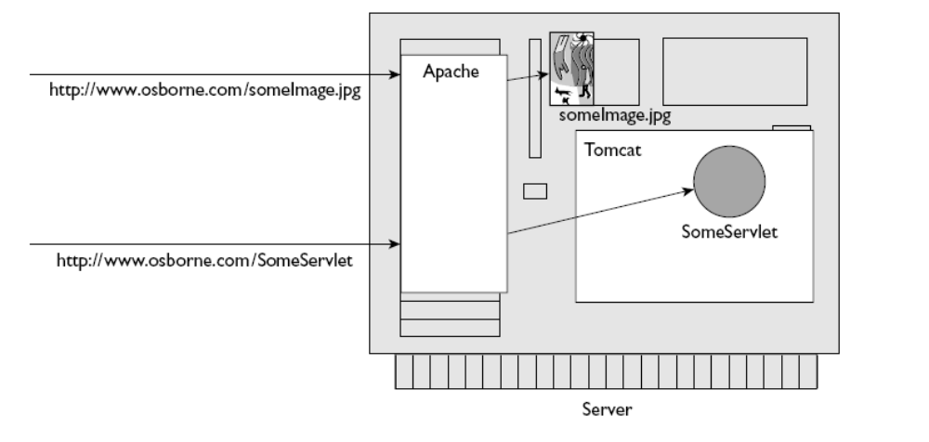
Web Server and Servlet Container – Difference
Java Servlets and JSP |

Slide 12
Need for Container
Communications support
  Handles communications (i.e. protocols) between the Web server and our application
Lifecycle management
  Manages life and death of servlets
Multithreading support
  Creates and destroys threads for user requests and their completion
Declarative security
  XML deployment descriptors are used, no code inside servlets for this
JSP support
  Translate JSP code into servlets
Java Servlets and JSP |

Slide 13
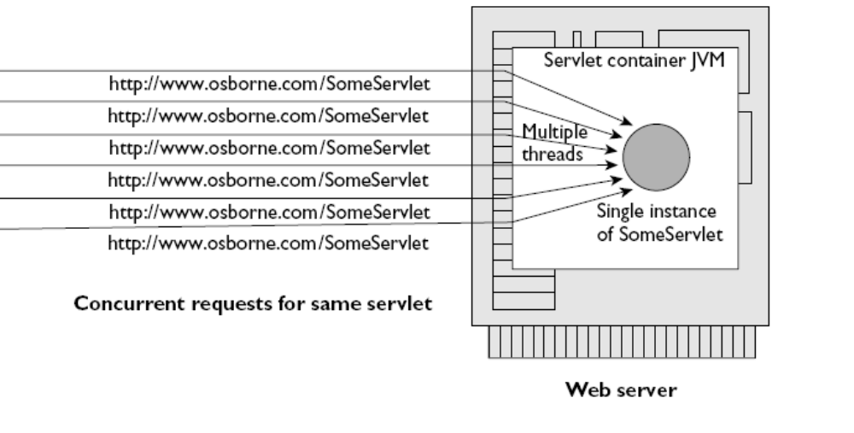
Servlet Multi-threading
Java Servlets and JSP |

Slide 14
Servlet Advantages
Performance
  Get loaded upon first request and remain in memory indefinitely
  Multithreading (unlike CGI)
    Each request runs in its own separate thread
Simplicity
  Run inside controlled server environment
  No specific client software is needed: Web browser is enough
Session management
  Overcome HTTP’s stateless nature
Java technology
  Network access, Database connectivity, J2EE integration
Java Servlets and JSP |

Slide 15
Development and Execution Environment

Slide 16
How to Create and Run Servlets
Download and install Java SE 6 (including JRE)
  Set PATH=c:\j2sdk1.4.2_04\bin
Download Tomcat
  Download Tomcat from http://jakarta.apche.org/tomcat/, Create it as c:\tomcat
Configure the server
  Set JAVA_HOME=c:\j2sdk1.4.2_04
  Set CATALINA_HOME=c:\tomcat
  Set CLASSPATH=C:\tomcat\common\lib\servlet-api.jar
Test set up
  Start tomcat
  Open browser and type http://localhost:8080
Java Servlets and JSP |

Slide 17
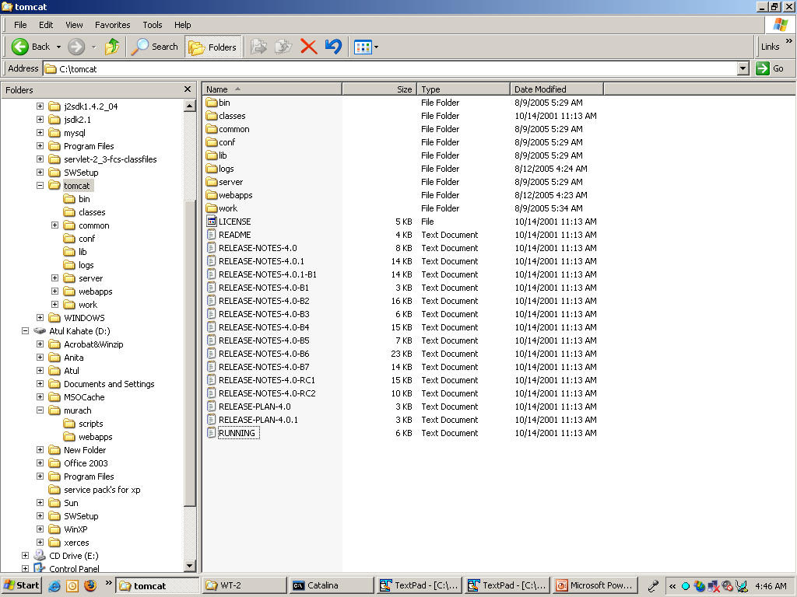
Tomcat Directory/File Structure
Java Servlets and JSP |

Slide 18
Tomcat Directories/Files Description
Directory | Description
bin | The binary executables and scripts
classes | Unpacked classes that are available to all Web applications
common | Classes available to internal and Web applications
conf | Configuration files
lib | JAR files that contain classes that are available to all Web applications
logs | Log files
server | Internal classes
webapps | Web applications
work | Temporary files and directories for Tomcat
Java Servlets and JSP |

Slide 19
Using Tomcat
Starting Tomcat
  Open DOS prompt
  Execute startup.bat from c:\tomcat\bin
Viewing a Web page
  Open browser
  Type a URL name in the address text box (e.g. http://localhost:8080/examples/servlets/index.html)
Changing port number used by Tomcat
  Default is 8080
  Edit server.xml file in the conf directory and change this to whatever port you want (should be 80 or > 1024)
Java Servlets and JSP |

Slide 20
How to Deploy a Web Application
Our application should be under the c:\tomcat\webapps directory
All applications that use servlets must have the WEB-INF and WEB-INF\classes directories
We can create a root directory for our application under the c:\tomcat\webapps directory (e.g. c:\tomcat\webapps\musicstore)
  All directories and files pertaining to our applications should be under this diretcory
Important directories: See next slide
Java Servlets and JSP |

Slide 21
Tomcat: Important Directories
Directory | Description
doument root | Contains sub-directories, the index file, and HTML/JSP files for the application.
\WEB-INF | Contains a file named web.xml. It can be used to configure servlets and other components that make up the application.
\WEB-INF\classes | Contains servlets and other Java classes that are not compressed into a JAR file. If Java packages are used, each package must be stored in a subdirectory that has the same name as the package.
\WEB-INF\lib | Contains any JAR files that contain Java classes that are needed by this application, but not by other Web applications.
Java Servlets and JSP |

Slide 22
Deploying Servlets and JSPs
Servlet Deployment
  Compile the servlet into a .class file
  Put the .class file into the classes folder of the above directory structure
JSP Deployment
  No need to compile
  Just put the JSP file into the document root directory of the above directory structure
  Tomcat automatically picks up and compiles it
    If explicit compilation is needed, look for the JSP compiler named jspc in the bin folder
Java Servlets and JSP |

Slide 23
Servlet Lifecycle and Execution

Slide 24
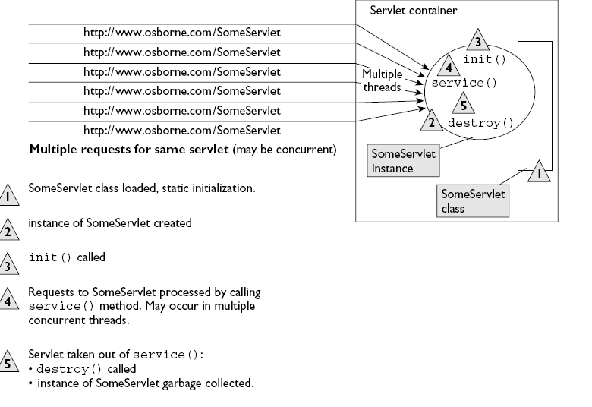
Java Servlets and JSP |

Slide 25
GenericServlet and HttpServlet
These are the two main abstract classes for servlet programming
HttpServlet is inherited from GenericServlet
When we develop servlets, we need to extend one of these two classes
See next slide
Important: A servlet does not have a main () method
All servlets implement the javax.servlet.http.HttpServlet interface
Java Servlets and JSP |

Slide 26
<<interface>>
javax.servlet.Servlet
service (…)
init (…)
destroy (…)
…
<<abstract class>>
javax.servlet.GenericServlet
service (…)
init (…)
destroy (…)
…
<<abstract class>>
javax.servlet. http.HttpServlet
service (…)
init (…)
destroy (…)
doGet (…)
doPost (…)
…
Java Servlets and JSP |

Slide 27
Servlet Lifecycle
Managed by servlet container
  Loads a servlet when it is first requested
  Calls the servlet’s init () method
  Handles any number of client requests by calling the servlet’s service () method
  When shutting down, calls the destroy () method of every active servlet
Java Servlets and JSP |

Slide 28
service () Method
Receives two parameters created by the servlet container
  ServletRequest
    Contains information about the client and the request sent by the client
  ServletResponse
    Provides means for the servlet to communicate back with the client
Rarely used (i.e. we should not override the service method): “HTTP versions” are used instead
  doGet: Handles HTTP GET requests
  doPost: Handles HTTP POST requests
Option 1
  Servlet container calls service () method
  This method calls doGet () or doPost (), as appropriate
Option 2
  The programmers can directly code doGet () or doPost ()
In simple terms, override doGet or doPost: See next slides
Java Servlets and JSP |

Slide 29
Servlet Execution Overview – 1
Web server receives the request and hands it over to the container
HTTP
request
Web server
Browser
User clicks on a link that sends an HTTP request to the Web server to invoke a servlet
Container
Container creates HTTPServletRequest and HTTPServletResponse objects and invokes the servlet, passing these objects to the servlet
Servlet
Thread
Servlet thread is created to serve this request
Java Servlets and JSP |

Slide 30
Servlet Execution Overview – 2
Container
Container calls (a) The servlet’s service method, if supplied, else (b) The doGet or doPost method
Thread
Servlet
The doGet or doPost method generates the response, and embeds it inside the response object – Remember the container still has a reference to it!
doGet ( )
{
…
}
HTTP
response
Java Servlets and JSP |

Slide 31
Servlet Execution Overview – 3
Container forwards the HTTP response to the Web server
HTTP
response
Web server
Browser
HTTP
response
Web server forwards the HTTP response to the browser, which interprets and displays HTML
Container
Servlet thread and the request and response objects are destroyed by now
Servlet
Thread
Java Servlets and JSP |

Slide 32
Understanding Servlet Lifecycle - 1
import java.io.*;
import javax.servlet.*;
import javax.servlet.http.*;
public class LifeCycleServlet extends HttpServlet {
public void init () {
System.out.println ("In init () method");
}
public void doGet (HttpServletRequest request,
HttpServletResponse response) {
System.out.println ("In doGet () method");
}
public void destroy () {
System.out.println ("In destroy () method");
}
}
Java Servlets and JSP |

Slide 33
Deployment Descriptor
Deployment descriptor is an XML file with the name web.xml
It should be in the WEB-INF directory
Example follows …
Java Servlets and JSP |

Slide 34
DD Example
<?xml version="1.0" encoding="ISO-8859-1"?>
<!DOCTYPE web-app …>
<web-app>
<servlet>
<servlet-name>LifeCycleServlet</servlet-name>
<servlet-class>LifeCycleServlet</servlet-class>
</servlet>
<servlet-mapping>
<servlet-name>LifeCycleServlet</servlet-name>
<url-pattern>/servlet/LifeCycleServlet</url-pattern>
</servlet-mapping>
</web-app>
Name for referring to it elsewhere in the DD
Full name, including any package details
Name of the servlet again
Client’s URL will have this
Java Servlets and JSP |

Slide 35
Understanding Servlet Lifecycle - 2
Run the example: http://localhost:8080/examples/servlet/LifeCycleServlet
Look at the Tomcat messages window
To see the message corresponding to destroy () method, just recompile the servlet
Java Servlets and JSP |

Slide 36
HTTP Request-Response – Step 1
Client
Server
Payment Details
Card number:
Valid till:
Submit
Cancel
Java Servlets and JSP |

Slide 37
HTTP Request-Response – Step 2
Client
Server
POST /project/myServlet HTTP/1.1
Accept: image/gif, application/msword, …
…
cardnumber=1234567890123&validtill=022009
…
HTTP request
Java Servlets and JSP |

Slide 38
init () Method
Called only when a servlet is called for the very first time
Performs the necessary startup tasks
  Variable initializations
  Opening database connections
We need not override this method unless we want to do such initialization tasks
Java Servlets and JSP |

Slide 39
HTTP Request-Response – Step 3
Client
Server
http/1.1 200 OK
…
<html>
<head>
<title>Hello World!</title>
<body>
<h1>
…
…
HTTP response
Java Servlets and JSP |

Slide 40
Difference Between doGet ( ) and doPost ( )
doGet ( )
  Corresponds to the HTTP GET command
  Limit of 256 characters, user’s input gets appended to the URL
  Example: http://www.test.com?user=test&password=test
doPost ( )
  Corresponds the HTTP POST command
  User input is sent inside the HTTP request
  Example
    POST /project/myServlet HTTP/1.1
    Accept: image/gif, application/msword, …
    …
    username=test&password=test
    …
Java Servlets and JSP |

Slide 41
Servlets and Multi-threading
Container runs multiple threads to process multiple client requests for the same servlet
Every thread (and therefore, every client) has a separate pair of request and response objects
See next slide
Java Servlets and JSP |

Slide 42
Multi-threading in Servlets
HTTP request
HTTP request
Web browser
Web browser
Container
Servlet
Thread A
Thread B
response
request
request
response
Java Servlets and JSP |

Slide 43
destroy () Method
Only servlet container can destroy a servlet
Calling this method inside a servlet has no effect
Java Servlets and JSP |

Slide 44
“Hello World” Servlet Example (HelloWWW.java)
import java.io.*;
import javax.servlet.*;
import javax.servlet.http.*;
public class HelloWWW extends HttpServlet {
public void doGet (HttpServletRequest request,
HttpServletResponse response)
throws ServletException, IOException
{
response.setContentType ("text/html");
PrintWriter out = response.getWriter ();
out.println("<HTML>\n" +
"<HEAD><TITLE>Hello World</TITLE></HEAD>\n"+ "<BODY>\n" +
"<H1>Hello WWW</H1>\n" +
"</BODY></HTML>");
}
}
http://localhost:8080/examples/servlet/HelloWorldExample
Java Servlets and JSP |

Slide 45
Servlet Code: Quick Overview
Regular Java code: New APIs, no new syntax
Unfamiliar import statements (Part of Servlet and J2EE APIs, not J2SE)
Extends a standard class (HttpServlet)
Overrides the doGet method
Java Servlets and JSP |

Slide 46
PrintWriter Class
In package java.io
Specialized class for text input-output streams
Important methods: print and println
Java Servlets and JSP |

Slide 47
Exercise: Currency Conversion
Write a servlet that displays a table of dollars versus Indian rupees. Assume a conversion rate of 1USD = 45 Indian rupees. Display the table for dollars from 1 to 50.
Java Servlets and JSP |
Notes:
/*
* CurrencyConvertor.java
*
* Created on March 25, 2005, 4:14 PM
*/
import java.io.*;
import java.net.*;
import javax.servlet.*;
import javax.servlet.http.*;
/**
*
* @author comp
* @version
*/
public class CurrencyConvertor extends HttpServlet {
/** Initializes the servlet.
*/
public void init(ServletConfig config) throws ServletException {
super.init(config);
}
/** Destroys the servlet.
*/
public void destroy() {
}
/** Processes requests for both HTTP <code>GET</code> and <code>POST</code> methods.
* @param request servlet request
* @param response servlet response
*/
protected void processRequest(HttpServletRequest request, HttpServletResponse response)
throws ServletException, IOException {
response.setContentType("text/html");
PrintWriter out = response.getWriter();
/* TODO output your page here */
out.println("<html>");
out.println("<head>");
out.println("<title>Dollars to Rupees Conversion Chart</title>");
out.println("</head>");
out.println("<body>");
out.println ("<center>");
out.println ("<h1>Currency Conversion Chart</h1>");
out.println ("<table border='1' cellpadding='3' cellspacing='0'>");
out.println ("<tr>");
out.println ("<th>Dollars</th>");
out.println ("<th>Rupees</th>");
out.println ("</tr");
for (int dollars = 1; dollars <= 50; dollars++)
{
int rupees = dollars * 45;
out.println ("<tr>"
+ "<td align='right'>" + dollars + "</td>"
+ "<td align='right'>" + rupees + "</td>"
+ "</tr>");
}
out.println("</table>");
out.println("</center>");
out.println("</body>");
out.println("</html>");
out.close();
}
/** Handles the HTTP <code>GET</code> method.
* @param request servlet request
* @param response servlet response
*/
protected void doGet(HttpServletRequest request, HttpServletResponse response)
throws ServletException, IOException {
processRequest(request, response);
}
/** Handles the HTTP <code>POST</code> method.
* @param request servlet request
* @param response servlet response
*/
protected void doPost(HttpServletRequest request, HttpServletResponse response)
throws ServletException, IOException {
processRequest(request, response);
}
/** Returns a short description of the servlet.
*/
public String getServletInfo() {
return "Short description";
}
}

Slide 48
Servlets: Accepting User Input – 1
Write a small application that prompts the user to enter an email ID and then uses a servlet to display that email ID
HTML page to display form
  <html>
  <head>
  <title>Servlet Example Using a Form</title>
  </head>
  <body>
  <H1> Forms Example Using Servlets</H1>
  <FORM ACTION = “servlet/emailServlet">
  <!– URL can be /examples/servlet/emailServlet as well, but not /servlet/emailServlet -->
  Enter your email ID: <INPUT TYPE="TEXT" NAME="email">
  <INPUT TYPE="SUBMIT">
  </FORM>
  </body>
  </html>
Java Servlets and JSP |

Slide 49
Servlets: Accepting User Input – 2
Servlet: doGet method
protected void doGet(HttpServletRequest request, HttpServletResponse response)
throws ServletException, IOException {
String email;
email = request.getParameter ("email");
response.setContentType("text/html");
PrintWriter out = response.getWriter();
out.println("<html>");
out.println("<head>");
out.println("<title>Servlet Example</title>");
out.println("</head>");
out.println("<body>");
out.println ("<P> The email ID you have entered is: " + email + "</P>");
out.println("</body>");
out.println("</html>");
out.close();
}
Java Servlets and JSP |
Notes:
import java.io.*;
import java.net.*;
import javax.servlet.*;
import javax.servlet.http.*;
/**
*
* @author comp
* @version
*/
public class emailServlet extends HttpServlet {
/** Initializes the servlet.
*/
public void init(ServletConfig config) throws ServletException {
super.init(config);
}
/** Destroys the servlet.
*/
public void destroy() {
}
/** Processes requests for both HTTP <code>GET</code> and <code>POST</code> methods.
* @param request servlet request
* @param response servlet response
*/
protected void processRequest(HttpServletRequest request, HttpServletResponse response)
throws ServletException, IOException {
String email;
email = request.getParameter ("email");
response.setContentType("text/html");
PrintWriter out = response.getWriter();
out.println("<html>");
out.println("<head>");
out.println("<title>Servlet Example</title>");
out.println("</head>");
out.println("<body>");
out.println ("<P> The email ID you have entered is: " + email + "</P>");
out.println("</body>");
out.println("</html>");
out.close();
}
/** Handles the HTTP <code>GET</code> method.
* @param request servlet request
* @param response servlet response
*/
protected void doGet(HttpServletRequest request, HttpServletResponse response)
throws ServletException, IOException {
processRequest(request, response);
}
/** Handles the HTTP <code>POST</code> method.
* @param request servlet request
* @param response servlet response
*/
protected void doPost(HttpServletRequest request, HttpServletResponse response)
throws ServletException, IOException {
processRequest(request, response);
}
/** Returns a short description of the servlet.
*/
public String getServletInfo() {
return "Short description";
}
}

Slide 50
Exercise
Write a servlet to accept the credit card details from the user using an HTML form and show them back to the user.
Java Servlets and JSP |

Slide 51
Process Credit Card Details (HTML Page)
<HTML>
<HEAD>
<TITLE>A sample form using HTML and Servlets</TITLE>
</HEAD>
<BODY BGCOLOR = "#FDFE6">
<H1 ALIGN = "CENTER">A sample form using GET</H1>
<FORM ACTION = "/sicsr/servlet/CreditCardDetailsServlet" METHOD = "GET">
Item Number: <INPUT TYPE = "TEXT" NAME = "itemNum"><BR>
Description: <INPUT TYPE = "TEXT" NAME = "description"><BR>
Unit Price: <INPUT TYPE = "TEXT" NAME = "price" value = "Rs."><BR>
<HR>
First Name: <INPUT TYPE = "TEXT" NAME = "firstName" value = "Rs."><BR>
Middle Initial: <INPUT TYPE = "TEXT" NAME = "initial" value = "Rs."><BR>
Last Name: <INPUT TYPE = "TEXT" NAME = "lastName" value = "Rs."><BR>
<HR>
Address: <TEXTAREA NAME = "address" ROWS = 3 COLS = 40 </TEXTAREA><BR>
<HR>
<B>Credit Card Details</B><BR>
&nbsp;&nbsp;<INPUT TYPE = "RADIO" NAME = "cardType" value = "Visa"><BR>
&nbsp;&nbsp;<INPUT TYPE = "RADIO" NAME = "cardType" value = "Master"><BR>
&nbsp;&nbsp;<INPUT TYPE = "RADIO" NAME = "cardType" value = "Amex"><BR>
&nbsp;&nbsp;<INPUT TYPE = "RADIO" NAME = "cardType" value = "Other"><BR>
Credit Card Number: <INPUT TYPE = "PASSWORD" NAME = "cardNum"><BR>
<HR><HR>
<CENTER><INPUT TYPE = "SUBMIT" VALUE = "Submit Order"></CENTER>
</FORM>
</BODY>
</HTML>
Java Servlets and JSP |

Slide 52
Credit Card Details Servlet
import java.io.*;
import javax.servlet.*;
import javax.servlet.http.*;
public class CreditCardDetailsServlet extends HttpServlet {
public void doGet (HttpServletRequest request, HttpServletResponse response)
throws ServletException, IOException {
String firstName = request.getParameter ("firstName");
String lastName = request.getParameter ("lastName");
String cardType = request.getParameter ("cardType");
response.setContentType ("text/html");
PrintWriter out = response.getWriter ();
out.println ("<HTML><HEAD><TITLE>Order Processing</TITLE></HEAD>");
out.println ("<BODY> <H1> Thank You! </H1>");
out.println ("Hi " + firstName + " " + lastName + "<BR>");
out.println ("Your credit card is " + cardType);
out.println ("</BODY></HTML");
out.close ();
}
}
Java Servlets and JSP |

Slide 53
Exercises
Write a servlet for the following:
Accept the user’s age, and then display “You are young” if the age is < 60, else display “You are old”.
Accept a number from the user and compute and show its factorial.
Java Servlets and JSP |

Slide 54
How to read multiple form values using a different syntax?
InputForm.html
<HTML>
<HEAD>
<TITLE>A Sample FORM using POST</TITLE>
</HEAD>
<BODY BGCOLOR="#FDF5E6">
<H1 ALIGN="CENTER">A Sample FORM using POST</H1>
<FORM ACTION="/ServletExample/ShowParameters"
METHOD="POST">
Item Number:
<INPUT TYPE="TEXT" NAME="itemNum"><BR>
Quantity:
<INPUT TYPE="TEXT" NAME="quantity"><BR>
Price Each:
<INPUT TYPE="TEXT" NAME="price" VALUE="$"><BR>
<HR>
First Name:
<INPUT TYPE="TEXT" NAME="firstName"><BR>
Last Name:
<INPUT TYPE="TEXT" NAME="lastName"><BR>
Middle Initial:
<INPUT TYPE="TEXT" NAME="initial"><BR>
Shipping Address:
<TEXTAREA NAME="address" ROWS=3 COLS=40></TEXTAREA><BR>
Credit Card:<BR>
<INPUT TYPE="RADIO" NAME="cardType"
VALUE="Visa">Visa<BR>
<INPUT TYPE="RADIO" NAME="cardType"
VALUE="Master Card">Master Card<BR>
<INPUT TYPE="RADIO" NAME="cardType"
VALUE="Amex">American Express<BR>
<INPUT TYPE="RADIO" NAME="cardType"
VALUE="Discover">Discover<BR>
<INPUT TYPE="RADIO" NAME="cardType"
VALUE="Java SmartCard">Java SmartCard<BR>
Credit Card Number:
<INPUT TYPE="PASSWORD" NAME="cardNum"><BR>
Repeat Credit Card Number:
<INPUT TYPE="PASSWORD" NAME="cardNum"><BR><BR>
<CENTER>
<INPUT TYPE="SUBMIT" VALUE="Submit Order">
</CENTER>
</FORM>
</BODY>
</HTML>
Java Servlets and JSP |

Slide 55
Servlet (ShowParameters.java)
package hello;
import java.io.*;
import javax.servlet.*;
import javax.servlet.http.*;
import java.util.*;
/** Shows all the parameters sent to the servlet via either
* GET or POST. Specially marks parameters that have no values or
* multiple values.
*
* Part of tutorial on servlets and JSP that appears at
* http://www.apl.jhu.edu/~hall/java/Servlet-Tutorial/
* 1999 Marty Hall; may be freely used or adapted.
*/
public class ShowParameters extends HttpServlet {
public void doGet(HttpServletRequest request,
HttpServletResponse response)
throws ServletException, IOException {
response.setContentType("text/html");
PrintWriter out = response.getWriter();
String title = "Reading All Request Parameters";
out.println(ServletUtilities.headWithTitle(title) +
"<BODY BGCOLOR=\"#FDF5E6\">\n" +
"<H1 ALIGN=CENTER>" + title + "</H1>\n" +
"<TABLE BORDER=1 ALIGN=CENTER>\n" +
"<TR BGCOLOR=\"#FFAD00\">\n" +
"<TH>Parameter Name<TH>Parameter Value(s)");
Enumeration paramNames = request.getParameterNames();
while(paramNames.hasMoreElements()) {
String paramName = (String)paramNames.nextElement();
out.println("<TR><TD>" + paramName + "\n<TD>");
String[] paramValues = request.getParameterValues(paramName);
if (paramValues.length == 1) {
String paramValue = paramValues[0];
if (paramValue.length() == 0)
out.print("<I>No Value</I>");
else
out.print(paramValue);
} else {
out.println("<UL>");
for(int i=0; i<paramValues.length; i++) {
out.println("<LI>" + paramValues[i]);
}
out.println("</UL>");
}
}
out.println("</TABLE>\n</BODY></HTML>");
}
public void doPost(HttpServletRequest request,
HttpServletResponse response)
throws ServletException, IOException {
doGet(request, response);
}
}
Java Servlets and JSP |

Slide 56
Configuring Applications

Slide 57
More Details on the web.xml File
Also called as deployment descriptor
Used to configure Web applications
  Can provide an alias for a servlet class so that a servlet can be called using a different name
  Define initialization parameters for a servlet or for an entire application
  Define error pages for an entire application
  Provide security constraints to restrict access to Web pages and servlets
Java Servlets and JSP |

Slide 58
Deploy or Redeploy Servlets Without Restarting Tomcat
For Tomcat versions prior to 5.5, in the server.xml file, add the following line
  <DefaultContext reloadable="true"/>
For Tomcat versions from 5.5, do the following in the context.xml file
  <Context reloadable="true">
Should be used in development environments only, as it incurs overhead
Java Servlets and JSP |

Slide 59
Invoking a Servlet Without a web.xml Mapping

Slide 60
No need to Edit web.xml Every Time
Make the following changes to the c:\tomcat\conf\web.xml file
<servlet>
<servlet-name>invoker</servlet-name>
<servlet-class>
org.apache.catalina.servlets.InvokerServlet
</servlet-class>
<init-param>
<param-name>debug</param-name>
<param-value>0</param-value>
</init-param>
<load-on-startup>2</load-on-startup>
</servlet>
<servlet-mapping>
<servlet-name>invoker</servlet-name>
<url-pattern>/servlet/*</url-pattern>
</servlet-mapping>
Java Servlets and JSP |

Slide 61
Invoking Servlets Now
Simple paths
  http://localhost:8080/examples/servlet/HelloServletTest
Paths containing package names
  http://localhost:8080/examples/servlet/com.test.mypackage.HelloServletTest
Java Servlets and JSP |

Slide 62
Use of init ()

Slide 63
Use of init ()
We can perform any initializations that we want, inside this method
For example, the following servlet initializes some lottery numbers in the init () method and the doGet () method displays them
http://localhost:8080/sicsr/servlet/LotteryNumbers
Java Servlets and JSP |

Slide 64
Use of init ()
import java.io.*;
import javax.servlet.*;
import javax.servlet.http.*;
public class LotteryNumbers extends HttpServlet {
public long modTime;
private int[] numbers = new int [10];
public void init () throws ServletException {
modTime = System.currentTimeMillis ( )/1000*1000;
for (int i=0; i<numbers.length; i++) {
numbers[i] = randomNum ();
}
}
public void doGet (HttpServletRequest request, HttpServletResponse response)
throws ServletException, IOException {
response.setContentType ("text/html");
PrintWriter out = response.getWriter ();
String title = "Your Lottery Numbers";
out.println ("<HTML><HEAD><TITLE>" + title + "</TITLE></HEAD>");
out.println ("H1" + title + "/H1");
out.println ("Your lottery numbers are: " + "<BR>");
out.println ("<OL>");
for (int i=0; i<numbers.length; i++) {
out.println (" <LI>" + numbers [i]);
}
out.println ("</OL></BODY></HTML>");
}
private int randomNum () {
return ((int) (Math.random () * 100));
}
}
Java Servlets and JSP |

Slide 65
Introduction to JSP

Slide 66
JSP Advantages
Automatically compiled to servlets whenever necessary
HTML-like, so easier to code
  Servlets
    System.out.println (“<HTML> … Hello … </HTML>”);
  JSP
    <HTML> … Hello … </HTML>
Can make use of JavaBeans
Java Servlets and JSP |

Slide 67
JSP Lifecycle
Step | Description
1. JSP source code | Written by the developer. Text file (.jsp) consisting of HTML code, Java statements, etc.
2. Java source code | JSP container translates JSP code into a servlet (i.e. Java code) as needed.
3. Compiled Java class | Servlet code is compiled into Java bytecode (i.e. a .class file), ready to be loaded and executed.
Java source code (Servlet)
JSP source code
Compiled Java class
Interpret and Execute
Java Servlets and JSP |

Slide 68
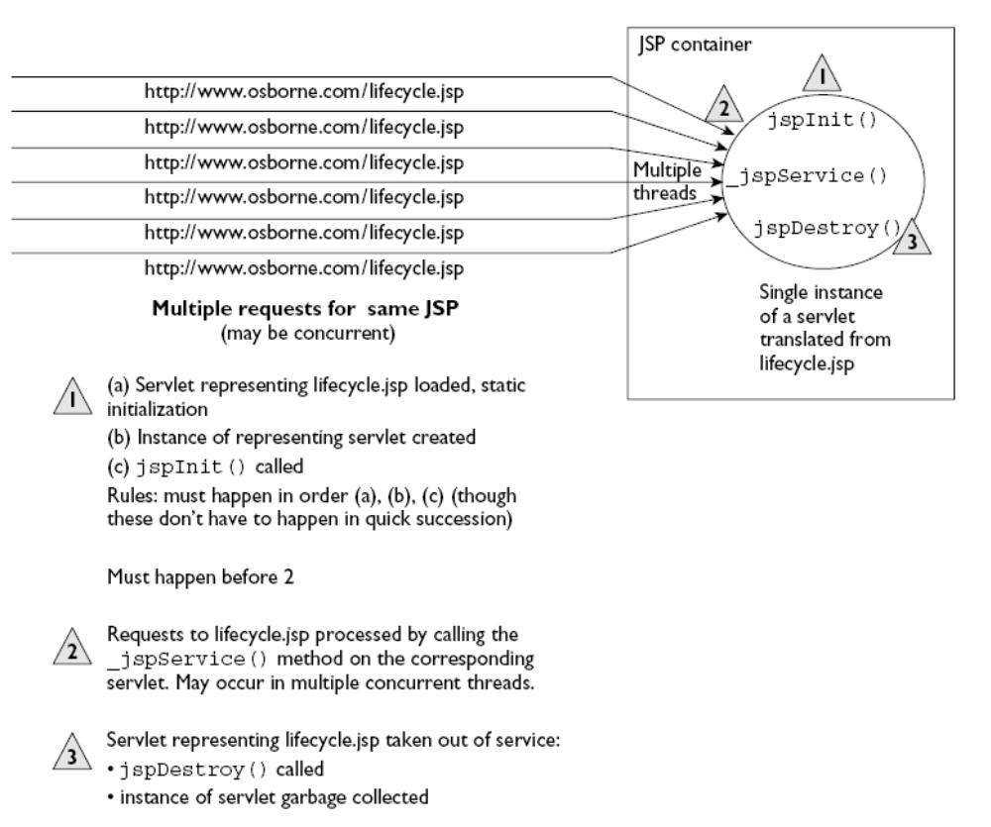
Java Servlets and JSP |

Slide 69
“Hello World” JSP Example (HelloWWW.jsp)
<html>
<head>
<title>Hello World</title>
</head>
<body>
<h2>
Hello World
</h2>
<%
out.print("<p><b>Hello World!</b>");
%>
</body>
</html>
Java Servlets and JSP |

Slide 70
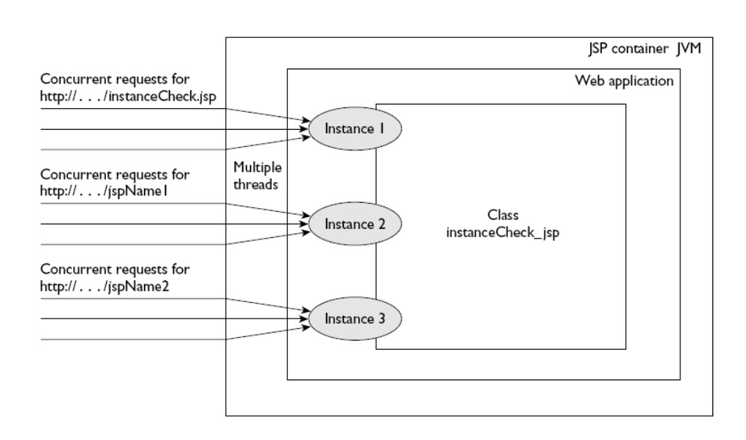
JSP is also Multi-threaded
Java Servlets and JSP |

Slide 71
Elements of JSP
JSP Syntax and Semantics

Slide 72
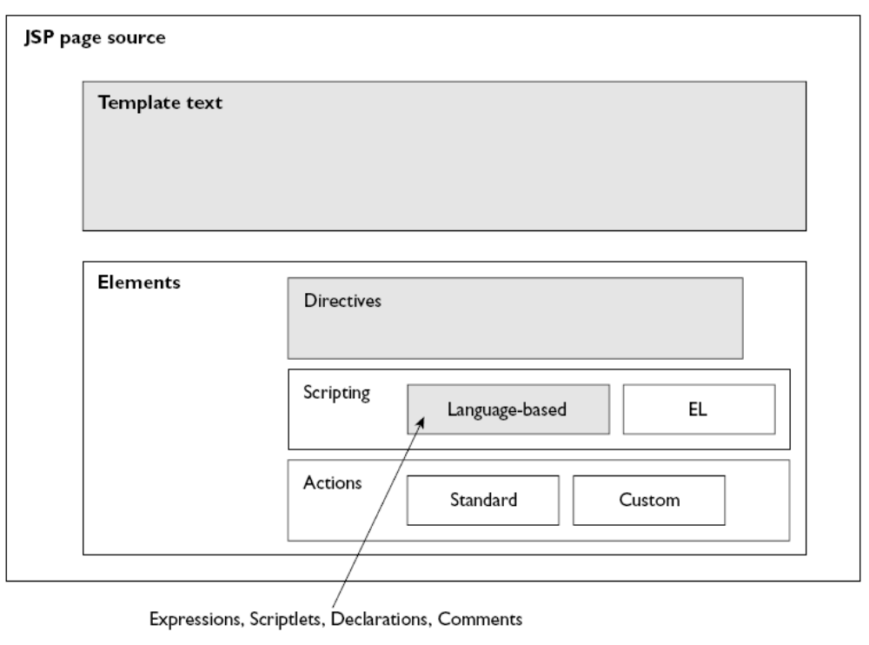
JSP Page Anatomy
Java Servlets and JSP |

Slide 73
Components of a JSP Page
Directives
  Instructions to the JSP container
  Describe what code should be generated
Comments
  Two types
    Visible only inside the JSP page
    Visible in the HTML page generated by the JSP code
Scripting elements
  Expressions : Java expression
  Scriptlets : One or more Java statements
  Declarations : Declarations of objects, variables, etc
Actions
  JSP elements that create, modify or use objects
Java Servlets and JSP |

Slide 74
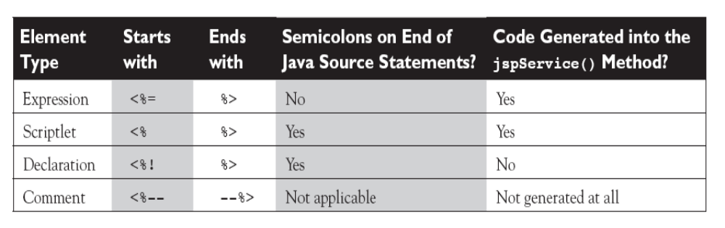
More Details
Java Servlets and JSP |

Slide 75
Directives Overview

Slide 76
Directives Overview
Instructions to JSP container that describe what code should be generated
Generic form
  <%@ Directive-name Attribute-Value pairs %>
There are three directives in JSP
  page
  include
  taglib
Java Servlets and JSP |

Slide 77
The page Directive
Used to specify attributes for the JSP page as a whole
Rarely used, except for specialized situations
Syntax
  <%@ page Attribute-Value pairs %>
Possible attributes
Attribute | Purpose
language | Always Java
extends | Inheritance relationship, if any
import | Include other classes, packages etc
session | Indicates whether the JSP page needs session management
isThreadSafe | Can the page handle multiple client requests?
contentType | Specifies the MIME type to be used
Java Servlets and JSP |

Slide 78
Usage of the page Directive – 1
language
  No need to discuss, since it is Java by default
extends
  Not needed in most situations
import
  By default, the following packages are included in every JSP page
    java.lang
    java.servlet
    java.servlet.http
    java.servlet.jsp
  No need to import anything else standard in most cases: import your custom packages only
session
  Default is session = “true”
  Specify session=“false” if the page does not need session management
  Saves valuable resources
Java Servlets and JSP |

Slide 79
Usage of the page Directive – 2
isThreadSafe
  By default, the servlet engine loads a single servlet instance
  A pool of threads service individual requests
  Two or more threads can execute the same servlet method simultaneously, causing simultaneous access to variables
  <%@ page isThreadSafe="false" %> would have N servlet instances running for N requests
contentType
  Generally, a JSP page produces HTML output (i.e. content type is “text/html”
  Other content types can be produced
  In that case, use <%@ page contentType=“value”>
  Now, non-HTML output can be sent to the browser
Java Servlets and JSP |

Slide 80
JSP Comments: Two Types
Hidden comments (also called as JSP comments)
  Visible only inside JSP page but not in the generated HTML page
  Example
  <%-- This is a hidden JSP comment --%>
Comments to be generated inside the output HTML page
  Example
  <!-- This comment is included inside the generated HTML -->
Notes
  When the JSP compiler encounters the tag <%--, it ignores everything until it finds a matching end tag --%>
  Therefore, JSP comments cannot be nested!
  Use these comments to temporarily hide/enable parts of JSP code
Java Servlets and JSP |

Slide 81
Scripting Elements
Expressions
Scriptlets
Declarations

Slide 82
Expressions
Simple means for accessing the value of a Java variable or other expressions
Results can be merged with the HTML in that page
Syntax
  <%= expression %>
Example
  The current time is <%= new java.util.Date ( ) %>
HTML portion
Java portion
Java Servlets and JSP |

Slide 83
More Expression Examples
Square root of 2 is <%= Math.sqrt (2) %>
The item you are looking for is <%= items [i] %>
Sum of a, b, and c is <%= a + b + c %>.
Java Servlets and JSP |

Slide 84
Exercise: Identify Valid Expressions
Expression | Valid/Invalid and why?
<%= 27 %>
<%= ((Math.random () + 5 * 2); %>
<%= “27” %>
<%= Math.random () %>
<%= String s = “foo” %>
<% = 42*20 %>
<%= 5 > 3 %>
Java Servlets and JSP |

Slide 85
Exercise: Identify Valid Expressions
Expression | Valid/Invalid and why?
<%= 27 %> | Valid: All primitive literals are ok
<%= ((Math.random () + 5 * 2); %> | Invalid: No semicolon allowed
<%= “27” %> | Valid: String literal
<%= Math.random () %> | Valid: method returning a double
<%= String s = “foo” %> | Invalid: Variable declaration not allowed
<% = 42*20 %> | Invalid: Space between % and =
<%= 5 > 3 %> | Valid: Results into a Boolean
Java Servlets and JSP |

Slide 86
Scriptlets
One or more Java statements in a JSP page
Syntax
  <% Statement; %>
Example
  <TABLE BORDER=2>
  <%
  for (int i = 0; i < n; i++)
  {
  %>
  <TR>
  <TD>Number</TD>
  <TD><%= i+1 %></TD>
  </TR>
  <%
  }
  %>
  </TABLE>
HTML code
JSP code
HTML code
JSP code
Java Servlets and JSP |

Slide 87
Understanding how this works
The JSP code would be converted into equivalent servlet code to look something like this:
out.println (“<TABLE BORDER=2>”);
for (int i = 0; i < n; i++)
{
out.println (“<TR>”);
out.println (“<TD>Number</TD>”);
out.println (“<TD>” + i+1 + “</TD>”);
out.println (“</TR>”);
}
out.println (“</TABLE”);
Java Servlets and JSP |

Slide 88
Another Scriptlet Example
<%
if (hello == true) <%-- hello is assumed to be a boolean variable --%>
{
%>
<P>Hello, world
<%
}
else
{
%>
<P>Goodbye, world
<%
}
%>
Java Servlets and JSP |

Slide 89
JSP Exercise
Accept amount in USD from the user, convert it into Indian Rupees and display result to the user by using a JSP. Consider that USD 1 = Indian Rupees 39.
Java Servlets and JSP |

Slide 90
Scriptlets Exercise
Write a JSP page to produce Fahrenheit to Celsius conversion table. The temperature should start from 32 degrees Fahrenheit and display the table at the interval of every 20 degrees Fahrenheit.
  Formula: c = ((f - 32) * 5) / 9.0
Java Servlets and JSP |

Slide 91
Solution to the Scriptlets Exercise
<%@ page import="java.text.*" session = "false" %>
<HTML>
<HEAD>
<TITLE> Scriptlet Example </TITLE>
</HEAD>
<BODY>
<TABLE BORDER = "0" CELLPADDING = "3">
<TR>
<TH> Fahrenheit </TH>
<TH> Celsius </TH>
</TR>
<%
NumberFormat fmt = new DecimalFormat ("###.000");
for (int f = 32; f <= 212; f += 20)
{
double c = ((f - 32) * 5) / 9.0;
String cs = fmt.format (c);
%>
<TR>
<TD ALIGN = "RIGHT"> <%= f %> </TD>
<TD ALIGN = "RIGHT"> <%= cs %> </TD>
</TR>
<%
}
%>
</TABLE>
</BODY>
</HTML>
Java Servlets and JSP |

Slide 92
Declarations
Used to declare objects, variables, methods, etc
Syntax
  <%! Statement %>
Examples
  <%! int i = 0; %>
  <%! int a, b; double c; %>
  <%! Circle a = new Circle(2.0); %>
We must declare a variable or method in a JSP page before we use it in the page.
The scope of a declaration is usually a JSP file, but if the JSP file includes other files with the include directive, the scope expands to cover the included files as well.
Resulting code is included outside of any method (unlike scriptlet code)
Java Servlets and JSP |

Slide 93
Where to declare a Variable?
Variables can be declared inside a scriptlet or inside a declaration block
Declaring inside a scriptlet
  Makes the variable local (i.e. inside the service () method of the corresponding servlet)
Declaring inside a declaration
  Makes the variable instance (i.e. outside the service () method of the corresponding servlet)
See next slide …
Java Servlets and JSP |

Slide 94
Declaring a variable in a scriptlet
JSP (C:\tomcat\webapps\atul\Vardeclaration\var1.jsp)
<html>
<body>
<% int counter = 0; %>
The page count is now: <%= ++counter %>
</body>
</html>
Every time output remains 1! Why?
➔ The resulting servlet has this variable as a local variable of the service method: gets initialized every time.
Java Servlets and JSP |

Slide 95
Declaring a variable in a declaration
JSP (C:\tomcat\webapps\atul\Vardeclaration\var2.jsp)
<html>
<body>
<%! int counter = 0; %>
The page count is now: <%= ++counter %>
</body>
</html>
Now counter gets declared before the service method of the servlet; becomes an instance variable (Created and initialized only once, when the servlet instance is first created and never updated)
Now, output is as expected
Java Servlets and JSP |

Slide 96
Another Example
Var4.jsp
  <%@ page import="java.text.*" %>
  <%@ page import="java.util.*" %>
  <%
  DateFormat fmt = new SimpleDateFormat ("hh:mm:ss aa");
  String now = fmt.format (new Date ());
  %>
  <h4> The time now is <%= now %> </h4>
Var5.jsp
  <%@ page import="java.text.*" %>
  <%@ page import="java.util.*" %>
  <%!
  DateFormat fmt = new SimpleDateFormat ("hh:mm:ss aa");
  String now = fmt.format (new Date ());
  %>
  <h4> The time now is <%= now %> </h4>
Java Servlets and JSP |

Slide 97
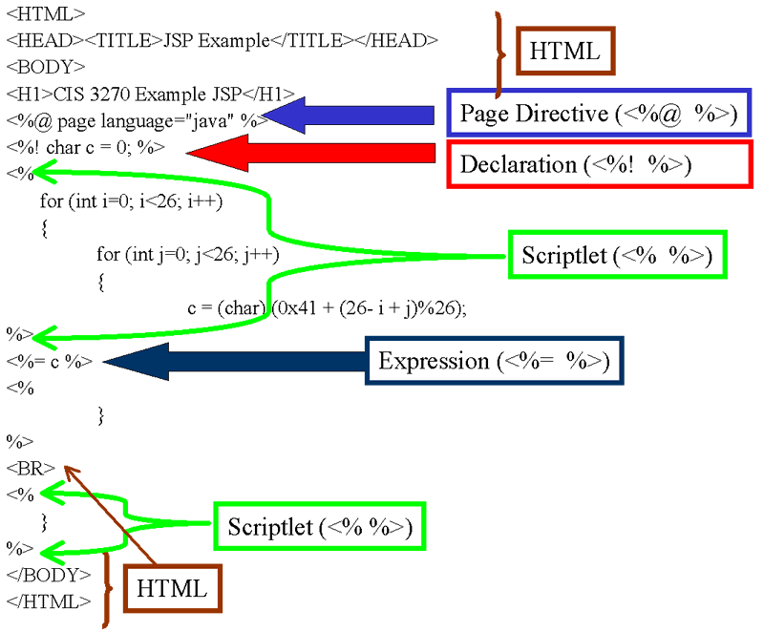
JSP: A Complete Example – All Elements
Java Servlets and JSP |

Slide 98
Actions
Will be discussed later: Just remember the syntax for the time being
Two types
  Standard actions
  Other actions
Standard action example
  <jsp:include page=“myExample.jsp” />
Other action example
  <c:set var = “rate” value = “32” />
Java Servlets and JSP |

Slide 99
Exercise
Identify which of the following is a directive, declaration, scriptlet, expression, and action
Syntax | Language element
<% Float one = new Float (42.5); %>
<%! int y = 3; %>
<%@ page import = “java.util.*”
<jsp include file = “test.html”
<%= pageContext.getAttribute (“Name”) %>
Java Servlets and JSP |

Slide 100
Exercise
Identify which of the following is a directive, declaration, scriptlet, expression, and action
Syntax | Language element | Explanation
<% Float one = new Float (42.5); %> | Scriptlet | Goes inside the service method of the JSP
<%! int y = 3; %> | Declaration | A member declaration is inside a class, but outside of any method
<%@ page import = “java.util.*”> | Directive | A page directive with an import attribute translates into a Java import statement
<jsp include file = “test.html” | Action | Causes the file to be included
<%= pageContext.getAttribute (“Name”) %> | Expression | Gets translated into write statements of the service method
Java Servlets and JSP |

Slide 101
Exercises
Write a JSP for the following:
Accept the user’s age, and then display “You are young” if the age is < 60, else display “You are old”.
Accept a number from the user and compute and show its factorial.
Java Servlets and JSP |

Slide 102
Exercise
Accept three numbers from the user using an HTML page and compute and display the factorial of the largest of those three numbers using a JSP (e.g. if the user enters 3, 5, 7; compute the factorial of 7).
Java Servlets and JSP |

Slide 103
factorial.html
<html>
<head>
<title>Compute Factorial of the Largest Number</title>
</head>
<body>
<h1>Compute Factorial of the Largest Number</h1>
<form action = "factorial.jsp">
Enter three numbers:
<input type = "text" name = "num_1"> &nbsp;&nbsp;
<input type = "text" name = "num_2"> &nbsp;&nbsp;
<input type = "text" name = "num_3">
<br />
<br />
<input type = "submit" value = "Compute the factorial of the largest">
</form>
</body>
</html>
Java Servlets and JSP |

Slide 104
factorial.jsp
<html>
<head>
<title>Compute Factorial of the Largest Number</title>
</head>
<body>
<h1>Compute Factorial of the Largest Number</h1>
<%
String num_1_str = request.getParameter ("num_1");
String num_2_str = request.getParameter ("num_2");
String num_3_str = request.getParameter ("num_3");
int num_1 = Integer.parseInt (num_1_str);
int num_2 = Integer.parseInt (num_2_str);
int num_3 = Integer.parseInt (num_3_str);
int largest = 0;
if (num_1 > num_2 && num_1 > num_3) {
largest = num_1;
}
else if (num_2 > largest && num_2 > num_3) {
largest = num_2;
}
else {
largest = num_3;
}
int fact = 1;
while (largest > 1) {
fact *= largest;
largest--;
}
%>
<h3> The numbers entered are: <%= num_1 %>, <%= num_2 %>, and <%= num_3 %>. </h3>
<h2> The largest among them is: <%= largest %>, and its factorial is <%= fact %> </h2>
</body>
</html>
Java Servlets and JSP |

Slide 105
Exercise
Accept currency code (USD or INR) from the user, and the amount to convert. Depending on the currency selected, convert the amount into equivalent of the other currency. (e.g. if the user provides currency as USD and amount as 10, convert it into equivalent INR).
Java Servlets and JSP |

Slide 106
CurrencyCrossConversion.html
<html>
<head>
<title>Currency Cross-Conversion</title>
</head>
<body>
<h1>Currency Cross-Conversion</h1>
<form action = "CurrencyCrossConversion.jsp">
Choose Source Currency <br />
<input type = "radio" name ="currency" value="USD">USD<br />
<input type = "radio" name ="currency" value="INR">INR<br />
<br />
Type amount: <input type = "text" name = "amount">
<br />
<input type = "submit" value = "Convert">
</form>
</body>
</html>
Java Servlets and JSP |

Slide 107
CurrencyCrossConversion.jsp
<html>
<head>
<title>Currency Cross Conversion Results</title>
</head>
<body>
<h1>Currency Cross Conversion Results</h1>
<%
String currency = request.getParameter ("currency");
String amount_str = request.getParameter ("amount");
int sourceAmount = Integer.parseInt (amount_str);
float targetAmount = 0;
if (currency.equals("USD")) {
targetAmount = sourceAmount * 39;
}
else {
targetAmount = sourceAmount / 39;
}
out.println ("Converted amount is: " + targetAmount);
%>
</body>
</html>
Java Servlets and JSP |

Slide 108
Exercise
Accept the USD value (e.g. 10). Then display a table of USD to INR conversion, starting with this USD value (i.e. 10) for the next 10 USD values (i.e. until USD 20).
Java Servlets and JSP |

Slide 109
forexample.jsp
<html>
<head>
<title>USD to INR Conversion</title>
</head>
<body>
<h1>USD to INR Conversion</h1>
<table>
<%
String usd_str = request.getParameter ("usd");
int usd = Integer.parseInt (usd_str);
for (int i=usd; i< (usd + 10); i++) {
%>
<tr>
<td>
<%= i * 39 %>
</td>
</tr>
<%
}
%>
</table>
</body>
</html>
Java Servlets and JSP |

Slide 110
Simple Example of using a Java Class in a Servlet

Slide 111
Servlet (HelloWWW2.java)
package hello;
import java.io.*;
import javax.servlet.*;
import javax.servlet.http.*;
public class HelloWWW2 extends HttpServlet {
public void doGet(HttpServletRequest request,
HttpServletResponse response)
throws ServletException, IOException {
response.setContentType("text/html");
PrintWriter out = response.getWriter();
out.println(ServletUtilities.headWithTitle("Hello WWW") +
"<BODY>\n" +
"<H1>Hello WWW</H1>\n" +
"</BODY></HTML>");
}
}
Java Servlets and JSP |

Slide 112
ServletUtilities.java
package hello;
public class ServletUtilities {
public static final String DOCTYPE =
"<!DOCTYPE HTML PUBLIC \"-//W3C//DTD HTML 4.0 Transitional//EN\">";
public static String headWithTitle(String title) {
return(DOCTYPE + "\n" +
"<HTML>\n" +
"<HEAD><TITLE>" + title + "</TITLE></HEAD>\n");
}
// Other utilities will be shown later...
}
Java Servlets and JSP |

Slide 113
Important Implicit Objects in JSP
request
response
pageContext
session
application
out

Slide 114
Implicit Objects – Basic Concepts
Scriptlets and expressions cannot do too much of work themselves
They need an environment to operate in
JSP container provides this environment in the form of the implicit objects
There are six such standard objects, as listed earlier
Java Servlets and JSP |

Slide 115
Implicit Objects: request Object
Web browser (client) sends an HTTP request to a Web server
The request object provides a JSP page an access to this information by using this object
Web Browser
Web Server
HTTP Request
GET /file/login.jsp HTTP/1.1
… <Other data>
… ID = atul, password = …
login.jsp
{
String uID = request.getParameter (ID);
…
Java Servlets and JSP |

Slide 116
Implicit Objects: response Object
Web server sends an HTTP response to the Web browser
The response object provides a JSP page an access to this information by using this object
Web Browser
Web Server
HTTP Response
<HTTP headers>
<HTML>
Cookie ID = atul …
login.jsp
...
<HTML>
Cookie mycookie = new Cookie (“ID", “atul"); response.addCookie (mycookie);
Java Servlets and JSP |

Slide 117
Implicit Objects: pageContext Object
JSP environment hierarchy
Application
Session
Request
Page
Java Servlets and JSP |

Slide 118
Using pageContext
We can use a pageContext reference to get any attributes from any scope
Supports two overloaded getAttribute () methods
  A one-argument method, which takes a String
  A two-argument method, which takes a String and an int
Examples follow
Java Servlets and JSP |

Slide 119
pageContext Examples
Setting a page-scoped attribute
  <% Float one = new Float (42.5); %>
  <% pageContext.setAttribute (“foo”, one); %>
Getting a page-scoped attribute
  <%= pageContext.getAttribute (“foo”); %>
Java Servlets and JSP |

Slide 120
Implicit Objects: session Object
HTTP is a stateless protocol
Does not remember what happened between two consecutive requests
Example – Online bookshop
  Browser sends a login request to the server, sending the user ID and password
  Server authenticates user and responds back with a successful login message along with the menu of options available to the user
  User clicks on one of the options (say Buy book)
  Browser sends user’s request to the server
  Ideally, we would expect the server to remember who this user is, based on steps 1 and 2
  But this does not happen!
  Server does not know who this user is
  Browser has to remind server every time!
  Hence, server is stateless
Java Servlets and JSP |

Slide 121
Implicit Objects: application Object
Master object – Consists of all JSP pages, servlets, HTML pages, sessions, etc for an application
Used to control actions that affect all users of an application
Example: Count the number of hits for a Web page
Java Servlets and JSP |

Slide 122
Implicit Objects: out Object
Used to generate output to be sent to the user
Example
<%
String [] colors = {“red”, “green”, “blue”};
for (int i = 0; i < colors.length; i++)
out.println (“<p>” + colors [i] + “</p>”);
%>
Of course, this can also be written as:
<%
String [] colors = {“red”, “green”, “blue”};
for (int i = 0; i < colors.length; i++)
%>
<p> <%= colors [i] %> </p>
Java Servlets and JSP |

Slide 123
Creating Welcome Files for a Web Application

Slide 124
Configuring Welcome Files
Suppose the user just provides the directory name, and not an actual file name, in the browser
We can set up default home page or welcome page that would be displayed to the user, instead of a list of files
Java Servlets and JSP |

Slide 125
Edit Your Application Directory’s web.xml file
<welcome-file-list>
<welcome-file>index.html</welcome-file>
<welcome-file>default.jsp</welcome-file>
</welcome-file-list>
Indicates that if the user types the URL http://localhost:8080/examples, contents of index.html should be shown; and if it is not found, then that of default.jsp should be shown
Java Servlets and JSP |

Slide 126
Transferring Control to Other Pages

Slide 127
Two methods
Redirect
  Makes the browser do all the work
  Servlet needs to call the sendRedirect () method
Request Dispatch
  Work happens on the server side
  Browser does not get involved
Java Servlets and JSP |

Slide 128
Understanding Redirect – 1
HTTP Request
…
response.sendRedirect (New URL)
1. Client types a URL in the browser’s URL bar
2. Servlet decides that it cannot handle this – hence, REDIRECT!
3. Browser sees the 301 status code and looks for a Location header
HTTP Response
Status = 301
Location = new URL
Java Servlets and JSP |

Slide 129
Understanding Redirect – 2
HTTP Request
…
1. Browser sends a new request to the new URL
2. Servlet processes this request like any other request
3. Browser renders HTML as usual
HTTP Response
Status = 200 OK
…
Java Servlets and JSP |

Slide 130
Understanding Redirect – 3
User comes to know of redirection – Sees a new URL in the browser address bar
We should not write anything to the response and then do a redirect
Java Servlets and JSP |

Slide 131
Redirect Example – 1
OriginalServlet.java
import java.io.*;
import javax.servlet.*;
import javax.servlet.http.*;
public class OriginalServlet extends HttpServlet {
public void doGet (HttpServletRequest request,
HttpServletResponse response)
throws ServletException, IOException {
System.out.println ("Inside OriginalServlet ...");
response.sendRedirect ("RedirectedToServlet");
}
}
Java Servlets and JSP |

Slide 132
Redirect Example – 2
RedirectedToServlet.java
import java.io.*;
import javax.servlet.*;
import javax.servlet.http.*;
public class RedirectedToServlet extends HttpServlet {
public void doGet (HttpServletRequest request,
HttpServletResponse response)
throws ServletException, IOException {
System.out.println ("Inside RedirectedToServlet ...");
response.setContentType ("text/html");
PrintWriter out = response.getWriter ();
out.println("<HTML>\n" +
"<HEAD><TITLE>Hello World</TITLE></HEAD>\n"+ "<BODY>\n" +
"<H1>You have been redirected successfully</H1>\n" +
"</BODY></HTML>");
}
}
Java Servlets and JSP |

Slide 133
Understanding Request Dispatch – 1
RequestDispatcher view = request.getRequestDispatcher (“result.jsp”);
view.forward (request, response);
HTTP Request
…
1. Browser sends a request for a servlet
2. Servlet decides to forward this request to another servlet/JSP
3. result.jsp produces an HTTP response
4. Browser renders HTML as usual
HTTP Response
Status = 200 OK
…
Java Servlets and JSP |

Slide 134
Understanding Request Dispatch – 2
Server automatically does the forwarding, unlike in the previous case
URL in the browser does not change
Java Servlets and JSP |

Slide 135
Dispatch Example – 1
OriginalServletTwo.java
import java.io.*;
import javax.servlet.*;
import javax.servlet.http.*;
public class OriginalServletTwo extends HttpServlet {
public void doGet (HttpServletRequest request,
HttpServletResponse response)
throws ServletException, IOException {
System.out.println ("Inside OriginalServlet ...");
RequestDispatcher view = request.getRequestDispatcher ("/result.jsp");
view.forward (request, response);
}
}
Java Servlets and JSP |

Slide 136
Dispatch Example – 2
result.jsp
<html>
<head>
<title>Dispatched to a New Page</title>
</head>
<body>
<h2>
Dispatched
</h2>
<%
out.print("<p><b>Hi! I am result.jsp<b>");
System.out.println ("In request.jsp ...");
%>
</body>
</html>
Java Servlets and JSP |

Slide 137
Using Regular Java Classes with JSP
http://localhost:8080/examples/join_email.html

Slide 138
Using Java Classes in JSP: An Example
User class
  Defines a user of the application
  Contains three instance variables: firstName, lastName, and emailAddress
  Includes a constructor to accept values for these three instance variables
  Includes get and set methods to for each instance variable
UserIO class
  Contains a static method addRecord, that writes the values stored in an User object into a text file
Java Servlets and JSP |

Slide 139
User class: Plain Java class (Actually a JavaBean)
//c:\tomcat\webapps\examples\WEB-INF\classes\user\user.java
package user;
public class User{
private String firstName;
private String lastName;
private String emailAddress;
public User(){}
public User(String first, String last, String email){
firstName = first;
lastName = last;
emailAddress = email;
}
public void setFirstName(String f){
firstName = f;
}
public String getFirstName(){ return firstName; }
public void setLastName(String l){
lastName = l;
}
public String getLastName(){ return lastName; }
public void setEmailAddress(String e){
emailAddress = e;
}
public String getEmailAddress(){ return emailAddress; }
}
Java Servlets and JSP |

Slide 140
UserIO class: Plain Java class
//c:\tomcat\webapps\examples\WEB-INF\classes\user\userIOr.java
package user;
import java.io.*;
public class UserIO{
public synchronized static void addRecord(User user, String fileName) throws IOException{
PrintWriter out = new PrintWriter(new FileWriter(fileName, true));
out.println(user.getEmailAddress()+ "|"
+ user.getFirstName() + "|"
+ user.getLastName());
out.close();
}
}
Java Servlets and JSP |

Slide 141
HTML page
C:\tomcat\webapps\examples\join_email.html
<html>
<head>
<title>Email List application</title>
</head>
<body>
<h1>Join our email list</h1>
<p>To join our email list, enter your name and
email address below. <br>
Then, click on the Submit button.</p>
<form action="EmailData.jsp" method="get">
<table cellspacing="5" border="0">
<tr>
<td align="right">First name:</td>
<td><input type="text" name="firstName"></td>
</tr>
<tr>
<td align="right">Last name:</td>
<td><input type="text" name="lastName"></td>
</tr>
<tr>
<td align="right">Email address:</td>
<td><input type="text" name="emailAddress"></td>
</tr>
<tr>
<td></td>
<td><br><input type="submit" value="Submit"></td>
</tr>
</table>
</form>
</body>
</html>
Java Servlets and JSP |

Slide 142
JSP page that uses the Java classes defined earlier
<!– c:\tomcat\webapps\examples\EmailData.jsp →
<html>
<head>
<title>Email List application</title>
</head>
<body>
<%@ page import="user.*" %>
<%
String firstName = request.getParameter("firstName");
String lastName = request.getParameter("lastName");
String emailAddress = request.getParameter("emailAddress");
User user = new User(firstName, lastName, emailAddress);
UserIO.addRecord(user, "c:\\tomcat\\webapps\\examples\\UserEmail.txt");
%>
<h1>Thanks for joining our email list</h1>
<p>Here is the information that you entered:</p>
<table cellspacing="5" cellpadding="5" border="1">
<tr>
<td align="right">First name:</td>
<td><%= user.getFirstName () %></td>
</tr>
<tr>
<td align="right">Last name:</td>
<td><%= user.getLastName ()%></td>
</tr>
<tr>
<td align="right">Email address:</td>
<td><%= user.getEmailAddress () %></td>
</tr>
</table>
<p>To enter another email address, click on the Back <br>
button in your browser or the Return button shown <br>
below.</p>
<form action="join_email.html" method="post">
<input type="submit" value="Return">
</form>
</body>
</html>
Java Servlets and JSP |

Slide 143
Using Servlets and JSP Together
Model-View-Control (MVC) Architecture

Slide 144
Traditional Web Applications using Servlets
Traditional Web applications would involve writing server-side code for processing client requests
One servlet would receive request, process it (i.e. perform database operations, computations, etc) and send back the response in the form of HTML page to the client
  May be, more than one servlet would be used
  Still not good enough
This model combines
  What should happen when the user sends a request
  How should this request be processed
  How should the result be shown to the user
Separate these aspects using Model-View-Controller (MVC) architecture
Java Servlets and JSP |

Slide 145
The basics of MVC
Model-View-Control (MVC) Architecture
Recommended approach for developing Web applications
View
  The end user’s view (i.e. what does the end user see?)
  Mostly done using JSP
Controller
  Controls the overall flow of the application
  Usually a servlet
Model
  The back-end of the application
  Can be legacy code or Java code (usually JavaBeans)
Java Servlets and JSP |

Slide 146
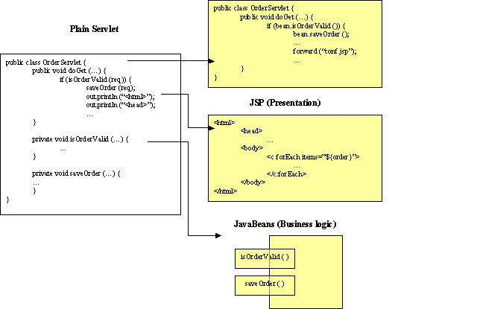
Separating Request Processing, Business Logic, and Presentation
Java Servlets and JSP |

Slide 147
MVC: Depicted
Client
JSP
Servlet
Legacy code
View
Controller
Model
class shopping
{
…
DB
<%
%>
Servlet: The Controller
1. Takes user input and decides what action to take on it
2. Tells the model to update itself and makes the new model state available to the view (the JSP)
JSP: The View
1. Gets the state of the model from the controller
2. Gets the user input and provides it to the controller
Java code: The Model
1. Performs business logic and state management
2. Performs database interactions
Java Servlets and JSP |

Slide 148
Case Study using MVC
Problem statement
  Design a small Web application that shows names of players to the user. Based on the name selected, some basic information about that player should be displayed on the user’s screen. Use the MVC architecture and write the necessary code in JSP/servlet/HTML, as appropriate.
Java Servlets and JSP |

Slide 149
Application Flow – Part 1
Web server
Web browser
1
Container
<html>
<head>
…
</html>
Container logic
2
Controller
1. User sends a request for the page SelectPlayer.html.
2. Web server sends that page to the browser.
See next slide
Servlet
SelectPlayer.
html
Player
Expert
Result.jsp
Model
View
Java Servlets and JSP |

Slide 150
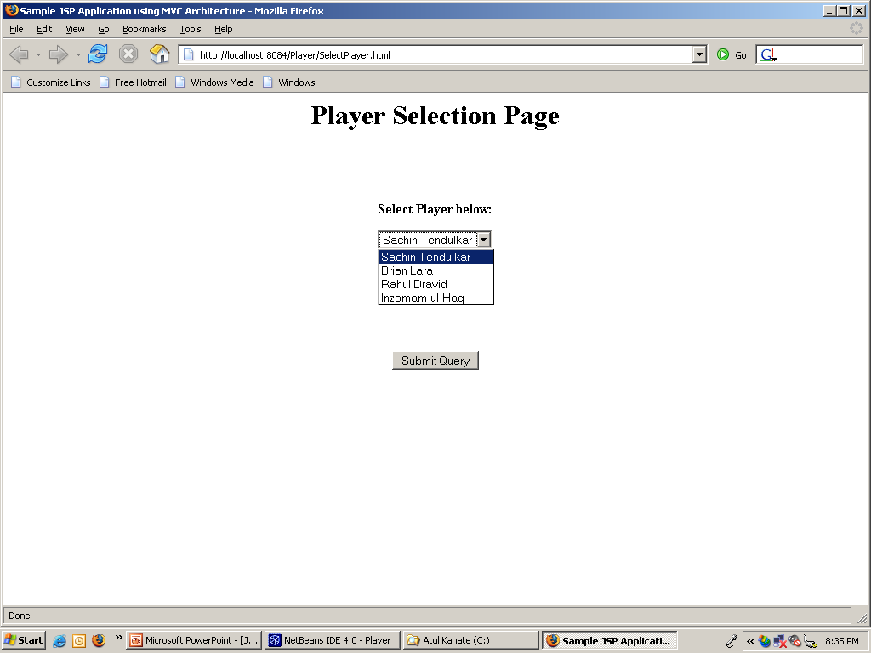
Initial HTML Screen – SelectPlayer.html
Java Servlets and JSP |

Slide 151
Application Flow – Part 2
Web server
Web browser
3
Container
<html>
<head>
…
</html>
Container logic
4
10
3. User selects player.
4. Container calls getPlayer servlet.
5. Servlet calls PlayerExpert class.
6. PlayerExpert class returns an answer, which the servlet adds to the request object.
7. Servlet forwards the request to the JSP.
8. JSP reads the request object.
9. JSP generates the output and sends to the container.
10. Container returns result to the user.
Controller
Servlet
9
5
6
Player
Expert
Result.jsp
7
8
Request
Model
View
Java Servlets and JSP |

Slide 152
Developing the Application – SelectPlayer.html
The main HTML page that presents the choice of players to the user
<html>
<head>
<title>Sample JSP Application using MVC Architecture</title>
</head>
<body>
<h1> <center> Player Selection Page </center> </h1>
<br> <br> <br>
<form method = "post" action = "getPlayer">
<center> <b> Select Player below: </b> </center>
<p>
<center>
<select name = "playerName" size = "1">
<option> Sachin Tendulkar
<option> Brian Lara
<option> Rahul Dravid
<option> Inzamam-ul-Haq
</select>
</center>
<br> <br> <br> <br> <br> <br>
<center>
<input type = "submit">
</center>
</form>
</body>
</html>
Java Servlets and JSP |

Slide 153
Developing the Application – Controller Servlet (getPlayer)
Aim of the first version: SelectPlayer.html should be able to call and find the servlet
protected void processRequest(HttpServletRequest request, HttpServletResponse response)
throws ServletException, IOException {
response.setContentType("text/html");
PrintWriter out = response.getWriter();
out.println ("Player Information <br>");
String name = request.getParameter ("playerName");
out.println ("<br> You have selected: " + name);
out.close();
}
protected void doPost(HttpServletRequest request, HttpServletResponse response)
throws ServletException, IOException {
processRequest(request, response);
}
Java Servlets and JSP |

Slide 154
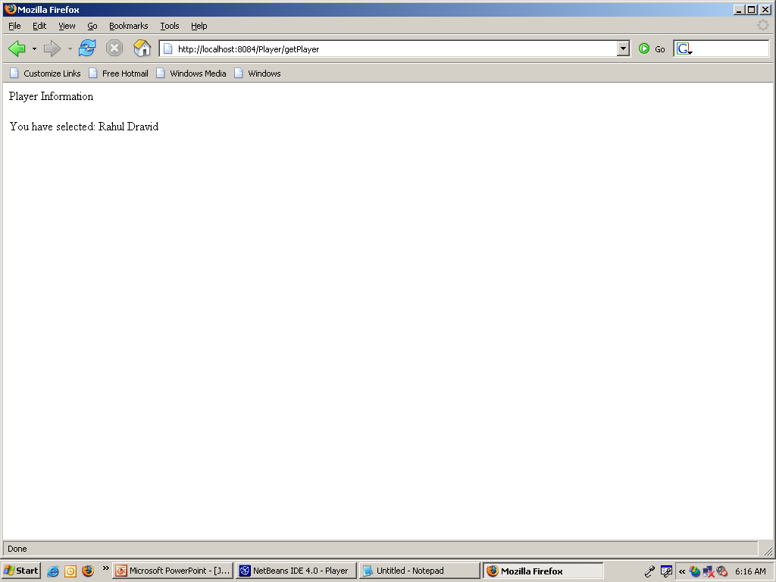
Output of the Servlet – First Version 1
Java Servlets and JSP |

Slide 155
Building and Testing the Model Class (PlayerExpert.java)
The model contains the business logic
Here, our model is a simple Java class
  This Java class receives the player name and provides a couple of pieces of information for these players
/* PlayerExpert.java */
import java.util.*;
public class PlayerExpert
{
  public List getPlayerDetails (String playerName)
{
List characteristics = new ArrayList ();
if (playerName.equals ("Sachin Tendulkar"))
{
characteristics.add ("Born on 24 April 1973");
characteristics.add ("RHB RM OB");
}
else
if (playerName.equals ("Rahul Dravid"))
{
characteristics.add ("Born on 11 January 1973");
characteristics.add ("RHB WK");
}
return characteristics;
}
}
Java Servlets and JSP |

Slide 156
Controller Servlet (getPlayer) – Version 2
Let us now enhance the servlet to call our model Java class
protected void processRequest(HttpServletRequest request, HttpServletResponse response)
throws ServletException, IOException
{
response.setContentType("text/html");
PrintWriter out = response.getWriter();
out.println ("<H1>Player Information</H1><br>");
String name = request.getParameter ("playerName");
out.println ("<H2>" + name + "</H2><br>");
PlayerExpert PE = new PlayerExpert ();
List result = PE.getPlayerDetails(name);
Iterator it = result.iterator ();
while (it.hasNext ())
{
out.println ("<br>" + it.next ());
}
}
Java Servlets and JSP |

Slide 157
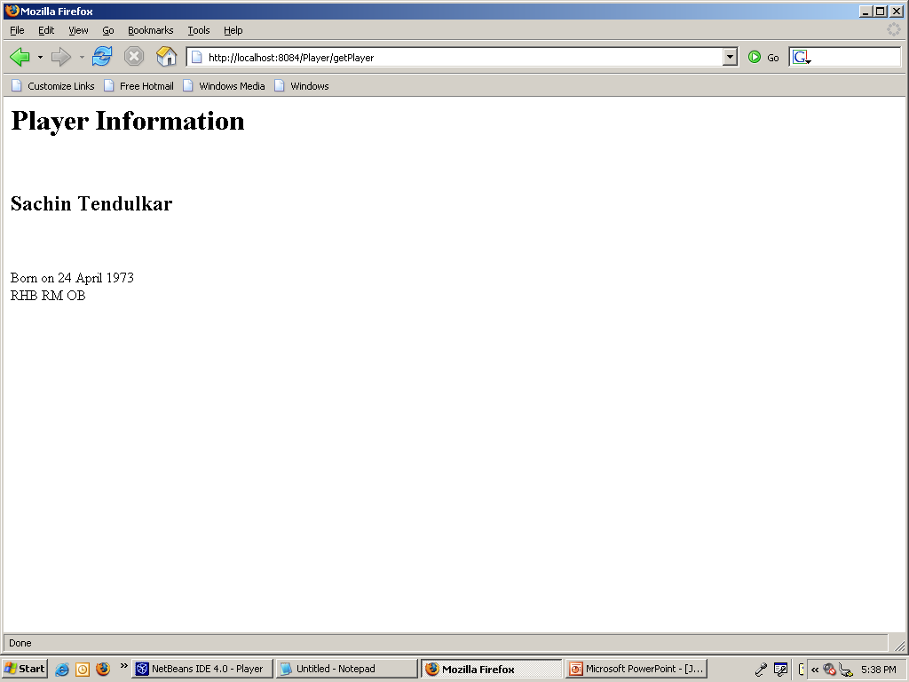
Sample Output as a Result of Modifying the Controller Servlet
Java Servlets and JSP |

Slide 158
Our Application Flow At This Stage
Web server
Web browser
1
Container
<html>
<head>
…
</html>
Container logic
2
5
1. Browser sends user’s request to the container.
2. The container finds the correct servlet based on the URL and passes on the user’s request to the servlet.
3. The servlet calls the PlayerExpert class.
4. The servlet outputs the response (which prints more information about the player).
5. The container returns this to the user.
Controller
4
Servlet
3
Player
Expert
Model
Java Servlets and JSP |

Slide 159
Our Application Flow - The Ideal Architecture
Web server
Web browser
1
Container
<html>
<head>
…
</html>
Container logic
2
8
Controller
Servlet
7
5
3
4
Player
Expert
Result.jsp
6
Request
Model
View
Java Servlets and JSP |

Slide 160
Developing the Application – result.jsp – The View
<html>
<head><title>Player Details</title></head>
<body>
<h1 align = "center"> Player Information </h1>
<p>
<%
// We have not yet defined what this attribute is. Will be clear soon.
List PC = (List) request.getAttribute ("playerCharacteristics");
Iterator it = PC.iterator ();
String name = (String) request.getAttribute ("playerName");
out.println ("<H2>" + name + "</H2><br>");
while (it.hasNext ())
out.print ("<br>" + it.next ());
%>
</body>
</html>
Java Servlets and JSP |

Slide 161
Changes to the Controller Servlet
What changes to we need to make to the controller servlet so that it uses our JSP now?
  Add the answer returned by the PlayerExpert class to the request object
  Do not have any displaying (i.e. view) capabilities in the controller servlet
  Instead, comment out/remove this code and call the JSP
Java Servlets and JSP |

Slide 162
Controller Servlet (getPlayer) – Version 3
protected void doPost (HttpServletRequest request, HttpServletResponse response)
throws ServletException, IOException {
// response.setContentType("text/html");
// PrintWriter out = response.getWriter();
// out.println ("<H1>Player Information</H1><br>");
String name = request.getParameter ("playerName");
// out.println ("<H2>" + name + "</H2><br>");
PlayerExpert PE = new PlayerExpert ();
List result = PE.getPlayerDetails(name);
// Iterator it = result.iterator ();
// while (it.hasNext ())
// {
// out.println ("<br>" + it.next ());
// }
request.setAttribute ("playerCharacteristics", result);
request.setAttribute ("playerName", name);
RequestDispatcher view = request.getRequestDispatcher ("result.jsp");
view.forward (request, response);
// out.close();
}
Java Servlets and JSP |

Slide 163
RequestDispatcher
Interface consisting of the following method
  forward (ServletRequest, ServletResponse)
Steps
  Get a RequestDispatcher from a ServletRequest
    RequestDispatcher view = request.getRequestDispatcher ("result.jsp");
    Takes a string path for the resource to which we want to forward the request
  Call forward () on the RequestDispatcher
    view.forward (request, response);
    Forwards the request to the resource mentioned earlier (in this case, to result.jsp)
Java Servlets and JSP |

Slide 164
Session Management

Slide 165
The Need for Session Management
HTTP is stateless
So far, we have seen situations where:
  The client sends a request
  The server sends a response
  The conversation is over
How to deal with situations where:
  The server needs to possibly remember what the client had asked for in the previous requests
Use session management
Example: Shopping cart
Java Servlets and JSP |

Slide 166
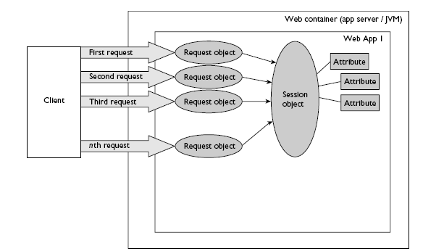
Session Concept
Java Servlets and JSP |

Slide 167
Technology behind Session Management
Cookies
  Small text files that contain the session ID
  Container creates a cookie and sends it to the client
  Client creates a temporary file to hold it till the session lasts
Alternatives
  URL rewriting
  Hidden form variables
Java Servlets and JSP |

Slide 168
Possible Approaches
Server
Browser
HTTP Response
HTTP/1.0 200 OK
Set-cookie: sid=test123
Cookie method
HTTP Request
GET /next.jsp HTTP/1.0
Cookie: sid=test123
HTTP Response
HTTP/1.0 200 OK
<input type=hidden name=sid value=test123>
Hidden form field method
HTTP Request
POST /next.jsp HTTP/1.0
sid=test123
HTTP Response
HTTP/1.0 200 OK
<a href=next.jsp;sid=test123>Next page</a>
URL rewriting method
HTTP Request
GET /next.jsp;sid=test123 HTTP/1.0
Java Servlets and JSP |

Slide 169
Cookie Exchange: Technical Level – 1
Step 1: Cookie is one of the header fields of the HTTP response
HTTP/1.1 200 OK
Set-Cookie: JSESSIONID = 0AAB6C8DE415
Content-type: text/html
Date: Tue, 29 Mar 2005 11:25:40 GMT
…
<html>
…
</html>
Server/
Container
Web browser
Here is your cookie containing the session ID
HTTP Response
Java Servlets and JSP |

Slide 170
Cookie Exchange: Technical Level – 2
Step 2: Client sends the cookie with the next request
POST SelectDetails HTTP/1.1
Host: www.cricket.com
Cookie: JSESSIONID = 0AAB6C8DE415
Accept: text/xml, …
Accept-Language: en-us, …
…
…
Server/
Container
Web browser
Here is my cookie containing the session ID
HTTP Request
Java Servlets and JSP |

Slide 171
Programmer and Session Management – 1
Sending a cookie in the HTTP Response
  HTTPSession session = request.getSession ( );
  When the above code executes, the container creates a new session ID (if none exists for this client)
  The container puts the session ID inside a cookie
  The container sends the cookie to the client (using the Set-Cookie header seen earlier)
Java Servlets and JSP |

Slide 172
Programmer and Session Management – 2
Getting a cookie from the HTTP Request
  HTTPSession session = request.getSession ( );
  The same method is used for getting a cookie, as was used for setting it!
  When the above code executes, the container does the following check:
  If the request object received from the client contains a session ID cookie
    Find the session matching the session ID of the cookie
  Else (it means that there is no session in place for this user)
    Create a new session (as explained earlier)
Java Servlets and JSP |

Slide 173
Adding and Retrieving Session Variables
setAttribute (String name, Object value)
  Sets a session variable name to the specified value
Object getAttribute (String name)
  Retrieves the value of a session variable set previously
Example
  HttpSession session = request.getSession ();
  session.setAttribute (“name”, “ram”);
  …
  String user_name = (String) session.getAttribute (name);
  …
  session.removeAttribute (name);
  …
  session.invalidate ();
Java Servlets and JSP |

Slide 174
Session Example
<%@ page session="true" %>
<HTML>
<HEAD>
<TITLE>Page Counter using Session Variables</TITLE>
<STYLE TYPE="text/css">
H1 {font-size: 150%;}
</STYLE>
</HEAD>
<BODY>
<H1>Page Counter using Session Variables</H1>
<%
int count = 0;
Integer parm = (Integer) session.getAttribute ("count");
if (parm != null)
count = parm.intValue ();
session.setAttribute ("count", new Integer (count + 1));
if (count == 0) {
%>
This is the first time you have accessed the page.
<%
}
else if (count == 1) {
%>
You have accessed the page once before.
<%
}
else {
%>
You have accessed the page <%= count %> times before.
<%
}
%>
<p>
Click <a href=
Click <a href="/atul/CounterSession.jsp">here </a> to visit again.
</p>
</body>
</html>
Java Servlets and JSP |

Slide 175
Another Session Example – 1
sessiondemo.jsp
<%@ page import = "java.util.*" %>
<html>
<head>
<title>Session Demo</title>
<link href = "mystyle.css" rel = "stylesheet" type = "text/css">
</head>
<body>
<%!
int i = 0;
int getCount () { return ++i;}
%>
<%
String user = (String)session.getAttribute ("user");
if (user == null) {
user = "Guest";
}
%>
<br />Refresh Count: <%=getCount ()%>.
<br />Click to <a href = "sessiondemo.jsp">Refresh</a>
<hr>
<%
Date date = new Date ();
out.println (date.toString ());
%>
<div id="welcome">
<h2>Welcome <%=user%></h2>
</div>
<form action = "user_info.jsp" method = "post">
<table>
<tr>
<td>Enter your full name</td>
<td><input type = "text" name = "fullname"></td>
</tr>
<tr>
<td>Enter your city</td>
<td><input type = "text" name = "city"></td>
</tr>
<tr>
<td colspan = "2"><input type = "submit" value = "Submit"></td>
</tr>
</table>
</form>
</body>
</html>
Java Servlets and JSP |

Slide 176
Another Session Example – 2
Mystyle.css
td {
font-family: Geneva,Arial,Helvetica,sans-serif;
font-size: 12px;
color: #000033;
font-weight: bold;
}
Java Servlets and JSP |

Slide 177
Another Session Example – 3
User_info.jsp
<html>
<head>
<title>User Information</title>
<link href = "mystyle.css" rel = "stylesheet" type = "text/css">
</head>
<body>
Displaying data using the user's request ...
<%
String fullname = request.getParameter ("fullname");
String city = request.getParameter ("city");
if (fullname.length() == 0) {
out.println ("<br />The full name field is left blank.");
}
else
{
out.println ("<br />Your full name is: " + fullname);
}
if (city.length() == 0) {
out.println ("<br />The city field is left blank.");
}
else
{
out.println ("<br />Your city is: " + city);
}
%>
<br /> <br />
<hr />
Setting full name into the session ...
<%
if (fullname.length () == 0) {
session.setAttribute ("user", "Guest");
}
else {
session.setAttribute ("user", fullname);
}
%>
<h2>You are <%=session.getAttribute ("user")%></h2>
<br /> <br />
<a href = "sessiondemo.jsp">Back</a>
</body>
</html>
Java Servlets and JSP |

Slide 178
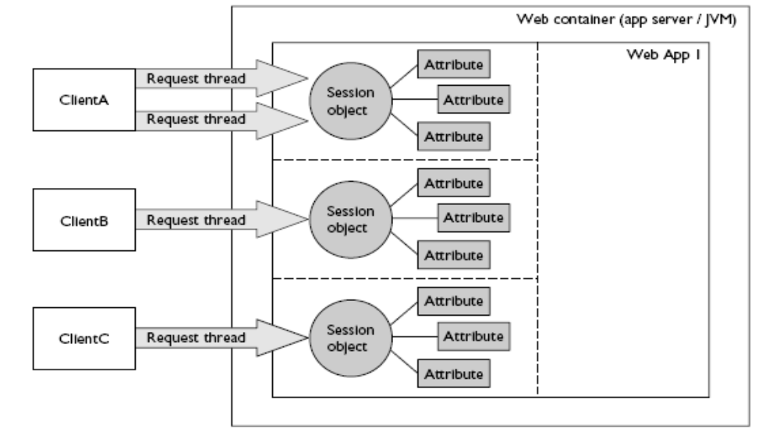
Session Objects are Threadsafe
Java Servlets and JSP |

Slide 179
URL Rewriting

Slide 180
URL Rewriting Basics
A URL can have parameters appended, which can travel to the Web sever along with the HTTP request
Example
  http://myserver.com/MyPage.jsp?name=atul&city=pune
JSP can retrieve this as:
  String value1 = request.getParameter (“name”);
  String value2 = request.getParameter (“city”);
These parameters can hold session data
Java Servlets and JSP |

Slide 181
URL Rewriting
Some browsers do not accept cookies (user can disable them)
Session management will fail in such situations
Set-cookie statement would not work!
Solution: Use URL Rewriting
  Append the session ID to the end of every URL
  Example
URL + ;jsessionid = B1237U5619T
mail.yahoo.com;jsessionid = B1237U5619T
Java Servlets and JSP |

Slide 182
URL Rewriting – 1
Step 1: Container appends the session ID to the URL that the client would access during the next request
HTTP/1.1 200 OK
Content-type: text/html
Date: Tue, 29 Mar 2005 11:25:40 GMT
…
<html>
<a href=http://www.cricket.com/PlayerExpert;jsessionid=B1237U5619T Click me </a>
…
</html>
Server/
Container
Web browser
HTTP Response
Java Servlets and JSP |

Slide 183
URL Rewriting – 2
Step 2: When client sends the next request to the container, the session ID travels, appended to the URL
GET /SelectDetails; jsessionid= B1237U5619T
Host: www.cricket.com
Accept: text/xml, …
…
Server/
Container
Web browser
HTTP Request
The session ID comes back to the server as extra information added to the end of the URL
Java Servlets and JSP |

Slide 184
Programmer and URL Rewriting
URL rewriting kicks in only if:
  Cookies fail AND
  The programmer has encoded the URLs
Example
public void doGet (HttpServletRequest request, HttpServletResponse response) throws IOException
{
response.setContentType (“text/html”);
PrintWriter out = response.getWriter ();
HttpSession session = request.getSession ();
out.println (“<html> <body>”);
out.println (“<a href=\”” + response.encodeURL(“SelectDetails”)+ “\”>Click me</a”);
out.println (“</body> </html>”);
}
Get a session
Add session ID info to the URL
Java Servlets and JSP |

Slide 185
URL Rewriting: The Pitfalls
Never use the jsessionid variable yourself. If you see that as a request parameter, something is wrong!
  String sessionID = request.getParameter (“jsessionid”); // WRONG
Do not try to pass a jsessionid parameter yourself!
  POST /SelectDetails HTTP 1.1
  …
  JSESSIONID: 0A89B6Y7uUI9 // WRONG!!!
The only place where a JSESSIONID can come is inside a cookie header (as shown earlier)
  POST /SelectDetails HTTP 1.1
  …
  Cookie: JSESSIONID: 0A89B6Y7uUI9
  Remember that the above should be done by browser, and not by you!
Java Servlets and JSP |

Slide 186
URL Rewriting Example (Not for Session ID, but for a User Attribute)
<H1>Page Counter using URL Rewriting</H1>
<%
int count = 0;
String parm = request.getParameter ("count");
if (parm != null) {
count = Integer.parseInt (parm);
}
if (count == 0) {
%>
This is the first time you have accessed the page.
<%
}
else if (count == 1) {
%>
You have accessed the page once before.
<%
}
else {
%>
You have accessed the page <%= count %> times before.
<%
}
%>
<p>
Click <a href="counter.jsp?count=<%=count + 1 %>">here </a> to visit again.
</p>
</body>
</html>
Java Servlets and JSP |

Slide 187
Session Timeouts
What happens if a user accesses some site, does some work, a session gets created for her and the user does not do anything for a long time?
  Container would unnecessarily hold session information
Session timeouts are used in such situations
  If a user does not perform an action for some time (say 20 minutes), the session information is automatically destroyed
  We can change this default programmatically:
  Session.setMaxInactiveInterval (20 * 60); // 20 minutes
Java Servlets and JSP |

Slide 188
More on Cookies …

Slide 189
Cookies
A browser is expected to support up to 20 cookies from each Web server, 300 cookies total, and may limit cookie size to 4 KB each
Java Servlets and JSP |

Slide 190
More on Cookies
Cookies can be used to store session-related information apart from just the session ID
Example: Suppose we want the user to register with our site and thereafter whenever the user visits our site, display a Welcome <user name> message
  We can create a persistent cookie
  This type of cookie can be created on the client computer and lasts beyond the lifetime of a single session
  By default, all cookies are transient (live only for the duration of a session) – they are destroyed the moment a session ends (i.e. when a user closes browser)
Example: Create a persistent cookie on the user’s computer and use it the next time the user visits any page belonging to our site
Java Servlets and JSP |

Slide 191
Writing Cookies
To send cookies to the client, a servlet needs to:
  Use the Cookie constructor to create cookies with designated names and values
  Set optional attributes with Cookie.setxyz (and read them by Cookie.getxyz)
  Insert cookies into the HTTP response header with response.addCookie
Java Servlets and JSP |

Slide 192
Reading Cookies
Call request.getCookies
  Returns array of Cookie objects corresponding to the cookies the browser has associated with our site OR null if there are no cookies
Java Servlets and JSP |

Slide 193
Cookie Types
Transient Cookies
  Session-level
  Stored in browser’s memory and deleted when the user quits the browser
Persistent Cookies
  Remain on the user’s hard disk beyond a session
Java Servlets and JSP |

Slide 194
Writing Cookies Using a Servlet – CookieWriter.java
Cookie myCookie = new Cookie ("userID", "123");
myCookie.setMaxAge (60 * 60 * 24 * 7); // One week
response.addCookie (myCookie);
Java Servlets and JSP |
Notes:
/*
* cookieWriter.java
*
* Created on March 25, 2005, 4:51 PM
*/
import java.io.*;
import java.net.*;
import javax.servlet.*;
import javax.servlet.http.*;
/**
*
* @author comp
* @version
*/
public class cookieWriter extends HttpServlet {
/** Initializes the servlet.
*/
public void init(ServletConfig config) throws ServletException {
super.init(config);
}
/** Destroys the servlet.
*/
public void destroy() {
}
/** Processes requests for both HTTP <code>GET</code> and <code>POST</code> methods.
* @param request servlet request
* @param response servlet response
*/
protected void processRequest(HttpServletRequest request, HttpServletResponse response)
throws ServletException, IOException {
/* TODO output your page here */
Cookie myCookie = new Cookie ("userID", "123");
response.addCookie (myCookie);
response.setContentType("text/html");
PrintWriter out = response.getWriter();
out.println("<html>");
out.println("<head>");
out.println("<title>Writing Cookie</title>");
out.println("</head>");
out.println("<body>");
out.println ("<H1> This servlet has written a cookie </H1>");
out.println("</body>");
out.println("</html>");
out.close();
}
/** Handles the HTTP <code>GET</code> method.
* @param request servlet request
* @param response servlet response
*/
protected void doGet(HttpServletRequest request, HttpServletResponse response)
throws ServletException, IOException {
processRequest(request, response);
}
/** Handles the HTTP <code>POST</code> method.
* @param request servlet request
* @param response servlet response
*/
protected void doPost(HttpServletRequest request, HttpServletResponse response)
throws ServletException, IOException {
processRequest(request, response);
}
/** Returns a short description of the servlet.
*/
public String getServletInfo() {
return "Short description";
}
}

Slide 195
HTML Page to Accept User Name
<!– c:\tomcat\webapps\sicsr\Cookie_Writer.html”→
<html>
<head><title>Cookie Writer</title></head>
<body>
<form method = "get" action = "servlet/CookieWriter">
<center> <b> Please enter your name below: </b> </center>
<p>
<center>
<input type = "text" name = "name">
</center>
<br> <br> <br> <br> <br> <br>
<center>
<input type = "submit">
</center>
</form>
</body>
</html>
Java Servlets and JSP |

Slide 196
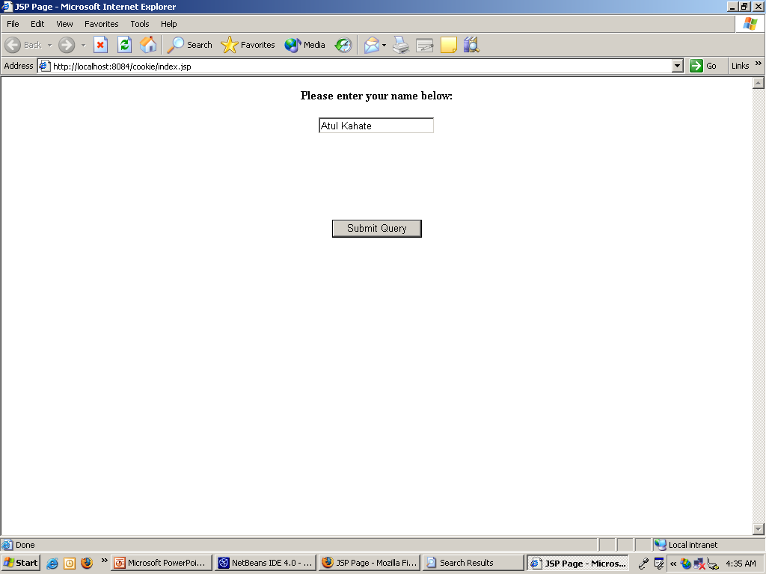
Output of this HTML Page
Java Servlets and JSP |

Slide 197
CookeWriter Servlet
This servlet would do the following:
  Create a session ID
  Write the user name to a cookie
  Write the password to a session variable
Interestingly, the user name and session ID get stored as cookies on the client computer, but the password does not!
  Tells us that the session variables remain on the server, but just the session ID gets sent as a cookie to the client (e.g. password here)
  On the other hand, if we use cookie variables explicitly, they get stored on the client’s computer (e.g. user id here)
Java Servlets and JSP |

Slide 198
CookieWriter Servlet
/* CookieWriter.java */
import javax.servlet.*;
import javax.servlet.http.*;
import java.io.*;
public class CookieWriter extends HttpServlet {
public void doGet (HttpServletRequest request, HttpServletResponse response)
throws ServletException, IOException {
// String name = request.getParameter ("name");
Cookie cookie = new Cookie ("username", "SICSR");
cookie.setMaxAge (30 * 60);
response.addCookie (cookie);
HttpSession session = request.getSession ();
session.setAttribute ("password", "SICSR");
response.setContentType("text/html");
PrintWriter out = response.getWriter();
out.println("<html>");
out.println("<head>");
out.println("<title>Writing Cookie</title>");
out.println("</head>");
out.println("<body>");
out.println ("<H1> This servlet has written a cookie </H1>");
out.println("</body>");
out.println("</html>");
out.close();
}
}
Java Servlets and JSP |

Slide 199
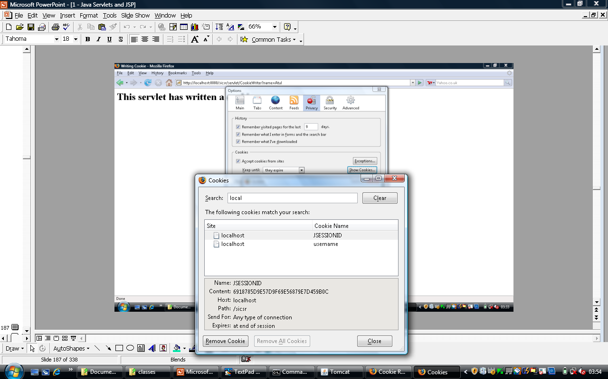
Java Servlets and JSP |

Slide 200
Reading Cookies Using a Servlet – CookieReader.java
// http://localhost:8080/sicsr/servlet/CookieReader
/* CookieReader.java */
import java.io.*;
import javax.servlet.*;
import javax.servlet.http.*;
public class CookieReader extends HttpServlet {
public void doGet (HttpServletRequest request, HttpServletResponse response)
throws ServletException, IOException {
response.setContentType("text/html");
PrintWriter out = response.getWriter();
out.println("<html>");
out.println("<head>");
out.println("<title>Cookie Reader</title>");
out.println("</head>");
out.println("<body>");
out.println ("<H1> This servlet is reading the cookies set previously </H1>");
out.println ("<P> </P>");
Cookie [] cookies = request.getCookies ();
if (cookies == null)
{
out.println ("No cookies");
}
else
{
Cookie MyCookie;
for (int i=0; i < cookies.length; i++)
{
MyCookie = cookies [i];
String name = MyCookie.getName (); // Cookie name
String value = MyCookie.getValue (); // Cookie value
int age = MyCookie.getMaxAge(); // Lifetime: -1 if cookie expires on browser closure
String domain = MyCookie.getDomain (); // Domain name
out.println ("Name = " + name + " Value = " + value + " Domain = " + domain + " Age = " + age);
out.println ("\n");
}
}
out.println ("<h2>Now reading session variables</h2>");
HttpSession session = request.getSession ();
String password = (String) session.getAttribute ("password");
out.println ("Password = " + password);
out.println("</body>");
out.println("</html>");
out.close();
}
}
Java Servlets and JSP |
Notes:
/*
* cookieReader.java
*
* Created on March 25, 2005, 5:12 PM
*/
import java.io.*;
import java.net.*;
import java.lang.*;
import javax.servlet.*;
import javax.servlet.http.*;
/**
*
* @author comp
* @version
*/
public class cookieReader extends HttpServlet {
/** Initializes the servlet.
*/
public void init(ServletConfig config) throws ServletException {
super.init(config);
}
/** Destroys the servlet.
*/
public void destroy() {
}
/** Processes requests for both HTTP <code>GET</code> and <code>POST</code> methods.
* @param request servlet request
* @param response servlet response
*/
protected void processRequest(HttpServletRequest request, HttpServletResponse response)
throws ServletException, IOException {
response.setContentType("text/html");
PrintWriter out = response.getWriter();
/* TODO output your page here */
out.println("<html>");
out.println("<head>");
out.println("<title>Cookie Reader</title>");
out.println("</head>");
out.println("<body>");
out.println ("<H1> This servlet is reading the cookie set previously </H1>");
out.println ("<P> </P>");
Cookie [] cookies = request.getCookies ();
if (cookies == null)
{
out.println ("No cookies");
}
else
{
Cookie MyCookie;
for (int i=0; i < cookies.length; i++)
{
MyCookie = cookies [i];
String name = MyCookie.getName (); // Cookie name
String value = MyCookie.getValue (); // Cookie value
int age = MyCookie.getMaxAge(); // Lifetime: -1 if cookie expires on browser closure
String domain = MyCookie.getDomain (); // Domain name
out.println (name + " " + value + " " + domain + " " + age);
}
}
out.println("</body>");
out.println("</html>");
out.close();
}
/** Handles the HTTP <code>GET</code> method.
* @param request servlet request
* @param response servlet response
*/
protected void doGet(HttpServletRequest request, HttpServletResponse response)
throws ServletException, IOException {
processRequest(request, response);
}
/** Handles the HTTP <code>POST</code> method.
* @param request servlet request
* @param response servlet response
*/
protected void doPost(HttpServletRequest request, HttpServletResponse response)
throws ServletException, IOException {
processRequest(request, response);
}
/** Returns a short description of the servlet.
*/
public String getServletInfo() {
return "Short description";
}
}

Slide 201
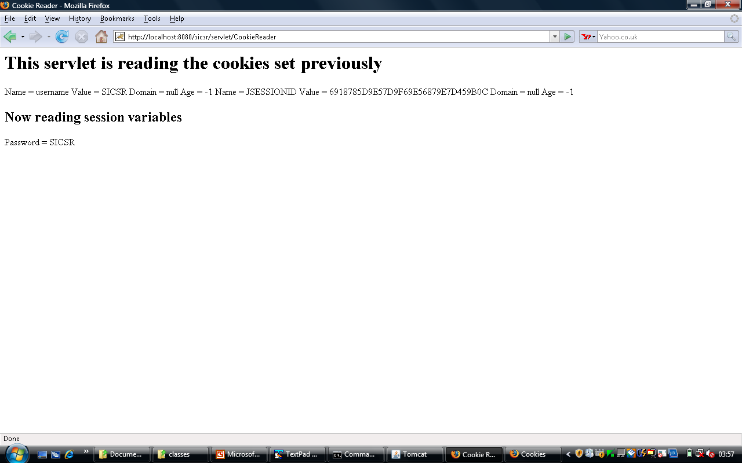
Reading a Persistent Cookie
Java Servlets and JSP |

Slide 202
Cookie Exercises

Slide 203
Tracking if the user is a first-time visitor or a repeat visitor
Write a servlet that detects if the user is visiting your site for the first time, or has visited earlier. Display a Welcome message accordingly.
Java Servlets and JSP |

Slide 204
RepeatVisitor Servlet
import java.io.*;
import javax.servlet.*;
import javax.servlet.http.*;
public class RepeatVisitor extends HttpServlet {
public void doGet (HttpServletRequest request, HttpServletResponse response)
throws ServletException, IOException {
boolean newUser = true;
Cookie [] cookies = request.getCookies ();
if (cookies != null) {
for (int i=0; i<cookies.length; i++) {
Cookie c = cookies[i];
if ((c.getName ().equals ("repeatVisitor")) && (c.getValue ().equals ("yes"))) {
newUser = false;
}
}
}
String title;
if (newUser) {
Cookie returnVisitorCookie = new Cookie ("repeatVisitor", "yes");
returnVisitorCookie.setMaxAge (60 * 60 * 24 * 365); // 1 year
response.addCookie (returnVisitorCookie);
title = "Welcome new user";
}
else {
title = "Welcome back user";
}
PrintWriter out = response.getWriter ();
out.println ("<HTML>" + "<HEAD>" + "<TITLE>" + "Hello" + "</TITLE>" + "</HEAD>\n");
out.println ("<BODY bgcolor = yellow>" + "<H1>" + title + "</H1>" + "</BODY>" + "</HTML>");
}
}
Java Servlets and JSP |

Slide 205
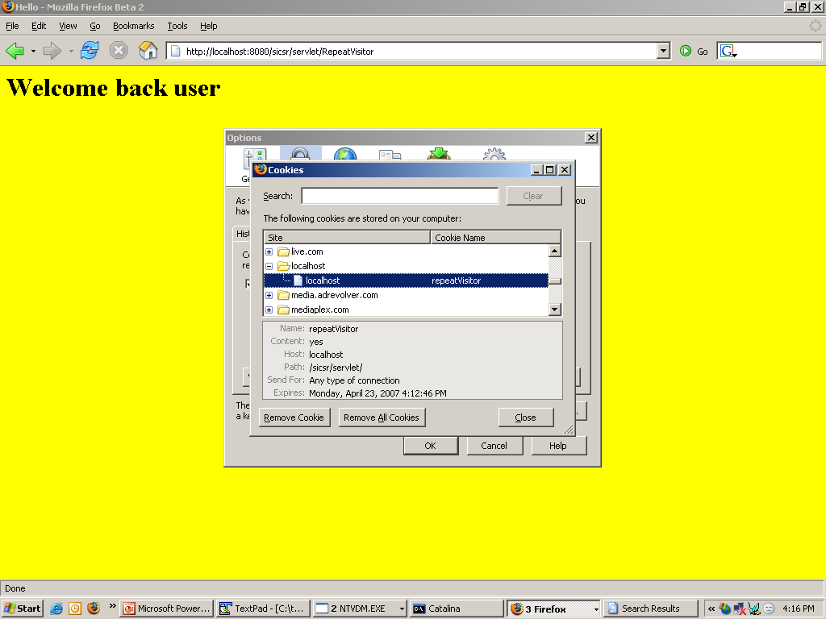
Viewing Cookies in Browser
Java Servlets and JSP |

Slide 206
Registration Forms and Cookies
Create an HTML form using the first servlet containing first name, last name, and email address.
The form sends this data to a second servlet, which checks if any of the form data is missing. It then stores the parameters inside cookies. If any parameter is missing, the second servlet redirects the user to the first servlet for redisplaying form. The first servlet should remember values entered by the user earlier by reading cookies.
Java Servlets and JSP |

Slide 207
RegistrationForm Servlet
import java.io.*;
import javax.servlet.*;
import javax.servlet.http.*;
public class RegistrationForm extends HttpServlet {
public void doGet (HttpServletRequest request, HttpServletResponse response)
throws ServletException, IOException {
PrintWriter out = response.getWriter ();
String actionURL = "RegistrationServlet";
String firstName = CookieUtilities.getCookieValue (request, "firstName", "");
String lastName = CookieUtilities.getCookieValue (request, "lastName", "");
String emailAddress = CookieUtilities.getCookieValue (request, "emailAddress", "");
System.out.println (" ");
System.out.println ("*** Inside Registration Form Servlet ***");
System.out.println ("Reading and displaying cookie values ...");
System.out.println ("Cookie firstName = " + firstName);
System.out.println ("Cookie lastName = " + lastName);
System.out.println ("Cookie emailAddress = " + emailAddress);
System.out.println ("*** Out of Registration Form Servlet ***");
System.out.println (" ");
out.println ("<HTML>" + "<HEAD>" + "<TITLE>" + "Please register" + "</TITLE>" + "</HEAD>\n");
out.println ("<BODY bgcolor = yellow>" + "<H1>" + "Please register" + "</H1>");
out.println ("<FORM ACTION = \"" + actionURL + "\">\n" +
"First Name: \n" +
" <INPUT TYPE=\"TEXT\" NAME=\"firstName\" " +
"VALUE=\"" + firstName + "\"><BR>\n" +
"Last Name: \n" +
" <INPUT TYPE=\"TEXT\" NAME=\"lastName\" " +
"VALUE=\"" + lastName + "\"><BR>\n" +
"Email Address: \n" +
" <INPUT TYPE=\"TEXT\" NAME=\"emailAddress\" " +
"VALUE=\"" + emailAddress + "\"><P>\n");
out.println ("<INPUT TYPE=\"SUBMIT\" VALUE=\"Register\">\n");
out.println ("</FORM>" + "</BODY>" + "</HTML>");
}
}
Java Servlets and JSP |

Slide 208
RegistrationServlet
import java.io.*;
import javax.servlet.*;
import javax.servlet.http.*;
public class RegistrationServlet extends HttpServlet {
public void doGet (HttpServletRequest request, HttpServletResponse response)
throws ServletException, IOException {
boolean isMissingValue = false;
String firstName = request.getParameter ("firstName");
if (isMissing (firstName)) {
firstName = "Missing first name";
isMissingValue = true;
}
System.out.println (" ");
System.out.println ("//// Inside RegistrationServlet ////");
System.out.println ("First name: " + firstName);
String lastName = request.getParameter ("lastName");
if (isMissing (lastName)) {
lastName = "Missing last name";
isMissingValue = true;
}
System.out.println ("Last name: " + lastName);
String emailAddress = request.getParameter ("emailAddress");
if (isMissing (emailAddress)) {
emailAddress = "Missing email address";
isMissingValue = true;
}
System.out.println ("Email address: " + emailAddress);
Cookie c1 = new Cookie ("firstName", firstName);
c1.setMaxAge (3600); // one hour
response.addCookie (c1);
Cookie c2 = new Cookie ("lastName", lastName);
c2.setMaxAge (3600); // one hour
response.addCookie (c2);
Cookie c3 = new Cookie ("emailAddress", emailAddress);
c3.setMaxAge (3600); // one hour
response.addCookie (c3);
String formAddress = "RegistrationForm";
if (isMissingValue) {
System.out.println ("Incomplete form data");
response.sendRedirect (formAddress);
}
else {
System.out.println ("Form is complete");
PrintWriter out = response.getWriter ();
String title = "Thanks for registering";
out.println ("<HTML>" + "<HEAD>" + "<TITLE>" + title + "</TITLE>" + "</HEAD>\n");
out.println ("<BODY> <UL>\n");
out.println ("<LI><B>First Name</B> : " + firstName + "\n");
out.println ("<LI><B>Last Name</B> : " + lastName + "\n");
out.println ("<LI><B>Email Address</B>: " + emailAddress+ "\n");
out.println ("</UL> </BODY> </HTML>");
}
}
private boolean isMissing (String param) {
return ((param == null) || (param.trim ().equals ("")));
}
}
Java Servlets and JSP |

Slide 209
CookieUtilities Java Class
import javax.servlet.*;
import javax.servlet.http.*;
public class CookieUtilities {
public static String getCookieValue (HttpServletRequest request,
String cookieName,
String defaultValue) {
Cookie [] cookies = request.getCookies ();
System.out.println ("=== Inside CookieUtilities.java ===");
System.out.println ("Cookie name: " + cookieName);
System.out.println ("Cookie value: " + defaultValue);
System.out.println ("* * * *");
if (cookies != null) {
for (int i=0; i<cookies.length; i++) {
Cookie c = cookies[i];
if (cookieName.equals (c.getName ())) {
return (c.getValue ());
}
}
}
return defaultValue;
}
}
Java Servlets and JSP |

Slide 210
Cookie Enabling and Sessions

Slide 211
What if Cookies are Disabled?
Session ID from the server is passed to the browser in the form of a cookie
If the user has disabled cookies, how would this work?
  It would create problems
  Session management would fail
Solution: Use the encodeURL approach, as shown next
Java Servlets and JSP |

Slide 212
Servlet 1
/*
* To change this template, choose Tools | Templates
* and open the template in the editor.
*/
package com.iflex;
import java.io.*;
import java.net.*;
import javax.servlet.*;
import javax.servlet.http.*;
/**
*
* @author atulk
*/
public class NewServlet extends HttpServlet {
protected void doGet(HttpServletRequest request, HttpServletResponse response)
throws ServletException, IOException {
response.setContentType("text/html;charset=UTF-8");
PrintWriter out = response.getWriter();
try {
HttpSession session = request.getSession(true);
session.setAttribute("name", "atul");
// String userName = (String) session.getAttribute("name");
// System.out.println(userName);
out.println("Hello world");
out.println ("<a href =");
out.print (response.encodeURL("SecondServlet"));
out.print (">Click here");
} catch (Exception e) {
e.printStackTrace();
}
}
}
Java Servlets and JSP |

Slide 213
Servlet 2
/*
* To change this template, choose Tools | Templates
* and open the template in the editor.
*/
package com.iflex;
import java.io.*;
import java.net.*;
import javax.servlet.*;
import javax.servlet.http.*;
/**
*
* @author atulk
*/
public class SecondServlet extends HttpServlet {
protected void doGet(HttpServletRequest request, HttpServletResponse response)
throws ServletException, IOException {
response.setContentType("text/html;charset=UTF-8");
PrintWriter out = response.getWriter();
try {
HttpSession session = request.getSession(true);
// session.setAttribute("name", "atul");
String userName = (String) session.getAttribute("name");
System.out.println(userName);
out.println("Hello world");
out.println ("hello" + userName);
out.println ("<a href = \"NewServlet\">Click here");
} catch (Exception e) {
e.printStackTrace();
}
}
}
Java Servlets and JSP |

Slide 214
Note
When the first servlet passes control to the second servlet, it encodes the URL, so that the session ID is passed to the second servlet via the encoded URL, even if the cookies are disabled in the browser
If we do not use encodeURL, session management would fail!
Java Servlets and JSP |

Slide 215
JSTL (JSP Standard Template Library)

Slide 216
What is JSTL?
Originally stand-alone, now almost a part of Web applications
Allows code development using tags, instead of scriptlets
Need: Reduces cluttering of scriptlet code with HTML
See next slide
Java Servlets and JSP |

Slide 217
Easy.jsp
<%@ taglib uri="http://java.sun.com/jstl/core" prefix="c" %>
<!– Try this if it does not work: <%@ taglib uri="http://java.sun.com/jsp/jstl/core" prefix="c" %>
→
<html>
<body>
<h1>JSP is as easy as ...</h1>
<%-- Calculate the sum of 1, 2, and 3 dynamically --%>
1 + 2 + 3 = <c:out value="${1 + 2 + 3}" />
</body>
</html>
Java Servlets and JSP |

Slide 218
Needs for Using JSTL
Download JSTL from http://jakarta.apache.org/taglibs/
Java Servlets and JSP |

Slide 219
Setting up JSTL in NetBeans
Using the Libraries -> Add Library menu option, add the above JARs to your project
Example (Next Slide)
Java Servlets and JSP |

Slide 220
JSP Code
<html>
<head>
<title>JSP Example with JavaBean </title>
</head>
<body>
<jsp:useBean id="stringBean" scope="page" class="test.StringBean" />
Initial value (getProperty): <jsp:getProperty name="stringBean" property="message" />
Initial value (JSP Expression): <%= stringBean.getMessage () %>
<jsp:setProperty name = "stringBean" property = "message" value = "New bean value" />
Value after setting property with setProperty:
<jsp:getProperty name = "stringBean" property = "message" />
<% stringBean.setMessage ("Modified value again!"); %>
Value after setting property with scriptlet: <%= stringBean.getMessage () %>
</body>
</html>
Java Servlets and JSP |

Slide 221
Jstl-example-1.jsp (In NetBeans)
<%@ taglib uri="http://java.sun.com/jstl/core" prefix="c" %>
<%@ taglib uri="http://java.sun.com/jstl/fmt" prefix="fmt" %>
<html>
<head>
<title>Temperature Conversion</title>
<style>
body, td, th {
font-family: Tahoma, Sans-Serif;
font-size: 10pt;
}
h1 { font-size: 140%; }
h2 { font-size: 120%; }
</style>
</head>
<body>
<center>
<h1>Temperature Conversion</h1>
<h2><i>Using JSTL</i></h2>
<table border="1" cellpadding="3" cellspacing="0">
<tr>
<th align="right" width="100">Fahrenheit</th>
<th align="right" width="100">Celcius</th>
</tr>
<c:forEach var="f" begin="32" end="212" step="20">
<tr>
<td align="right"> ${f} </td>
<td align="right">
<fmt:formatNumber pattern="##0.000">
${(f - 32) * 5 / 9.0}
</fmt:formatNumber>
</td>
</tr>
</c:forEach>
</table>
</center>
</body>
</html>
Java Servlets and JSP |

Slide 222
Setting up JSTL in Tomcat - 1
Copy JSTL JAR files into Tomcat’s lib directory
  Copy all JAR files of JSTL zip file into c:\tomcat\webapps\ROOT\WEB-INF\lib
Copy JSTL TLD files into Tomcat’s WEB-INF directory
  Copy files with .TLD extension from the JSTL zip file into c:\tomcat\webapps\ROOT\WEB-INF
Modify the web.xml file in c:\tomcat\webapps\ROOT\WEB-INF to add entries as shown on next slide
Java Servlets and JSP |

Slide 223
Setting up JSTL in Tomcat - 2
<taglib>
<taglib-uri>http://java.sun.com/jstl/fmt</taglib-uri>
<taglib-location>/WEB-INF/fmt.tld</taglib-location>
</taglib>
<taglib>
<taglib-uri>http://java.sun.com/jstl/fmt-rt</taglib-uri>
<taglib-location>/WEB-INF/fmt-rt.tld</taglib-location>
</taglib>
<taglib>
<taglib-uri>http://java.sun.com/jstl/core</taglib-uri>
<taglib-location>/WEB-INF/c.tld</taglib-location>
</taglib>
<taglib>
<taglib-uri>http://java.sun.com/jstl/core-rt</taglib-uri>
<taglib-location>/WEB-INF/c-rt.tld</taglib-location>
</taglib>
<taglib>
<taglib-uri>http://java.sun.com/jstl/sql</taglib-uri>
<taglib-location>/WEB-INF/sql.tld</taglib-location>
</taglib>
<taglib>
<taglib-uri>http://java.sun.com/jstl/sql-rt</taglib-uri>
<taglib-location>/WEB-INF/sql.tld</taglib-location>
</taglib>
<taglib>
<taglib-uri>http://java.sun.com/jstl/x</taglib-uri>
<taglib-location>/WEB-INF/x.tld</taglib-location>
</taglib>
<taglib>
<taglib-uri>http://java.sun.com/jstl/x-rt</taglib-uri>
<taglib-location>/WEB-INF/x-rt.tld</taglib-location>
</taglib>
Java Servlets and JSP |

Slide 224
Testing JSTL in Tomcat
Code our earlier JSP (Count.jsp) and save it in c:\tomcat\webapps\examples
Try http://localhost:8080/examples/Count.jsp in the browser
Java Servlets and JSP |

Slide 225
More on Actions
An action is represented by an HTML-like element in a JSP page
If the action element has a body, it is represented by an opening tag, followed by the attribute/value pairs, followed by the closing tag:
  <prefix:action_name attr1 = “value1” attr2 = “value2” …>
  action_body
  </prefix:action_name>
  OR
  <prefix:action_name attr1 = “value1” attr2 = “value2” … />
Java Servlets and JSP |

Slide 226
Actions and Tag Libraries
Actions are grouped into libraries, called as tag libraries
E.g.
  <%@ taglib prefix=“c” uri=“http://java.sun.com/jsp/jstl/core” %>
  …
  <c:out value=“${1 + 2 + 3}” />
  …
Java Servlets and JSP |

Slide 227
Standard Actions
Some actions are standard, meaning that the JSP specification itself has defined them
They have the jsp: prefix
Java Servlets and JSP |

Slide 228
Standard Actions Elements
Action element
Description
<jsp:useBean>
Makes a JavaBean component available in a page
<jsp:getProperty>
Gets a property value from a JavaBean component and adds it to the response
<jsp:setProperty>
Sets a JavaBean property
<jsp:include>
Includes the response from a servlet/JSP
<jsp:forward>
Forwards the processing of a request to a servlet/JSP
<jsp:param>
Adds a parameter value to a request handed off to another servlet/JSP
<jsp:element>
Dynamically generates an XML element
<jsp:attribute>
Adds an attribute to a dynamically generated XML element
<jsp:body>
Adds body to an XML element
<jsp:text>
Used when JSP pages are written as XML documents
Java Servlets and JSP |

Slide 229
Custom Tags/Actions
In addition to the basic JSP actions set, we can also define our own actions
Called as custom tags or custom actions
Java Servlets and JSP |

Slide 230
JSP Expression Language (EL)
Expression Language (EL) is used for setting action attribute values based on runtime data from various sources
An EL expression always starts with ${ and ends with }
Examples (to produce the same result)
  <c:out value=“${1 + 2 + 3}” /> OR
  <1 + 2 + 3 = ${1 + 2 + 3}
Java Servlets and JSP |

Slide 231
EL Operators
Operator
Purpose
.
Access a bean property or Map entry
[]
Access an array or list element
( )
Group a sub-expression to change the evaluation order
? :
Conditional operator
+ - / * %
Mathematical operators
< > <= >= != == (Or lt gt ge eq, …)
Relational operators
&& || ! (or and or not)
Logical operators
Java Servlets and JSP |

Slide 232
Implicit EL Variables
Variable name
Purpose
pageScope
Collection (a map) of all page scope variables
requestScope
Collection (a map) of all request scope variables
sessionScope
Collection (a map) of all session scope variables
applicationScope
Collection (a map) of all application scope variables
param
Collection (a map) of all request parameter values as a String array per parameter
header
Collection (a map) of all request header values as a String value per header
headerValues
Collection (a map) of all request header values as a String array per header
cookie
Collection (a map) of all request cookie values as a single Cookie value per cookie
pageContext
An instance of pageContext class, providing access to various request data
Java Servlets and JSP |

Slide 233
Displaying First 10 Numbers – Scriptlet Version
<html>
<head>
<title>Count Example</title>
</head>
<body>
<%
for (int i=1; i<=10; i++) {
%>
<%= i %>
<br/>
<%
}
%>
</body>
</html>
Java Servlets and JSP |

Slide 234
Displaying First 10 Numbers – JSTL Version
<%@ taglib uri="http://java.sun.com/jstl/core" prefix="c" %>
<html>
<head>
<title>Count Example</title>
</head>
<body>
<c:forEach var="i" begin="1" end="10" step="1">
<c:out value="${i}" />
<br/>
</c:forEach>
</body>
</html>
Java Servlets and JSP |

Slide 235
Accessing Session Variables Using JSTL
http://localhost:8080/examples/SessionCounterUsingJSTL.jsp
<%@ page contentType="text/html" %>
<%@ taglib uri="http://java.sun.com/jstl/core" prefix="c" %>
<html>
<head>
<title>Counter Page</title>
</head>
<body bgcolor="white">
<%-- Increment counter --%>
<c:set var="sessionCounter" scope="session" value="${sessionCounter+1}" />
<h1>Counter Page</h1>
This page has been visited <b><c:out value="${sessionCounter}"/></b> times within the current session.
</body>
</html>
Java Servlets and JSP |

Slide 236
MyClock.jsp
<%@ taglib uri="http://java.sun.com/jstl/core" prefix="c" %>
<html>
<body bgcolor="white">
<jsp:useBean id="clock" class="java.util.Date" />
<c:choose>
<c:when test="${clock.hours < 12}">
<h1>Good morning!</h1>
</c:when>
<c:when test="${clock.hours < 18}">
<h1>Good day!</h1>
</c:when>
<c:otherwise>
<h1>Good evening!</h1>
</c:otherwise>
</c:choose>
Welcome to our site, open 24 hours of the day!
</body>
</html>
Java Servlets and JSP |

Slide 237
Another JSTL Example – 1
jstlapp.jsp
<%@ taglib prefix = "c" uri = "http://java.sun.com/jstl/core_rt" %>
<%
String names [] = {"One", "Two", "Three"};
request.setAttribute ("usernames", names);
%>
<html>
<head>
<title>Using JSTL</title>
<link rel = "stylesheet" type = "text/css" href = "mystyle.css">
</head>
<body>
<c:set var = "message" value = "Welcome to JSTL" scope = "session" />
<h2><c:out value = "${message}" /></h2>
<form action = "jstlmain.jsp" method = "post">
<table>
<tr>
<td colspan = "2" align = "center">
<h4>User Detail</h4>
</td>
</tr>
<tr>
<td>Enter your Name</td>
<td>
<input type = "text" name = "name">
</td>
</tr>
<tr>
<td>Enter your City</td>
<td>
<input type = "text" name = "city">
</td>
</tr>
<tr>
<td>Type</td>
<td>
<select name= "type">
<option>Manager</option>
<option>Clerk</option>
</select>
</td>
</tr>
<tr>
<td colspan = "2">
<input type = "submit" value = "Submit">
</td>
</tr>
</table>
</form>
<br /> <br />
Iterating over the array ...
<br />
User Names:
<c:forEach var = "name" items = "${usernames}">
<c:out value = "${name}" />,
</c:forEach>
</body>
</html>
Java Servlets and JSP |

Slide 238
Another JSTL Example – 2
jstlmain.jsp
<%@ page import = "java.util.*" %>
<%@ taglib prefix="c" uri = "http://java.sun.com/jstl/core_rt" %>
<html>
<head>
<title>JSTL Example</title>
<link rel = "stylesheet" type = "text/css" href = "mystyle.css">
</head>
<body>
<h2>
<c:out value = "${message}" />
</h2>
<c:set var = "yourType" value = "${param.type}" />
<c:if test = "${yourType eq 'Manager'}">
<c:import url = "menu.jsp">
<c:param name = "option1" value = "Create user" />
<c:param name = "option2" value = "Delete user" />
</c:import>
</c:if>
<c:if test = "${yourType eq 'Clerk'}">
<c:import url = "menu.jsp">
<c:param name = "option1" value = "Reports" />
<c:param name = "option2" value = "Transactions" />
</c:import>
</c:if>
Hello <b><c:out value = "${param.name}" />!</b>
<br /> <br />
You are using this application as <b><c:out value = "${param.type}" /></b>
<c:set var = "city" value = "${param.city}" />
<br /> <br />
Your city is <b><c:out value = "${city}" /></b>
<br /> <br />
<c:choose>
<c:when test = "${city eq 'Delhi'}">
You are from <b>India</b>.
</c:when>
<c:when test = "${city eq 'London'}">
You are from <b>UK</b>.
</c:when>
<c:when test = "${city eq 'Paris'}">
You are from <b>France</b>.
</c:when>
<c:when test = "${city eq ''}">
You have left the city field blank.
</c:when>
<c:otherwise>
I do not know your country.
</c:otherwise>
</c:choose>
<c:url value = "jstlapp.jsp" var = "backurl" />
<br /> <br />
<a href = "${backurl}">Back</a>
</body>
</html>
Java Servlets and JSP |

Slide 239
Another JSTL Example – 3
menu.jsp
<hr>
<table align="center" width = "300" cellspacing="3">
<tr align="center" bgcolor = "#fee9c2" height = "20">
<td>${param.option1}</td>
<td>${param.option2}</td>
</tr>
</table>
<hr>
Java Servlets and JSP |

Slide 240
JSTL Types
core: General tags that allow us to set-get variables, loop, etc
xml: Tags to process XML files
sql: Database access and manipulations
fmt: For formatting numbers, text, etc
Java Servlets and JSP |

Slide 241
Form Processing Using JSTL

Slide 242
Traditional HTML
<html>
<head>
<title>User Info Entry Form</title>
</head>
<body bgcolor="white">
<form action="process.jsp" method="post">
<table>
<tr>
<td>Name:</td>
<td>
<input type="text" name="userName">
</td>
</tr>
<tr>
<td>Birth Date:</td>
<td>
<input ty=e"text" name="birthDate">
</td>
<td>(Use format yyyy-mm-dd)</td>
</tr>
<tr>
<td>Email Address:</td>
<td>
<input type="text" name="emailAddr">
</td>
<td>(Use format name@company.com)</td>
</tr>
<tr>
<td>Gender:</td>
<td>
<input type="radio" name="gender" value="m" checked>Male<br />
<input type="radio" name="gender" value="f">Female<br />
</td>
</tr>
<tr>
<td>Lucky number:</td>
<td>
<input type="text" name="luckyNumber">
</td>
<td>(A number between 1 and 100)</td>
</tr>
<tr>
<td>Favourite foods:</td>
<td>
<input type="checkbox" name="food" value="m">Maharashtrian<br />
<input type="checkbox" name="food" value="s">South Indian<br />
<input type="checkbox" name="food" value="n">North Indian<br />
</td>
</tr>
<tr>
<td colspan=2>
<input type="submit" value="Send data">
</td>
</tr>
</table>
</body>
</html>
Java Servlets and JSP |

Slide 243
Process.jsp
Kept as exercise
Java Servlets and JSP |

Slide 244
Now using JSTL (input_jstl.jsp)
<%@ page contentType="text/html" %>
<%@ taglib prefix="c" uri="http://java.sun.com/jstl/core" %>
<html>
<head>
<title>User Info Entry Form</title>
</head>
<body bgcolor="white">
<form action="input_jstl.jsp" method="post">
<table>
<tr>
<td>Name:</td>
<td>
<input type="text" name="userName">
</td>
</tr>
<tr>
<td>Birth Date:</td>
<td>
<input type"text" name="birthDate">
</td>
<td>(Use format yyyy-mm-dd)</td>
</tr>
<tr>
<td>Email Address:</td>
<td>
<input type="text" name="emailAddr">
</td>
<td>(Use format name@company.com)</td>
</tr>
<tr>
<td>Gender:</td>
<td>
<input type="radio" name="gender" value="m" checked>Male<br />
<input type="radio" name="gender" value="f">Female<br />
</td>
</tr>
<tr>
<td>Lucky number:</td>
<td>
<input type="text" name="luckyNumber">
</td>
<td>(A number between 1 and 100)</td>
</tr>
<tr>
<td>Favourite foods:</td>
<td>
<input type="checkbox" name="food" value="m">Maharashtrian<br />
<input type="checkbox" name="food" value="s">South Indian<br />
<input type="checkbox" name="food" value="n">North Indian<br />
</td>
</tr>
<tr>
<td colspan=2>
<input type="submit" value="Send data">
</td>
</tr>
</table>
</form>
You entered:<br>
Name: <c:out value="${param.userName}" /><br>
Birth Date: <c:out value="${param.birthDate}" /><br>
Email Address: <c:out value="${param.emailAddr}" /><br>
Gender: <c:out value="${param.gender}" /><br>
Lucky Number: <c:out value="${param.luckyNumber}" /><br>
Favourite food:
<c:forEach items="${paramValues.food}" var="current">
<c:out value="${current}" />&nbsp;
</c:forEach>
</body>
</html>
Java Servlets and JSP |

Slide 245
JavaBeans

Slide 246
JavaBeans Technology
A JavaBean is a plain Java class, which has a number of attributes (data members) and a get-set method for each of them
It can be used for any kinds of requirements, but is most suitable in forms processing
Allows ease of coding, instead of writing scriptlets in JSPs
Java Servlets and JSP |

Slide 247
JavaBeans Syntax
The jsp:setProperty standard action has a built-in method for automatically mapping the values submitted in a form to a JavaBean’s fields/variables
Names of the submitted parameters need to be the same as in the Javabean’s setter methods
Java Servlets and JSP |

Slide 248
JavaBeans Example
Accept user’s name, department, and email ID from the user.
First, process the form values using the traditional method of request.getParameter
Use JSTL to do the same
Use a JavaBean to store and display them back
Use a combination of JavaBean and JSTL for doing the same
Java Servlets and JSP |

Slide 249
Using JavaScript to Validate Form Values in a JSP

Slide 250
JSPJavaScript.jsp
<%@ taglib uri="http://java.sun.com/jstl/core" prefix="c" %>
<html>
<head>
<c:import url="/WEB-INF/javascript/validate.js" />
<title>Help Page</title>
<body>
<h2>Please submit your information</h2>
<form action="JSPJavaScript.jsp" onSubmit=" return validate(this) ">
<table>
<tr>
<td>Your name:</td>
<td><input type="text" name="username" size="20"></td>
</tr>
<tr>
<td>Your email:</td>
<td><input type="text" name="email" size="20"></td>
</tr>
<tr>
<td><input type="submit" value="Submit form"></td>
</tr>
</table>
</body>
</html>
Java Servlets and JSP |

Slide 251
Validate.js
<script language="JavaScript">
function validate (form1)
{
for (i=0; i<form1.length; i++)
{
if ((form1.elements[i].value == ""))
{
alert ("You must provide a value for the field named: " + form1.elements[i].name);
return false;
}
}
return true;
}
</script>
Java Servlets and JSP |

Slide 252
Server-side Form Processing: Validating Form using the Traditional Method

Slide 253
GetData.html
<html>
<body>
<form method=POST action="/examples/servlet/ProcessFormServlet">
<b>User Name: </b>
<input type = "text" name = "username" size = "20"> <br><br>
<b>Department: </b>
<input type = "text" name = "department" size = "15"> <br><br>
<b>Email: </b>
<input type = "text" name = "email" size = "20"> <br><br>
<input type = "submit" value = "Submit">
</form>
</body>
</html>
Java Servlets and JSP |

Slide 254
ProcessFormServlet.java
import javax.servlet.*;
import javax.servlet.http.*;
public class ProcessFormServlet extends HttpServlet {
public void doPost (HttpServletRequest request, HttpServletResponse response)
throws ServletException, java.io.IOException {
String uname = request.getParameter ("username");
String udepartment = request.getParameter ("department");
String uemail = request.getParameter ("email");
response.setContentType ("text/html");
java.io.PrintWriter out = response.getWriter ();
out.println ("<html>");
out.println ("<head>");
out.println ("<title>Welcome</title>");
out.println ("</head>");
out.println ("<body>");
out.println ("<h1>Your identity</h1>");
out.println ("Your name is: " +
( (uname == null || uname.equals ("")) ? "Unknown" : uname));
out.println ("<br /><br />");
out.println ("Your department is: " +
( (udepartment== null || udepartment.equals ("")) ? "Unknown" : udepartment));
out.println ("<br /><br />");
out.println ("Your email is: " +
( (uemail == null || uemail.equals ("")) ? "Unknown" : uemail));
out.println ("<br /><br />");
out.println ("</body>");
out.println ("</html>");
out.close ();
}
}
Java Servlets and JSP |

Slide 255
Same Example, Further Modified to use JSTL

Slide 256
GetData.html
<html>
<body>
<form method=POST action="ProcessFormJSP.jsp">
<b>User Name: </b>
<input type = "text" name = "username" size = "20"> <br><br>
<b>Department: </b>
<input type = "text" name = "department" size = "15"> <br><br>
<b>Email: </b>
<input type = "text" name = "email" size = "20"> <br><br>
<input type = "submit" value = "Submit">
</form>
</body>
</html>
Java Servlets and JSP |

Slide 257
ProcessFormJSP.jsp
<%@page contentType="text/html" %>
<%@ taglib uri="http://java.sun.com/jstl/core" prefix="c" %>
<html>
<head>
<title>Post Data Viewer</title>
</head>
<body>
<h2>Here is your posted data</h2>
<strong>User name</strong>
<c:out value ="${param.username}" />
<br /><br />
<strong>Department</strong>
<c:out value ="${param.department}" />
<br /><br />
<strong>Email</strong>
<c:out value ="${param.email}" />
</body>
</html>
Java Servlets and JSP |

Slide 258
Same Example Using a JavaBean

Slide 259
GetData.html
<html>
<body>
<form method=POST action="SetBean.jsp">
<b>User Name: </b>
<input type = "text" name = "username" size = "20"> <br><br>
<b>Department: </b>
<input type = "text" name = "department" size = "15"> <br><br>
<b>Email: </b>
<input type = "text" name = "email" size = "20"> <br><br>
<input type = "submit" value = "Submit">
</form>
</body>
</html>
Java Servlets and JSP |

Slide 260
SetBean.jsp
<jsp:useBean id="userBean" class="com.jspcr.UserBean">
<jsp:setProperty name="userBean" property="*" />
</jsp:useBean>
<html>
<head>
<title>Post Data Viewer</title>
</head>
<body>
<h2>Here is your posted data</h2>
<strong>User name</strong>
<jsp:getProperty name="userBean" property="username" />
<br /><br />
<strong>Department</strong>
<jsp:getProperty name="userBean" property="department" />
<br /><br />
<strong>Email</strong>
<jsp:getProperty name="userBean" property="email" />
</body>
</html>
Java Servlets and JSP |

Slide 261
UserBean.java
package com.jspcr;
public class UserBean implements java.io.Serializable {
String username;
String department;
String email;
public UserBean () {}
public void setusername (String uname) {
if (uname != null && uname.length() > 0) {
username = uname;
}
else {
username = "Unknown";
}
}
public String getusername () {
if (username != null) {
return username;
}
else {
return "Unknown";
}
}
public void setdepartment(String udepartment) {
if (udepartment != null && udepartment.length() > 0) {
department = udepartment;
}
else {
department = "Unknown";
}
}
public String getdepartment () {
if (department != null) {
return department;
}
else {
return "Unknown";
}
}
public void setemail (String uemail) {
if (uemail != null && uemail.length() > 0) {
email = uemail;
}
else {
uemail = "Unknown";
}
}
public String getemail () {
if (email != null) {
return email;
}
else {
return "Unknown";
}
}
}
Java Servlets and JSP |

Slide 262
Same Example Using a JavaBean and JSTL

Slide 263
GetData.html
<html>
<body>
<form method=POST action="ProcessFormJSTLJavaBean.jsp">
<b>User Name: </b>
<input type = "text" name = "username" size = "20"> <br><br>
<b>Department: </b>
<input type = "text" name = "department" size = "15"> <br><br>
<b>Email: </b>
<input type = "text" name = "email" size = "20"> <br><br>
<input type = "submit" value = "Submit">
</form>
</body>
</html>
Java Servlets and JSP |

Slide 264
ProcessFormJSTLJavaBean.jsp
<%@page contentType="text/html" %>
<%@ taglib uri="http://java.sun.com/jstl/core" prefix="c" %>
<jsp:useBean id="userBean" class="com.jspcr.UserBean">
<jsp:setProperty name="userBean" property="*" />
</jsp:useBean>
<html>
<head>
<title>Post Data Viewer</title>
</head>
<body>
<h2>Here is your posted data</h2>
<strong>User name</strong>
<c:out value ="${userBean.username}" />
<br /><br />
<strong>Department</strong>
<c:out value ="${userBean.department}" />
<br /><br />
<strong>Email</strong>
<c:out value ="${userBean.email}" />
</body>
</html>
Java Servlets and JSP |

Slide 265
UserBean.java
package com.jspcr;
public class UserBean implements java.io.Serializable {
String username;
String department;
String email;
public UserBean () {}
public void setusername (String uname) {
if (uname != null && uname.length() > 0) {
username = uname;
}
else {
username = "Unknown";
}
}
public String getusername () {
if (username != null) {
return username;
}
else {
return "Unknown";
}
}
public void setdepartment(String udepartment) {
if (udepartment != null && udepartment.length() > 0) {
department = udepartment;
}
else {
department = "Unknown";
}
}
public String getdepartment () {
if (department != null) {
return department;
}
else {
return "Unknown";
}
}
public void setemail (String uemail) {
if (uemail != null && uemail.length() > 0) {
email = uemail;
}
else {
uemail = "Unknown";
}
}
public String getemail () {
if (email != null) {
return email;
}
else {
return "Unknown";
}
}
}
Java Servlets and JSP |

Slide 266
Case Study: Other Syntaxes for JavaBeans

Slide 267
JavaBean Code
package test;
public class StringBean {
private String message = "No message specified";
public String getMessage () {
return message;
}
public void setMessage (String msg) {
message = msg;
}
}
Java Servlets and JSP |

Slide 268
StringBeanJSP.jsp
<html>
<head>
<title>JSP Example with JavaBean </title>
</head>
<body>
<jsp:useBean id="stringBean" scope="page" class="test.StringBean" />
Initial value (getProperty): <jsp:getProperty name="stringBean" property="message" />
Initial value (JSP Expression): <%= stringBean.getMessage () %>
<jsp:setProperty name = "stringBean" property = "message" value = "New bean value" />
Value after setting property with setProperty:
<jsp:getProperty name = "stringBean" property = "message" />
<% stringBean.setMessage ("Modified value again!"); %>
Value after setting property with scriptlet: <%= stringBean.getMessage () %>
</body>
</html>
Java Servlets and JSP |

Slide 269
Case Study

Slide 270
Requirement
Have an HTML form that accepts name, email, and age of the user. Have this stored inside a JavaBean via a JSP page. Display the same values in the next JSP, demonstrating that the JavaBean get and set methods work as expected.
Java Servlets and JSP |

Slide 271
GetName.html
<HTML>
<BODY>
<FORM METHOD=POST ACTION="SaveName.jsp">
What's your name? <INPUT TYPE=TEXT NAME=username SIZE=20><BR>
What's your e-mail address? <INPUT TYPE=TEXT NAME=email SIZE=20><BR>
What's your age? <INPUT TYPE=TEXT NAME=age SIZE=4>
<P><INPUT TYPE=SUBMIT>
</FORM>
</BODY>
</HTML>
Java Servlets and JSP |

Slide 272
UserData.java
public class UserData {
String username;
String email;
int age;
public void setUsername( String value )
{
username = value;
}
public void setEmail( String value )
{
email = value;
}
public void setAge( int value )
{
age = value;
}
public String getUsername() { return username; }
public String getEmail() { return email; }
public int getAge() { return age; }
}
Java Servlets and JSP |

Slide 273
SaveName.jsp
<jsp:useBean id="user" class="user.UserData" scope="session"/>
<jsp:setProperty name="user" property="*"/>
<HTML>
<BODY>
<A HREF="NextPage.jsp">Continue</A>
</BODY>
</HTML>
Java Servlets and JSP |

Slide 274
NextPage.jsp
<jsp:useBean id="user" class="user.UserData" scope="session"/>
<HTML>
<BODY>
You entered<BR>
Name: <%= user.getUsername() %><BR>
Email: <%= user.getEmail() %><BR>
Age: <%= user.getAge() %><BR>
</BODY>
</HTML>
Java Servlets and JSP |

Slide 275
Custom Tags

Slide 276
Introduction
Custom tags (also called tag extensions) are user-developed XML-like additions to the basic JSP page
Collections of tags are organized into libraries that can be packaged as JAR files
Just as we can use the standard tags using <jsp:getProperty> or <jsp:useBean>, we can now use our own custom tags
Java Servlets and JSP |

Slide 277
Advantages
Separation of content and presentation by allowing short-hand code instead of scriptlets
Simplicity: Easy to code and understand
Allows for code reuse
Java Servlets and JSP |

Slide 278
Developing Custom Tags
Four steps
Define the tag
Write the entry in the Tag Library Descriptor (TLD)
Write the tag handler
Use the tag in a JSP page
Java Servlets and JSP |

Slide 279
TLD Basics
JSP page
TLD file
<% taglib prefix = “diag”
uri = “http://www.jspcr.com/… %>
…
…
The Web server is: <diag:getWebServer />
…
…
<taglib>
… <short-name>diag</short-name>
<tag>
<name>getWebServer</name>
<… >com.jspcr..GetWebServerTag<…>
</tag>
…
GetWebServer
class
Java Servlets and JSP |

Slide 280
Step 1: Define the Tag
What is the name of the tag?
  Used with namespace qualifier, so always globally unique
What attributes does it have?
  Required or optional, used to enhance the usefulness of the tag
Will the tag define scripting elements?
Does the tag do anything with the body between its start and end?
Let us name our tag getWebServer, having no attributes, no scripting variables, and simply returns the name of the Web server
Java Servlets and JSP |

Slide 281
Step 2: Create the TLD Entry
A Tag Library Directive (TLD) is an XML document that defines the names and attributes of a collection of related tags
Java Servlets and JSP |

Slide 282
Our TLD (C:\tomcat\webapps\examples\WEB-INF\tlds\diagnostics.tld)
<?xml version="1.0"?>
<!DOCTYPE taglib PUBLIC "-//Sun Microsystems, Inc.//DTD JSP Tag Library 1.2//EN"
"http://java.sun.com/dtd/web-jsptaglibrary_1_2.dtd">
<taglib xlmns="http://java.sun.com/JSP/TagLibraryDescriptor">
<tlib-version>1.0</tlib-version>
<jsp-version>1.2</jsp-version>
<short-name>diag</short-name>
<tag>
<name>getWebServer</name>
<tag-class>
com.jspcr.taglibs.diag.GetWebServerTag
</tag-class>
<body-content>empty</body-content>
</tag>
</taglib>
Java Servlets and JSP |

Slide 283
Understanding the TLD
<name>getWebServer</name>
Specifies a tag name, which gets mapped to a fully qualified class name, as follows:
<tag-class> com.jspcr.taglibs.diag.GetWebServerTag
</tag-class>
The JSP container uses this mapping to create the appropriate servlet code when it evaluates the custom tag at compile time
Java Servlets and JSP |

Slide 284
Step 3: Write the Tag Handler
A tag’s action is implemented in a Java class called as tag handler
Instances of tag handlers are created and maintained by the JSP container, and predefined methods in these classes are called directly from a JSP page’s generated servlet
In this example, we send an HTTP request to the Web server to return its name
Java Servlets and JSP |

Slide 285
Tag Handler Code
package com.jspcr.taglibs.diag;
// We need to add \tomcat\common\lib\jsp-api.jar to the CLASSPATH to compile this
import javax.servlet.http.*;
import javax.servlet.jsp.*;
import javax.servlet.jsp.tagext.*;
import java.io.*;
import java.net.*;
// A tag handler needs to implement the Tag, IterationTag, or the BodyTag interface
// All of these are in javax.servlet.jsp.tagext package
// BodyTag is a sub-interface of IterationTag, which is a sub-interface of Tag
// We can extend one of these, or the default implementations of one of these
// Example: TagSupport and BodyTagSupport implement the above
public class GetWebServerTag extends TagSupport {
// This method is called when the start tag is encountered, after any attributes it specifies are set
// But this is called before the body of the tag is processed
// Here, there is no body and no attributes; so all code is inside doStartTag () method
// The method returns an integer return code
public int doStartTag () throws JspException {
try {
// Get server host and port number from page context, via the request object
// pageContext is defined inside the TagSupport superclass, so we can access it
HttpServletRequest request = (HttpServletRequest) pageContext.getRequest ();
String host = request.getServerName ();
int port = request.getServerPort ();
// Send an HTTP request to the server to retrieve the server info
//Constructor expects 4 parameters: protocol, server, port number, and path
URL url = new URL ("http", host, port, "/");
HttpURLConnection con = (HttpURLConnection) url.openConnection ();
// We specify the OPTIONS method instead of GET or POST because we do not want to open a specific file
// OPTIONS returns a list of request methods that the Web server supports
con.setRequestMethod ("OPTIONS");
// Send the request to the Web server and read its header fields from the response
String webserver = con.getHeaderField ("server");
// Write to the output stream by obtaining the current servlet output stream
JspWriter out = pageContext.getOut ();
out.print (webserver);
}
catch (IOException e) {
throw new JspException (e.getMessage ());
}
// RETURN_BODY is defined in hthe Tag interface
// Our tag has no body, and hence we need not evaluate it
// If we define any other return type, our JSP page will throw a run-time exception
return SKIP_BODY;
}
}
Java Servlets and JSP |

Slide 286
Step 4: Incorporate the Tag in a JSP File
<!-- ShowServer.jsp -->
<%@ page session="false" %>
<%@ taglib prefix="diag" uri="http://www.jspcr.com/taglibs/diagnostics" %>
<html>
<head>
<title>Basic Example of a Custom Tag</title>
<style>
h1 { font-size: 140% }
</style>
</head>
<body>
<h1>Basic Example of a Custom Tag</h1>
The Web Server is <diag:getWebServer/>
</body>
</html>
Java Servlets and JSP |

Slide 287
Case Study: User Input Validations

Slide 288
Requirement
Accept the values for DVD drive, floppy disk, and battery for a laptop and display them back to the user, using JSTL
Modify the example to add validations that ensure that the user inputs are not empty
Java Servlets and JSP |

Slide 289
Step 1: Just Accept and Display Back the Values
<%@ page contentType = "text/html" %>
<%@ taglib prefix = "c" uri = "http://java.sun.com/jstl/core" %>
<html>
<body>
<form method="POST" action="Test.jsp">
<input type = "hidden" name = "isFormPosted" value = "true">
Please select the features for your laptop<br>
DVD Drive: <input type="text" name="dvd" value = "<c:out value = "${param.dvd}" />" <br>
Floppy drive: <input type="text" name="floppy" value = "<c:out value = "${param.floppy}" />" <br>
Battery: <input type="text" name="battery" value = "<c:out value = "${param.battery}" />" <br>
<input type="submit" value="Submit form">
</form>
</body>
</html>
Java Servlets and JSP |

Slide 290
Step 2: Now Add Validations
<%@ page contentType = "text/html" %>
<%@ taglib prefix = "c" uri = "http://java.sun.com/jstl/core" %>
<html>
<body>
<form method="POST" action="Test.jsp">
<input type = "hidden" name = "isFormPosted" value = "true">
<h3> Please select the features for your laptop </h3> <br><br>
DVD Drive: <input type="text" name="dvd" value = "<c:out value = "${param.dvd}" />" <br>
<c:if test ="${param.isFormPosted && empty param.dvd}">
<font color = "red">
You must enter a value for the DVD drive <br><br>
</font>
</c:if>
Floppy drive: <input type="text" name="floppy" value = "<c:out value = "${param.floppy}" />" <br>
<c:if test ="${param.isFormPosted && empty param.floppy}">
<font color = "red">
You must enter a value for the floppy disk <br><br>
</font>
</c:if>
Battery: <input type="text" name="battery" value = "<c:out value = "${param.battery}" />" <br>
<c:if test ="${param.isFormPosted && empty param.battery}">
<font color = "red">
You must enter a value for battery <br><br>
</font>
</c:if>
<input type="submit" value="Submit form">
</form>
</body>
</html>
Java Servlets and JSP |

Slide 291
Case Study

Slide 292
Requirement
A JSP page accepts email ID and zip code from the user. These are posted back to the same JSP page. On the server-side, the same JSP page validates them. In case of errors, the JSP page sends appropriate error messages to the browser, asking the user to correct them and resubmit the form. If everything is ok, the control is passed to another JSP, which displays an OK message.
Java Servlets and JSP |

Slide 293
The JSP Page
<%-- Instantiate the form validation bean and supply the error message map --%>
<%@ page import="com.mycompany.*" %>
<jsp:useBean id="form" class="com.mycompany.MyForm" scope="request">
<jsp:setProperty name="form" property="errorMessages" value='<%= errorMap %>'/>
</jsp:useBean>
<%
// If process is true, attempt to validate and process the form
if ("true".equals(request.getParameter("process"))) {
%>
<jsp:setProperty name="form" property="*" />
<%
// Attempt to process the form
if (form.process()) {
// Go to success page
response.sendRedirect(“FormDone.jsp");
return;
}
}
%>
<html>
<head><title>A Simple Form</title></head>
<body>
<%-- When submitting the form, resubmit to this page --%>
<form action='<%= request.getRequestURI() %>' method="POST">
<%-- email --%>
<font color=red><%= form.getErrorMessage("email") %></font><br>
Email: <input type="TEXT" name="email" value='<%= form.getEmail() %>'>
<br>
<%-- zipcode --%>
<font color=red><%= form.getErrorMessage("zipcode") %></font><br>
Zipcode: <input type="TEXT" name="zipcode" value='<%= form.getZipcode() %>'>
<br>
<input type="SUBMIT" value="OK">
<input type="HIDDEN" name="process" value="true">
</form>
</body>
</html>
<%!
// Define error messages
java.util.Map errorMap = new java.util.HashMap();
public void jspInit() {
errorMap.put(MyForm.ERR_EMAIL_ENTER, "Please enter an email address");
errorMap.put(MyForm.ERR_EMAIL_INVALID, "The email address is not valid");
errorMap.put(MyForm.ERR_ZIPCODE_ENTER, "Please enter a zipcode");
errorMap.put(MyForm.ERR_ZIPCODE_INVALID, "The zipcode must be 5 digits");
errorMap.put(MyForm.ERR_ZIPCODE_NUM_ONLY, "The zipcode must contain only digits");
}
%>
Java Servlets and JSP |

Slide 294
The JavaBean (Java Class)
package com.mycompany;
import java.util.*;
public class MyForm {
/* The properties */
String email = "";
String zipcode = "";
public String getEmail() {
return email;
}
public void setEmail(String email) {
this.email = email.trim();
}
public String getZipcode() {
return zipcode;
}
public void setZipcode(String zipcode) {
this.zipcode = zipcode.trim();
}
/* Errors */
public static final Integer ERR_EMAIL_ENTER = new Integer(1);
public static final Integer ERR_EMAIL_INVALID = new Integer(2);
public static final Integer ERR_ZIPCODE_ENTER = new Integer(3);
public static final Integer ERR_ZIPCODE_INVALID = new Integer(4);
public static final Integer ERR_ZIPCODE_NUM_ONLY = new Integer(5);
// Holds error messages for the properties
Map errorCodes = new HashMap();
// Maps error codes to textual messages.
// This map must be supplied by the object that instantiated this bean.
Map msgMap;
public void setErrorMessages(Map msgMap) {
this.msgMap = msgMap;
}
public String getErrorMessage(String propName) {
Integer code = (Integer)(errorCodes.get(propName));
if (code == null) {
return "";
} else if (msgMap != null) {
String msg = (String)msgMap.get(code);
if (msg != null) {
return msg;
}
}
return "Error";
}
/* Form validation and processing */
public boolean isValid() {
// Clear all errors
errorCodes.clear();
// Validate email
if (email.length() == 0) {
errorCodes.put("email", ERR_EMAIL_ENTER);
} else if (!email.matches(".+@.+\\..+")) {
errorCodes.put("email", ERR_EMAIL_INVALID);
}
// Validate zipcode
if (zipcode.length() == 0) {
errorCodes.put("zipcode", ERR_ZIPCODE_ENTER);
} else if (zipcode.length() != 5) {
errorCodes.put("zipcode", ERR_ZIPCODE_INVALID);
} else {
try {
int i = Integer.parseInt(zipcode);
} catch (NumberFormatException e) {
errorCodes.put("zipcode", ERR_ZIPCODE_NUM_ONLY);
}
}
// If no errors, form is valid
return errorCodes.size() == 0;
}
public boolean process() {
if (!isValid()) {
return false;
}
// Process form...
// Clear the form
email = "";
zipcode = "";
errorCodes.clear();
return true;
}
}
Java Servlets and JSP |

Slide 295
FormDone.jsp
<html>
<head>
<title>Forms Processing</title>
</head>
<body>
<h1>Your form submission was successful!</h1>
</body>
</html>
Java Servlets and JSP |

Slide 296
Authenticating Users

Slide 297
Creating Users and Passwords with Tomcat
Add the user names, passwords, and roles to c:\tomcat\conf\tomcat-users.xml file
<?xml version='1.0' encoding='utf-8'?>
<tomcat-users>
<role rolename="tomcat"/>
<role rolename="role1"/>
<role rolename="manager"/>
<user username="both" password="tomcat" roles="tomcat,role1"/>
<user username="tomcat" password="tomcat" roles="tomcat"/>
<user username="role1" password="tomcat" roles="role1"/>
<user username="atul" password="atul" roles="manager" />
</tomcat-users>
Java Servlets and JSP |

Slide 298
Setting Up SSL on Tomcat
Create a digital certificate on the Tomcat Server
  Use the keytool utility to create a keystore file encapsulating a digital certificate used by the server for secure connections
    keytool –genkey –alias tomcat –keyalg RSA
    This creates a self-signed certificate for the Tomcat server with keystore file named .keystore
Java Servlets and JSP |

Slide 299
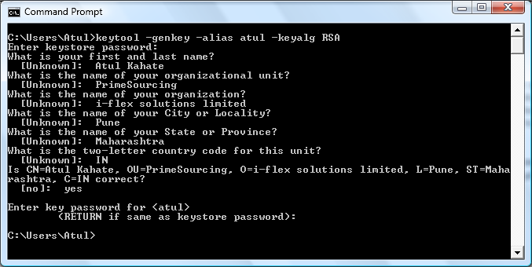
Keytool Output (Password is changeit)
Java Servlets and JSP |

Slide 300
Using BASIC Authentication
Create a security-constraint element in the deployment descriptor (web.xml), specifying the resources for which we require authentication
See next slide
Java Servlets and JSP |

Slide 301
Changes to local web.xml file - 1
<security-constraint>
<web-resource-collection>
<web-resource-name>My JSP</web-resource-name>
<url-pattern>/Test.jsp</url-pattern>
<http-method>GET</http-method>
<http-method>POST</http-method>
</web-resource-collection>
<auth-constraint>
<role-name>manager</role-name>
</auth-constraint>
<user-data-constraint>
<transport-guarantee>CONFIDENTIAL</transport-guarantee>
</user-data-constraint>
</security-constraint>
<login-config>
<auth-method>BASIC</auth-method>
</login-config>
<security-role>
<role-name>manager</role-name>
</security-role>
Java Servlets and JSP |

Slide 302
Changes to local web.xml file - 2
Applicable to GET and POST methods (indicated by the http-method elements)
Only users with a manager role can access the protected Web resource, even if they specify the right user name and password (indicated by the role-name element inside auth-constraint)
The auth-method specifies BASIC
  Indicates that user names and passwords are sent across the network using Base-64 encoding
Java Servlets and JSP |

Slide 303
Changes to c:\tomcat\conf\server.xml
Uncomment the following part
<!-- Define a SSL HTTP/1.1 Connector on port 8443 -->
<Connector port="8443" maxHttpHeaderSize="8192"
maxThreads="150" minSpareThreads="25" maxSpareThreads="75"
enableLookups="false" disableUploadTimeout="true"
acceptCount="100" scheme="https" secure="true"
clientAuth="false" sslProtocol="TLS" />
Indicates that TLS protocol should be enabled
Java Servlets and JSP |

Slide 304
In case of Errors …
<!-- Define an SSL HTTP/1.1 Connector on port 443 -->
<Connector className="org.apache.catalina.connector.http.HttpConnector"
port="443" minProcessors="5" maxProcessors="75"
keystoreFile="path.to.keystore"
enableLookups="true"
acceptCount="10" debug="0" scheme="https" secure="true">
<Factory className="org.apache.catalina.net.SSLServerSocketFactory"
clientAuth="false" protocol="TLS" keystorePass="keystore.password"/>
</Connector>
Java Servlets and JSP |

Slide 305
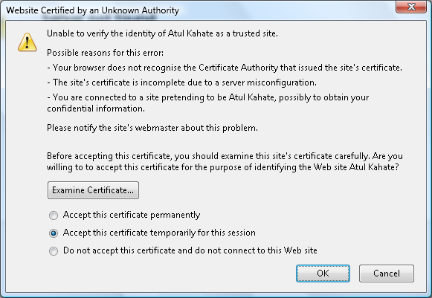
Running the Application - 1 (http://localhost:8080/examples/Test.jsp)
Java Servlets and JSP |

Slide 306
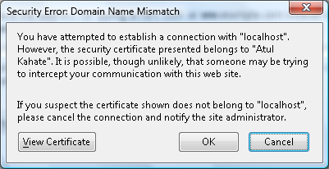
Running the Application - 2
Java Servlets and JSP |

Slide 307
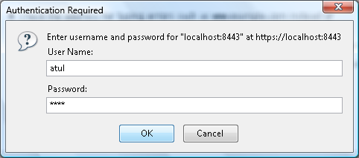
Running the Application - 3
Java Servlets and JSP |

Slide 308
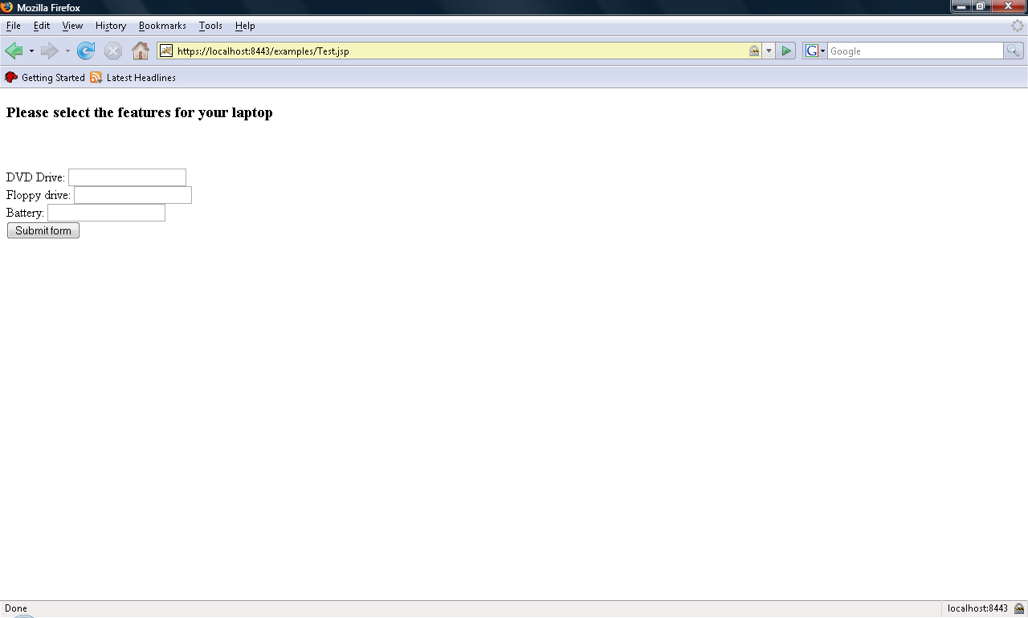
Running the Application - 4
Java Servlets and JSP |

Slide 309
Using Form-Based Authentication

Slide 310
What is Forms-Based Authentication?
Allows our own form to be used for authentication, instead of the standard dialog box that pops up in the BASIC method
Customized authentication and error handling is possible
Java Servlets and JSP |

Slide 311
Changes to Local web.xml
<security-constraint>
<web-resource-collection>
<web-resource-name>My JSP</web-resource-name>
<url-pattern>/Test.jsp</url-pattern>
<http-method>GET</http-method>
<http-method>POST</http-method>
</web-resource-collection>
….
</security-constraint>
<login-config>
<auth-method>FORM</auth-method>
<form-login-config>
<form-login-page>/login.html</form-login-page>
<form-error-page>/LoginError.jsp</form-error-page>
</form-login-config>
</login-config>
<security-role>
<role-name>manager</role-name>
</security-role>
Java Servlets and JSP |

Slide 312
Result of these Changes
Authentication type is now forms-based
Whenever the user attempts to access any protected resource, Tomcat automatically redirects the request to the login page (called as login.html)
If authentication fails, it calls LoginError.jsp
Java Servlets and JSP |

Slide 313
login.html
<html>
<head>
<title>Welcome</title>
</head>
<body bgcolor="#ffffff">
<h2>Please Login to the Application</h2>
<form method="POST" action="j_security_check">
<table border="0">
<tr>
<td>Enter the user name:</td>
<td>
<input type="text" name="j_username" size="15">
</td>
</tr>
<tr>
<td>Enter the password:</td>
<td>
<input type="password" name="j_password" size="15">
</td>
</tr>
<tr>
<td>
<input type="submit" value="Submit">
</td>
</tr>
</table>
</form>
</body>
</html>
Java Servlets and JSP |

Slide 314
LoginError.jsp
<html>
<head>
<title>Login Error</title>
</head>
<body bgcolor="#ffffff">
<h2>We Apologize, A Login Error Occurred</h2>
Please click <a href="http://localhost:8080/home/Test.jsp">here</a> for another try.
</body>
</html>
Java Servlets and JSP |

Slide 315
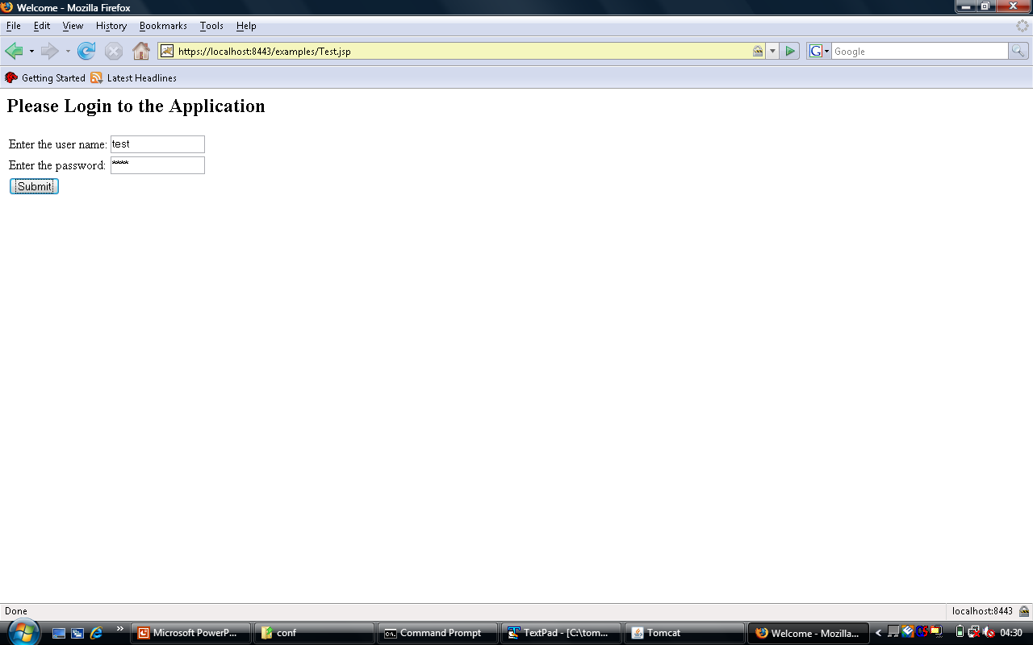
Restart Tomcat and Enter URL
Java Servlets and JSP |

Slide 316
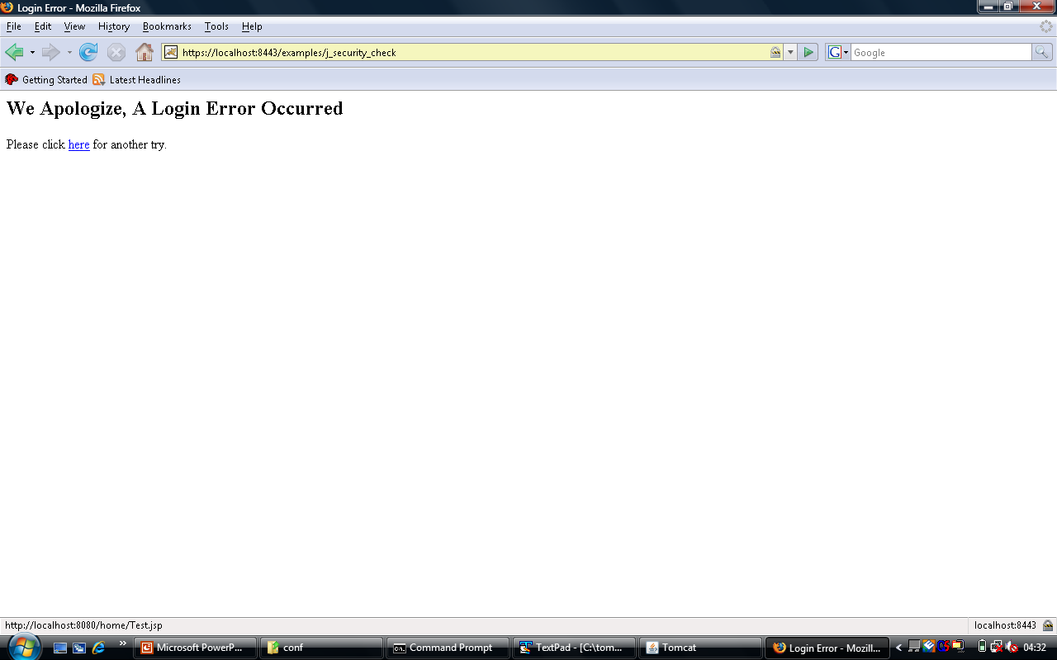
Incorrect User ID/Password
Java Servlets and JSP |

Slide 317
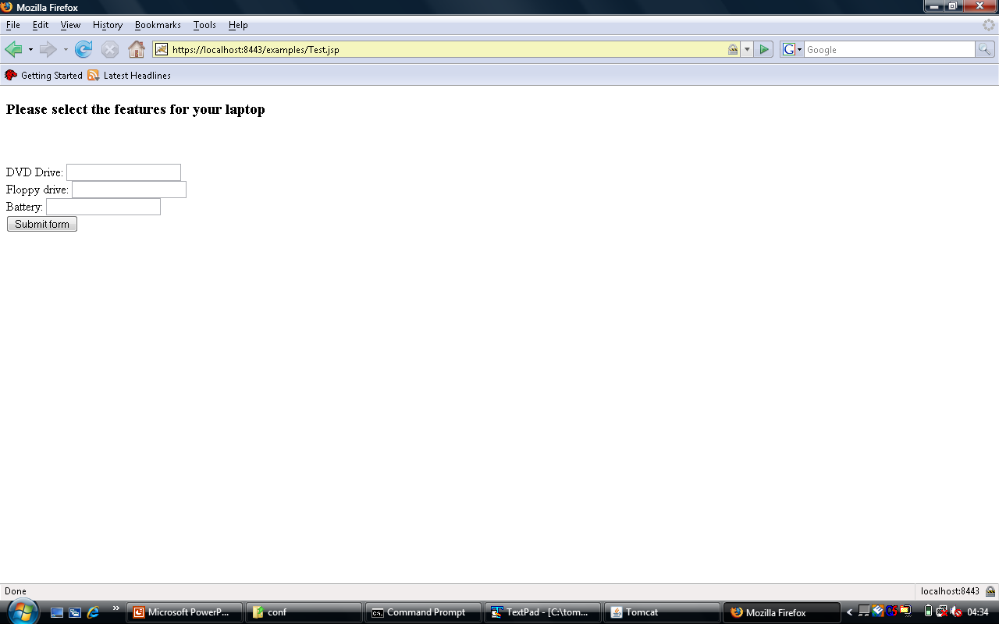
Correct Used ID and Password
Java Servlets and JSP |

Slide 318
JSP and Database Access
JDBC

Slide 319
JDBC Overview
One of the oldest Java APIs
Goal is to make database processing available to any Java programmer in an uniform manner
JDBC design goals
  SQL-level API
  Reuse of existing concepts
  Simple
Java Servlets and JSP |

Slide 320
JDBC Execution
Embed an SQL query inside a JDBC method call and send it to the DBMS
Process the query results or exceptions as Java objects
Earlier: Open Database Connectivity (ODBC)
  Windows only
  Complex
Java Servlets and JSP |

Slide 321
JDBC Architecture
JDBC provides a set of Java interfaces
These interfaces are implemented differently by different vendors
The set of classes that implement the JDBC interfaces for a particular database engine is called as its JDBC driver
Programmers need to think only about the JDBC interfaces, not the implementation
Java Servlets and JSP |

Slide 322
End-programmer’s View of JDBC
Application A
Application B
JDBC
Oracle
SQL Server
DB2
Java Servlets and JSP |

Slide 323
JDBC Drivers
Most commercial databases ship with a driver, or allow us to download one
Four types
  Type 1: Bridge between JDBC and another database-independent API, e.g. ODBC, comes with JDK
  Type 2: Translates JDBC calls into native API provided by the database vendor
  Type 3: Network bridge that use a vendor-neutral intermediate layer
  Type 4: Directly talks to a database using a network protocol, no native calls, can run on an JVM
Java Servlets and JSP |

Slide 324
Setting up MS-Access for JDBC
Control Panel -> Administrative Tools -> Data Sources (ODBC)
Java Servlets and JSP |

Slide 325

Java Database Connectivity (JDBC) Operations
Load a JDBC driver for your DBMS
  Class.forName () method is used
Use the driver to open a database connection
  getConnection (URL) method is used
Issue SQL statements through the connection
  Use the Statement object
Process results returned by the SQL operations
  Use the ResultSet interface
Java Servlets and JSP |

Slide 326
JDBC Operations: Depicted
1. Load the JDBC driver class:
Class.forName (“driver name”);
Driver
2. Open a database connection:
DriverManager.getConnection (“jdbc:xxx:data source”);
Database
Connection
3. Issue SQL statements:
Stmt = con.createStatement ();
Stmt.executeQuery (“SELECT …”);
Statement
4. Process result sets:
while (rs.next ()){
name = rs.getString (“emp_name”);
… }
Result Set
Java Servlets and JSP |

Slide 327
Main JDBC Interfaces
The JDBC interface is contained in the packages:
  java.sql – Core API, part of J2SE
  Javax.sql – Optional extensions API, part of J2EE
Why an interface, and not classes?
  Allows individual vendors to implement the interface as they like
Overall, about 30 interfaces and 9 classes are provided
  The ones of our interest are:
    Connection
    Statement
    PreparedStatement
    ResultSet
    SQLException
Java Servlets and JSP |

Slide 328
More on Useful JDBC Interfaces
Connection object
  Pipe between a Java program and a database
  Created by calling DriverManager.getConnection () or DataSource.getConnection ()
Statement object
  Allows SQL statements to be sent through a connection
  Retrieves result sets
  Three types
    Statement: Static SQL statements
    PreparedStatement: Dynamic SQL
    CallableStatement: Invokes a stored procedure
ResultSet
  An extract of the result of executing an SQL query
SQLException
  Error handling
Java Servlets and JSP |

Slide 329
JDBC Exception Types
SQLException
  Most methods in java.sql throw this to indicate failures, which requires a try/catch block
SQLWarning
  Subclass of SQLException
DataTruncation
  Indicates that a data value is truncated
Java Servlets and JSP |

Slide 330
SELECT Example – Problem
Consider a table containing student code, name, total marks, and percentage. Write a JSP page that would display the student code and name for all the students from this table.
Java Servlets and JSP |

Slide 331
Solution – student_select.jsp
<%@page import="java.sql.*" %>
<%@page import="java.util.*" %>
<html>
<head><title>Student Information</title></head>
<body>
<table bgcolor = "silver" border = "2">
<%
// Open Database Connection
Class.forName ("sun.jdbc.odbc.JdbcOdbcDriver");
// Open a connection to the database
Connection con = DriverManager.getConnection("jdbc:odbc:student");
String sql = "SELECT student_code, student_name FROM student_table";
// Create a statement object and use it to fetch rows in a resultset object
Statement stmt = con.createStatement ();
ResultSet rs = stmt.executeQuery (sql);
while (rs.next ())
{
String code = rs.getString (1);
String name = rs.getString (2);
%>
<tr>
<td><%= code %></td>
<td><%= name %></td>
</tr>
<%
}
rs.close ();
rs = null;
stmt.close();
stmt=null;
con.close ();
%>
</table>
<br> <br>
<b>-- END OF DATA --</b>
</body>
</html>
Java Servlets and JSP |

Slide 332
JDBC Case Study

Slide 333
Simple JDBC Example
CREATE TABLE departments (
deptno CHAR (2),
deptname CHAR (40),
deptmgr CHAR (4)
);
CREATE TABLE employees (
empno CHAR (4),
lname CHAR (20),
fname CHAR (20),
hiredate DATE,
ismgr BOOLEAN,
deptno CHAR (2),
title CHAR (50),
email CHAR (32),
phone CHAR (4)
);
Java Servlets and JSP |

Slide 334
Problem Statement
Write a JSP program to display a list of departments with their manager name, title, telephone number, and email address.
The SQL query that would be required:
SELECT D.deptname, E.fname, E.lname, E.title, E.email, E.phone
FROM departments D, employees E
WHERE D.deptmgr = E.empno
ORDER BY D.deptname
Java Servlets and JSP |

Slide 335
JSP Code – 1
<%@page contentType="text/html"%>
<%@page pageEncoding="UTF-8"%>
<%@page session="false" %>
<%@page import="java.sql.*" %>
<%@page import="java.util.*" %>
<html>
<head><title>Department Managers</title></head>
<body>
<%
// Open Database Connection
Class.forName ("sun.jdbc.odbc.JdbcOdbcDriver");
// Open a connection to the database
Connection con = DriverManager.getConnection("jdbc:odbc:Employee");
String sql = "SELECT D.deptname, E.fname, E.lname, E.title, E.email, E.phone " +
"FROM departments D, employees E " +
"WHERE D.deptmgr = E.empno " +
"ORDER BY D.deptname";
Java Servlets and JSP |

Slide 336
JSP Code – 2
// Create a statement object and use it to fetch rows in a resultset object
Statement stmt = con.createStatement ();
ResultSet rs = stmt.executeQuery (sql);
while (rs.next ())
{
String dept = rs.getString (1);
String fname = rs.getString (2);
String lname = rs.getString (3);
String title = rs.getString (4);
String email = rs.getString (5);
String phone = rs.getString (6);
%>
<h5>Department: <%= dept %> </h5>
<%= fname %> <%= lname %>, <%= title %>
<br> (91 20) 2290 <%= phone %>, <%= email %>
<%
}
rs.close ();
rs = null;
stmt.close();
stmt=null;
con.close ();
%>
<br> <br>
<b>-- END OF DATA --</b>
</body>
</html>
Java Servlets and JSP |

Slide 337
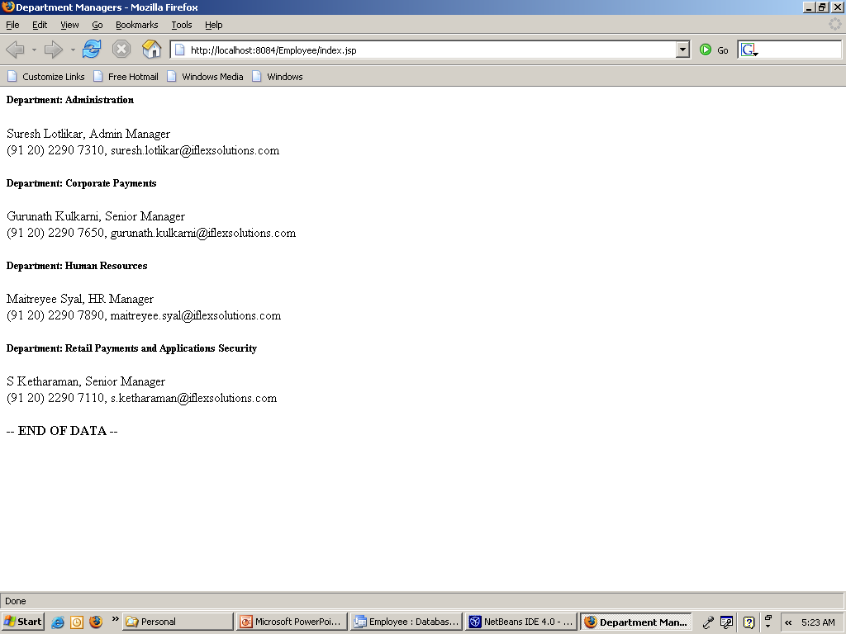
JSP Output
Java Servlets and JSP |

Slide 338
Scrollable Result Sets
By default, result sets are forward-only
Scrollable result sets allow us to move in either direction
  Statement stmt = con.createStatement (ResultSet.TYPE_SCROLL_SENSITIVE, ResultSet.CONCUR_READ_ONLY);
  Now, it is possible to call the following methods:
    previous (), absolute (), relative ()
  Options for 1st parameter: TYPE_FORWARD_ONLY, TYPE_SCROLL_SENSITIVE, TYPE_SCROLL_INSENSITIVE
    Sensitive and insensitive allow movement in both directions. Insensitive means ignore concurrent changes made by other programs to the same data; sensitive means consider those changes in your results
  Options for 2nd parameter: CONCUR_READ_ONLY, CONCUR_UPDATABLE
Java Servlets and JSP |

Slide 339
More on the Statement Interface
Does not have a constructor
Execute the createStatement () method on the connection object
Example
  Connection con = DriverManager.getConnection("jdbc:odbc:Employee");
  Statement stmt = con.createStatement ();
  …
Supported methods
Method | Purpose
executeQuery | Execute a SELECT and return result set
executeUpdate | INSERT/UPDATE/DELETE or DDL, returns count of rows affected
execute | Similar to (1) and (2) above, but does not return a result set (returns a Boolean value)
executeBatch | Batch update
Java Servlets and JSP |

Slide 340
executeUpdate Example
(If it does not exist,) add a new column titled location to the departments table using ALTER TABLE.
Programmatically, set the value of that column to Near SICSR for all the departments. Display the values before and after the update.
Java Servlets and JSP |

Slide 341
executeUpdate Code – 1
<%@page contentType="text/html"%>
<%@page pageEncoding="UTF-8"%>
<%@page session="false" %>
<%@page import="java.sql.*" %>
<%@page import="java.util.*" %>
<html>
<head><title>Update Employees</title></head>
<body>
<H1> List of Locations BEFORE the Update</H1>
<%
// Open Database Connection
Class.forName ("sun.jdbc.odbc.JdbcOdbcDriver");
// Open a connection to the database
Connection con = DriverManager.getConnection("jdbc:odbc:Employee");
String sql = "SELECT location " +
"FROM departments";
// Create a statement object and use it to fetch rows in a resultset object
Statement stmt = con.createStatement ();
ResultSet rs = stmt.executeQuery (sql);
while (rs.next ())
{
String location = rs.getString (1);
%>
Java Servlets and JSP |

Slide 342
executeUpdate Code – 2
<h5><%= location %> </h5>
<%
}
rs.close ();
rs = null;
%>
<p><H1> Now updating ... </H1></P>
<br> <br>
<%
try
{
String location = “Near SICSR";
int nRows = stmt.executeUpdate (
"UPDATE departments " +
"SET location = '" + location + "'");
out.println ("Number of rows updated: " + nRows);
stmt.close ();
stmt=null;
con.close ();
}
catch (SQLException se)
{
out.println (se.getMessage ());
}
%>
</body>
</html>
Java Servlets and JSP |

Slide 343
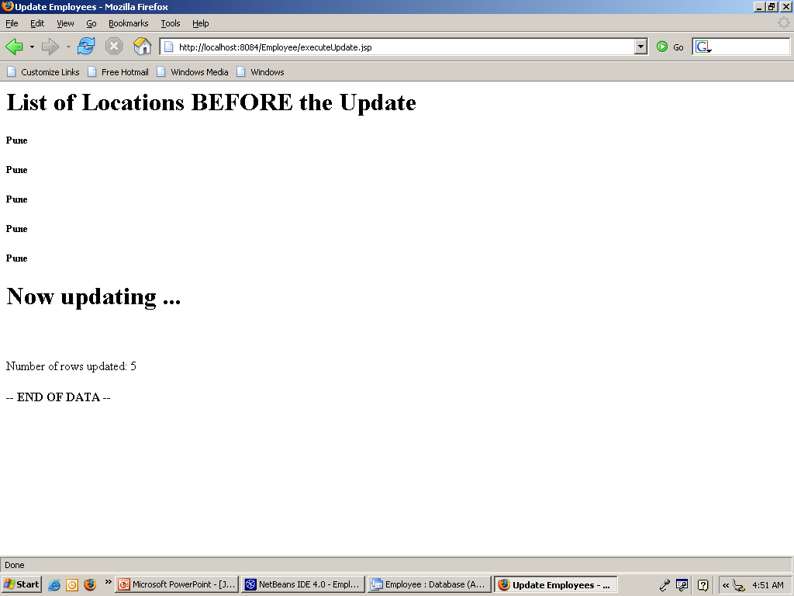
Program Output
Java Servlets and JSP |

Slide 344
Data updates through a result set
Once the executeQuery () method returns a ResultSet, we can use the updateXXX () method to change the value of a column in the current row of the result set
Then call the updateRow () method
Java Servlets and JSP |

Slide 345
Example
<%@page import="java.sql.*" %>
<%@page import="java.util.*" %>
<html>
<head><title>Update Department Name using ResultSet</title></head>
<body>
<H1> Fetching data from the table ...</H1>
<%
// Open Database Connection
Class.forName ("sun.jdbc.odbc.JdbcOdbcDriver");
// Open a connection to the database
Connection con = DriverManager.getConnection("jdbc:odbc:Employee");
String sql = "SELECT deptname " +
"FROM departments " +
"WHERE deptno = 'Test'";
Statement stmt = null;
ResultSet rs = null;
boolean foundInTable = false;
// Create a statement object and use it to fetch rows in a resultset object
try {
stmt = con.createStatement (ResultSet.TYPE_SCROLL_INSENSITIVE, ResultSet.CONCUR_UPDATABLE);
rs = stmt.executeQuery (sql);
foundInTable = rs.next ();
}
catch (SQLException ex) {
System.out.println ("Exception occurred: " + ex);
}
if (foundInTable) {
String str = rs.getString (1);
out.println ("Data found");
out.println ("Old value = " + str);
}
else {
out.println ("Data not found");
}
if (foundInTable) {
try {
rs.updateString (1, "New name");
rs.updateRow ();
rs.close ();
rs = null;
}
catch (SQLException ex) {
System.out.println ("Exception occurred: " + ex);
}
out.println ("Update successful");
}
try {
stmt.close ();
stmt=null;
con.close ();
}
catch (SQLException ex) {
System.out.println ("Exception occurred: " + ex);
}
%>
</body>
</html>
Java Servlets and JSP |

Slide 346
Deletion through a result set
Once the executeQuery () method returns a ResultSet, we can use the deleteRow () method
Java Servlets and JSP |

Slide 347
Example
<%@page import="java.sql.*" %>
<%@page import="java.util.*" %>
<html>
<head><title>Delete Department Name using ResultSet</title></head>
<body>
<H1> Fetching data from the table ...</H1>
<%
// Load driver
Class.forName ("sun.jdbc.odbc.JdbcOdbcDriver");
// Open a connection to the database
Connection con = DriverManager.getConnection("jdbc:odbc:Employee");
String sql = "SELECT deptname " +
"FROM departments " +
"WHERE deptno = 'Del'";
Statement stmt = null;
ResultSet rs = null;
boolean foundInTable = false;
// Create a statement object and use it to fetch rows in a resultset object
try {
stmt = con.createStatement (ResultSet.TYPE_SCROLL_INSENSITIVE, ResultSet.CONCUR_UPDATABLE);
rs = stmt.executeQuery (sql);
foundInTable = rs.next ();
}
catch (SQLException ex) {
System.out.println ("Exception occurred: " + ex);
}
if (foundInTable) {
String str = rs.getString (1);
out.println ("Data found");
out.println ("Old value = " + str);
}
else {
out.println ("Data not found");
}
if (foundInTable) {
try {
rs.deleteRow ();
rs.close ();
rs = null;
}
catch (SQLException ex) {
System.out.println ("Exception occurred: " + ex);
}
out.println ("Delete successful");
}
try {
stmt.close ();
stmt=null;
con.close ();
}
catch (SQLException ex) {
System.out.println ("Exception occurred: " + ex);
}
%>
</body>
</html>
Java Servlets and JSP |

Slide 348
Insertion through a result set
Call updateXXX (), followed by insertRow ()
Java Servlets and JSP |

Slide 349
Example
<%@page import="java.sql.*" %>
<%@page import="java.util.*" %>
<html>
<head><title>Insert a row to the table using ResultSet</title></head>
<body>
<H1> Fetching data from the table ...</H1>
<%
// Load driver
Class.forName ("sun.jdbc.odbc.JdbcOdbcDriver");
// Open a connection to the database
Connection con = DriverManager.getConnection("jdbc:odbc:Employee");
String sql = "SELECT deptno, deptname " +
"FROM departments " +
"WHERE deptno = 'Del'";
Statement stmt = null;
ResultSet rs = null;
boolean foundInTable = false;
// Create a statement object and use it to fetch rows in a resultset object
try {
stmt = con.createStatement (ResultSet.TYPE_SCROLL_INSENSITIVE, ResultSet.CONCUR_UPDATABLE);
rs = stmt.executeQuery (sql);
foundInTable = rs.next ();
}
catch (SQLException ex) {
System.out.println ("Exception occurred: " + ex);
}
if (foundInTable) {
String str1 = rs.getString (1);
String str2 = rs.getString (2);
out.println ("Data found ...");
out.println ("Dept no = " + str1);
out.println ("Dept name = " + str2);
}
else {
out.println ("Data not found");
}
if (foundInTable == false) {
try {
rs.updateString (1, "Del");
rs.updateString (2, "Delete this");
rs.insertRow ();
rs.close ();
rs = null;
}
catch (SQLException ex) {
System.out.println ("Exception occurred: " + ex);
}
out.println ("\n\nInsert successful");
}
try {
stmt.close ();
stmt=null;
con.close ();
}
catch (SQLException ex) {
System.out.println ("Exception occurred: " + ex);
}
%>
</body>
</html>
Java Servlets and JSP |

Slide 350
Transactions
By default, all operations are automatically committed in JDBC
We need to change this behaviour
  con.setAutoCommit (false);
Later, we need to do:
  con.commit (); OR
  con.rollback ();
Java Servlets and JSP |

Slide 351
Using Prepared Statements
Used to parameterize the SQL statements
Useful for repeated statements
Reduces checking and rechecking efforts
Better performance
Example
String preparedSQL = “SELECT location FROM departments WHERE deptno = ?”;
PreparedStatement ps = connection.prepareStatement (preparedSQL);
ps.setString (1, user_deptno);
ResultSet rs = ps.executeQuery ();
See C:\tomcat\webapps\atul\JDBCExample\preparedstmt.jsp
Java Servlets and JSP |

Slide 352
Assignment
Consider a student table containing student_code (char) and student_marks (number)
Code an HTML page to accept student code from the user
Write a JSP to fetch and display marks for this student – if the student code is not found, display an error
Allow the user to perform this as many times as desired
Java Servlets and JSP |

Slide 353
D:\tomcat\webapps\atul\JDBCExample\Student-PreparedSelect.html
<html>
<head>
<title>Student Details</title>
</head>
<body>
<h1>Student Selection</h1>
<form action = "Student-PreparedSelect.jsp">
<table border = "2">
<tr>
<td>Student Code:</td>
<td><input type = "text" name = "student_code"></td>
</tr>
<tr span = "2">
<td><input type = "submit" text = "Submit"></td>
</tr>
</table>
</form>
</body>
</html>
Java Servlets and JSP |

Slide 354
D:\tomcat\webapps\atul\JDBCExample\Student-PreparedSelect.jsp
<%@page import="java.sql.*" %>
<%@page import="java.util.*" %>
<html>
<head><title>Student Selection using PreparedStatement</title></head>
<body>
<%
// Open Database Connection
Class.forName ("sun.jdbc.odbc.JdbcOdbcDriver");
// Open a connection to the database
Connection con = DriverManager.getConnection("jdbc:odbc:student");
String sql = "SELECT student_marks FROM student_table WHERE student_code = ?";
String user_student_code = request.getParameter ("student_code");
PreparedStatement ps = con.prepareStatement (sql);
ps.setString (1, user_student_code);
ResultSet rs = ps.executeQuery ();
int marks = 0;
if (rs.next ()) {
marks = rs.getInt (1);
// out.println ("Marks for student " + user_student_code + " are " + marks);
}
else {
marks = -999;
// out.println ("Student with ID " + user_student_code + " was not found");
}
rs.close ();
rs = null;
con.close ();
%>
<form>
<%
if (marks != -999) {
%>
<h5>Marks for student with student code <%= user_student_code %> are <%= marks %></h5>
<% }
else {
%>
<h5>Error -- Student with student code <%= user_student_code %> was not found!</h5>
<% }
%>
<a href = "Student-PreparedSelect.html"> Try for another student</a>
</form>
</body>
</html>
Java Servlets and JSP |

Slide 355
Prepared statement for inserting a record
String preparedQuery = “INSERT INTO departments (deptno, deptname, deptmgr, location) VALUES (?, ?, ?, ?)”;
PreparedStatement ps = con.prepareStatement (preparedQuery);
ps.setString (1, user_deptno);
ps.setString (2, user_deptname);
ps.setString (3, user_deptmgr);
ps.setString (4, user_location);
ps.executeUpdate ();
See preparedinsert.jsp
Java Servlets and JSP |

Slide 356
Prepared Statement for Update
Update
String preparedSQL = “UPDATE departments SET deptname = ? WHERE deptno = ?”;
PreparedStatement ps = con.prepareStatement (preparedSQL);
ps.setString (1, user_deptname);
ps.setString (2, user_deptno);
ps.executeUpdate ();
See preparedupdate.jsp
Delete
String preparedQuery = “DELETE FROM departments WHERE deptno = ?”;
PreparedStatement ps = con.prepareStatement (preparedQuery);
ps.setString (1, user_deptno);
ps.executeUpdate ();
See prepareddelete.jsp
Java Servlets and JSP |

Slide 357
Prepared Statement and Transaction Example
<%@page contentType="text/html"%>
<%@page pageEncoding="UTF-8"%>
<%@page session="false" %>
<%@page import="java.sql.*" %>
<%@page import="java.util.*" %>
<% boolean ucommit = true; %>
<html>
<head><title>JDBC Transactions Application</title></head>
<body>
<h1> Account Balances BEFORE the transaction </h1>
<table bgcolor = "yellow" border = "2">
<tr>
<th>Account Number</th>
<th>Account Name</th>
<th>Account Balance</th>
</tr>
<%
// Open Database Connection
Class.forName ("sun.jdbc.odbc.JdbcOdbcDriver");
// Open a connection to the database
Connection con = DriverManager.getConnection("jdbc:odbc:accounts");
// ************************************************************************************
// THIS PART OF THE CODE DISPLAYS THE ACCOUNT DETAILS BEFORE THE TRANSACTION OPERATION
// ************************************************************************************
String sql = "SELECT Account_Number, Account_Name, Balance " +
"FROM accounts " +
"ORDER BY Account_Name";
// Create a statement object and use it to fetch rows in a resultset object
Statement stmt = con.createStatement ();
ResultSet rs = stmt.executeQuery (sql);
while (rs.next ())
{
String account_Number = rs.getString (1);
String account_Name = rs.getString (2);
String balance = rs.getString (3);
%>
<tr>
<td><%= account_Number %> </td>
<td><%= account_Name %> </td>
<td><%= balance %> </td>
</tr>
<%
}
rs.close ();
rs = null;
stmt.close();
stmt=null;
%>
</table>
<br> <br>
<b>-- END OF DATA --</b>
<br><br>
<%
// ************************************************************************************
// THIS PART OF THE CODE ATTEMPTS TO EXECUTE THE TRANSACTION IF COMMIT WAS SELECTED
// ************************************************************************************
if (request.getParameter ("Commit") == null) { // Rollback was selected
out.println ("<b> You have chosen to ROLL BACK the funds transfer. No changes would be made to the database. </b>");
}
else {
// Now try and execute the database operations
int fromAccount = Integer.parseInt (request.getParameter ("fromAcc"));
int toAccount = Integer.parseInt (request.getParameter ("toAcc"));
int amount = Integer.parseInt (request.getParameter ("amount"));
int nRows = 0;
// Debit FROM account
PreparedStatement stmt_upd = con.prepareStatement ("UPDATE accounts " +
"SET Balance = Balance - ?" +
" WHERE Account_Number = ?");
stmt_upd.setInt (1, amount);
stmt_upd.setInt (2, fromAccount);
out.print ("<br> Amount = " + amount);
out.print ("<br> From Acc = " + fromAccount);
try {
nRows = stmt_upd.executeUpdate ();
out.print ("<br>" + nRows);
// out.print ("<br>" + stmt_upd);
stmt_upd.clearParameters ();
}
catch (SQLException se) {
ucommit = false;
out.println (se.getMessage ());
}
// Credit TO account
stmt_upd = con.prepareStatement ("UPDATE accounts " +
"SET Balance = Balance + ?" +
" WHERE Account_Number = ?");
stmt_upd.setInt (1, amount);
stmt_upd.setInt (2, toAccount);
out.print ("<br> Amount = " + amount);
out.print ("<br> To Acc = " + toAccount);
try {
nRows = stmt_upd.executeUpdate ();
out.print ("<br>" + nRows);
// out.print ("<br>" + stmt_upd);
stmt_upd.clearParameters ();
}
catch (SQLException se) {
ucommit = false;
out.println (se.getMessage ());
}
if (ucommit) { // No problems, go ahead and commit transaction
con.commit ();
out.println ("<b> Transaction committed successfully! </b>");
}
else {
con.rollback ();
out.println ("<b> Transaction had to be rolled back! </b>");
}
}
%>
<%
// ************************************************************************************
// THIS PART OF THE CODE DISPLAYS THE ACCOUNT DETAILS AFTER THE TRANSACTION OPERATION
// ************************************************************************************
%>
<table bgcolor = "lightblue" border = "2">
<tr>
<th>Account Number</th>
<th>Account Name</th>
<th>Account Balance</th>
</tr>
<%
sql = "SELECT Account_Number, Account_Name, Balance " +
"FROM accounts " +
"ORDER BY Account_Name";
// Create a statement object and use it to fetch rows in a resultset object
stmt = con.createStatement ();
rs = stmt.executeQuery (sql);
while (rs.next ())
{
String account_Number = rs.getString (1);
String account_Name = rs.getString (2);
String balance = rs.getString (3);
%>
<tr>
<td><%= account_Number %> </td>
<td><%= account_Name %> </td>
<td><%= balance %> </td>
</tr>
<%
}
rs.close ();
rs = null;
stmt.close();
stmt=null;
con.close ();
%>
</table>
<br> <br>
<b>-- END OF DATA --</b>
<br><br>
</body>
</html>
Java Servlets and JSP |

Slide 358
executeBatch Method
Group of statements can be executed together
  clearBatch: Resets a batch to the empty state
  addBatch: Adds an update statement to the batch
  executeBatch: Submits the batch
Also think of transaction management here
  con.setAutoCommit (false): Sets auto-commit feature off
  con.commit: Commits a transaction
  con.rollback: Commits a transaction
Java Servlets and JSP |

Slide 359
Batch Example – HTML
<HEAD>
<TITLE>JDBC Batch Processing Example</TITLE>
</HEAD>
<BODY BGCOLOR = "#FDFE6">
<H1 ALIGN = "CENTER">One Operation: 10 Occurrences</H1>
<FORM ACTION = "/sicsr/FundsTransferBatch.jsp" METHOD = "GET">
Account: <INPUT TYPE = "TEXT" NAME = "account"><HR>
Amount: <INPUT TYPE = "TEXT" NAME = "amount" value = "Rs."><BR><BR><BR>
<HR>
<CENTER><INPUT TYPE = "SUBMIT" NAME = "Commit" VALUE = "Commit"></CENTER>
<CENTER><INPUT TYPE = "SUBMIT" NAME = "Commit" VALUE = "Rollback"></CENTER>
</FORM>
</BODY>
</HTML>
Java Servlets and JSP |

Slide 360
Batch Example – JSP
<%@page contentType="text/html"%>
<%@page pageEncoding="UTF-8"%>
<%@page session="false" %>
<%@page import="java.sql.*" %>
<%@page import="java.util.*" %>
<% boolean ucommit = true; %>
<html>
<head><title>JDBC Transactions Application</title></head>
<body>
<%
// ************************************************************************************
// THIS PART OF THE CODE PERFORMS BASIC INITIALIZATIONS SUCH AS DB CONNECTION, ETC
// ************************************************************************************
// Open Database Connection
Class.forName ("sun.jdbc.odbc.JdbcOdbcDriver");
// Open a connection to the database
Connection con = DriverManager.getConnection("jdbc:odbc:accounts");
int account = Integer.parseInt (request.getParameter ("account"));
int amount = Integer.parseInt (request.getParameter ("amount"));
ResultSet rs = null;
%>
<%
// ************************************************************************************
// THIS PART OF THE CODE DISPLAYS THE ACCOUNT DETAILS BEFORE THE BATCH OPERATION
// ************************************************************************************
%>
<h1> Account Balance AFTER the batch update </h1>
<table bgcolor = "yellow" border = "2">
<tr>
<th>Account Number</th>
<th>Account Name</th>
<th>Account Balance</th>
</tr>
<%
PreparedStatement stmt = con.prepareStatement
("SELECT Account_Number, Account_Name, Balance " +
"FROM accounts " +
"WHERE Account_Number = ?");
stmt.setInt (1, account);
// Create a statement object and use it to fetch rows in a resultset object
try {
rs = stmt.executeQuery ();
}
catch (SQLException se) {
ucommit = false;
out.println (se.getMessage ());
}
while (rs.next ())
{
String account_Number = rs.getString (1);
String account_Name = rs.getString (2);
String balance = rs.getString (3);
%>
<tr>
<td><%= account_Number %> </td>
<td><%= account_Name %> </td>
<td><%= balance %> </td>
</tr>
<%
}
rs.close ();
rs = null;
stmt.close();
stmt=null;
%>
</table>
<br> <br>
<b>-- END OF DATA --</b>
<br><br>
<%
// ************************************************************************************
// THIS PART OF THE CODE ATTEMPTS TO EXECUTE BATCH
// ************************************************************************************
if (request.getParameter ("Commit") == null) { // Rollback was selected
out.println ("<b> You have chosen to ROLL BACK the funds transfer. No changes would be made to the database. </b>");
}
else {
// Now try and execute the database operations
int[] rows;
// Create a PreparedStatement object
PreparedStatement stmt_upd = con.prepareStatement ("UPDATE accounts " +
"SET balance = balance + ? " +
"WHERE account_number = ?");
for (int i=1; i<=10; i++) {
stmt_upd.setInt (1, amount);
stmt_upd.setInt (2, account);
System.out.println ("Account = " + account);
System.out.println ("Amount = " + amount);
System.out.println ("Statement = " + stmt_upd);
try {
stmt_upd.addBatch ();
}
catch (SQLException se) {
ucommit = false;
out.println (se.getMessage ());
}
}
try {
rows = stmt_upd.executeBatch ();
con.commit ();
for (int i=1; i<10; i++)
System.out.println ("Result = " + rows[i]);
}
catch (SQLException se) {
ucommit = false;
out.println (se.getMessage ());
}
}
%>
<%
// ************************************************************************************
// THIS PART OF THE CODE DISPLAYS THE ACCOUNT DETAILS AFTER THE BATCH OPERATION
// ************************************************************************************
%>
<h1> Account Balance AFTER the batch update </h1>
<table bgcolor = "lightblue" border = "2">
<tr>
<th>Account Number</th>
<th>Account Name</th>
<th>Account Balance</th>
</tr>
<%
stmt = con.prepareStatement
("SELECT Account_Number, Account_Name, Balance " +
"FROM accounts " +
"WHERE Account_Number = ?");
stmt.setInt (1, account);
// Create a statement object and use it to fetch rows in a resultset object
try {
rs = stmt.executeQuery ();
}
catch (SQLException se) {
ucommit = false;
out.println (se.getMessage ());
}
while (rs.next ())
{
String account_Number = rs.getString (1);
String account_Name = rs.getString (2);
String balance = rs.getString (3);
%>
<tr>
<td><%= account_Number %> </td>
<td><%= account_Name %> </td>
<td><%= balance %> </td>
</tr>
<%
}
rs.close ();
rs = null;
stmt.close();
stmt=null;
con.close ();
%>
</table>
<br> <br>
<b>-- END OF DATA --</b>
<br><br>
</body>
</html>
Java Servlets and JSP |

Slide 361
Case Study
Student Example

Slide 362
Brief Requirements
Create an application to maintain student records. Use the following features/guidelines.
  Make use of MVC
  A student table should have four columns: roll (integer), name (string), course (string), and course (string)
  The application should be a mix of servlets, JSP and Java classes
Java Servlets and JSP |

Slide 363
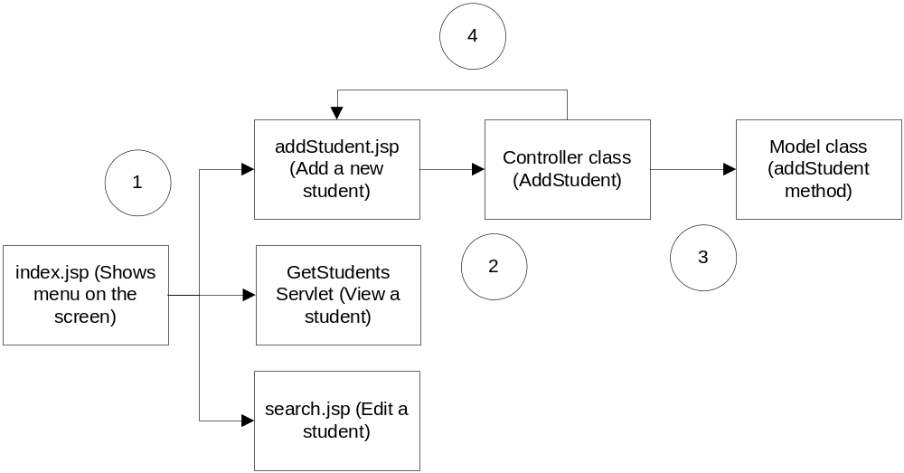
Sample Flow
Java Servlets and JSP |

Slide 364
Assignments

Slide 365
Exercise – 1
Create an application for Book Library Maintenance, which would do the following:
  Member registration and maintenance
  Book maintenance
  Book Issue/Return/Loss
  Reports
    Search for a book
    Find all books for an author/publisher
Java Servlets and JSP |

Slide 366
Exercise – 2
Create a Shopping cart application to do the following:
  Item maintenance
  User registration and maintenance
  Shopping cart display
  Select items and add to/remove from shopping cart
  Accept order
  Receive payments
  Search for past orders
  Report of orders for a particular date
Java Servlets and JSP |

Slide 367
Thank You!
Questions/Comments?

